Slide 1
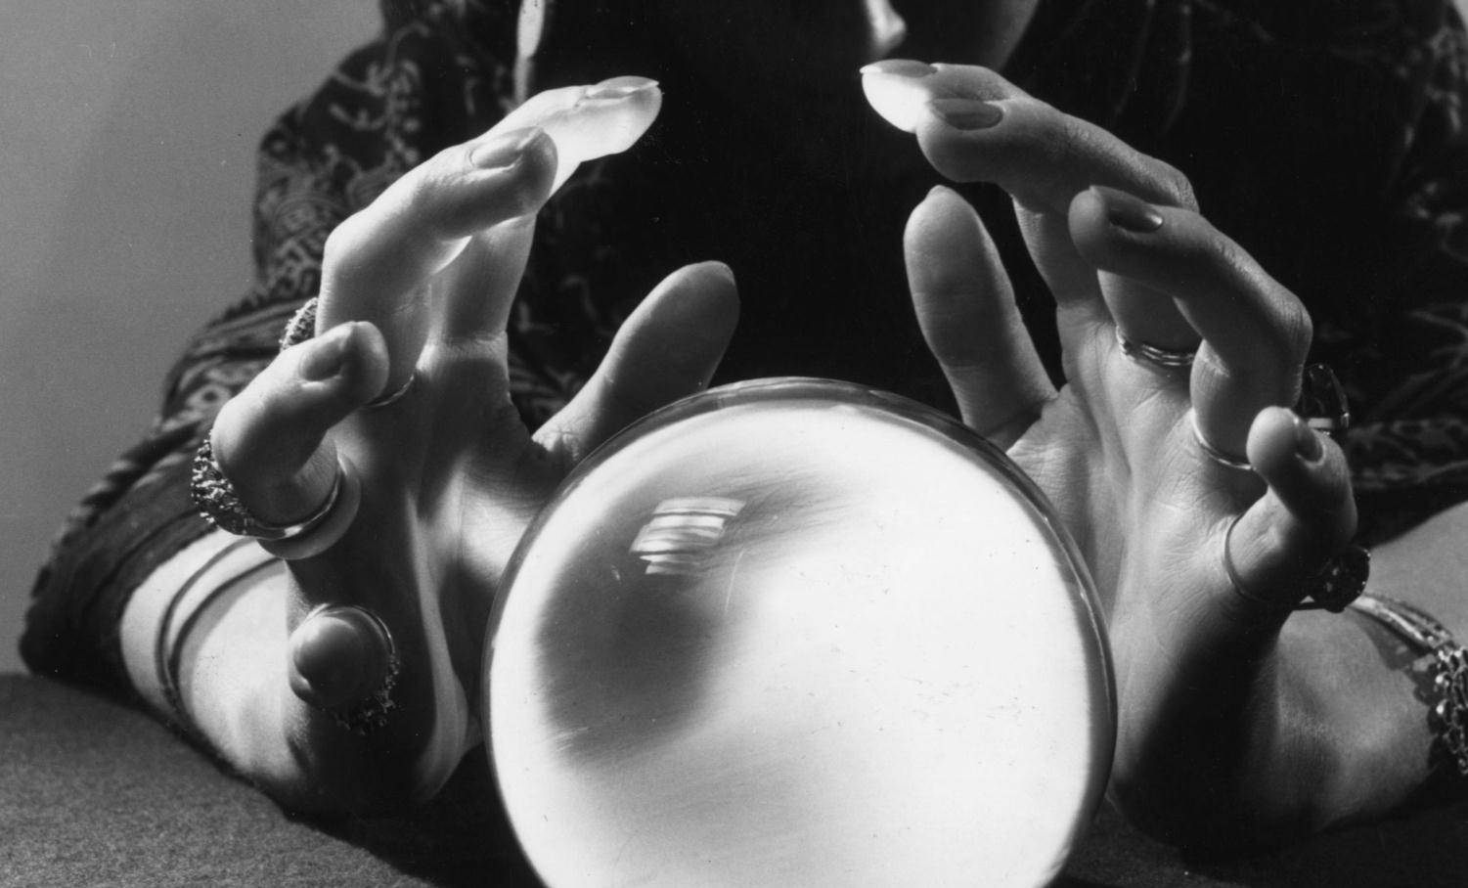
Vignettes and Requirements
Professor Jon Kolko

Slide 2
Prototyping
Research
Transcription
Utterances
Patterns & Anomalies
Interpretation
Insights
Principles
Value
Promise
Stories
Ethnography
Synthesis
Prototyping
Immersion in the cultural context of a wicked problem
Making meaning through inference and reframing
Hypothesis validation through generative, form-giving activities

Slide 3
Moving Toward Product Requirements
Research
Transcription
Utterances
Patterns & Anomalies
Interpretation
Insights
Principles
Value
Promise
Stories
Story Vignettes
A single-page illustration of a concept that emphasizes the core attributes or “Magic Moments” of a product, system or a service.
Distills the “forest and the trees” into something that is rapidly digestible.
Is descriptive enough to capture intention, but vague enough to allow for additional iterations by the viewer. Low fidelity is effective - your audience will fill in missing details.
Can include but is not limited to:
- Users & their interactions or emotional state
- Context of use (where, when, frequency, etc..)
- Primary use case
- Evolution over time

Slide 4
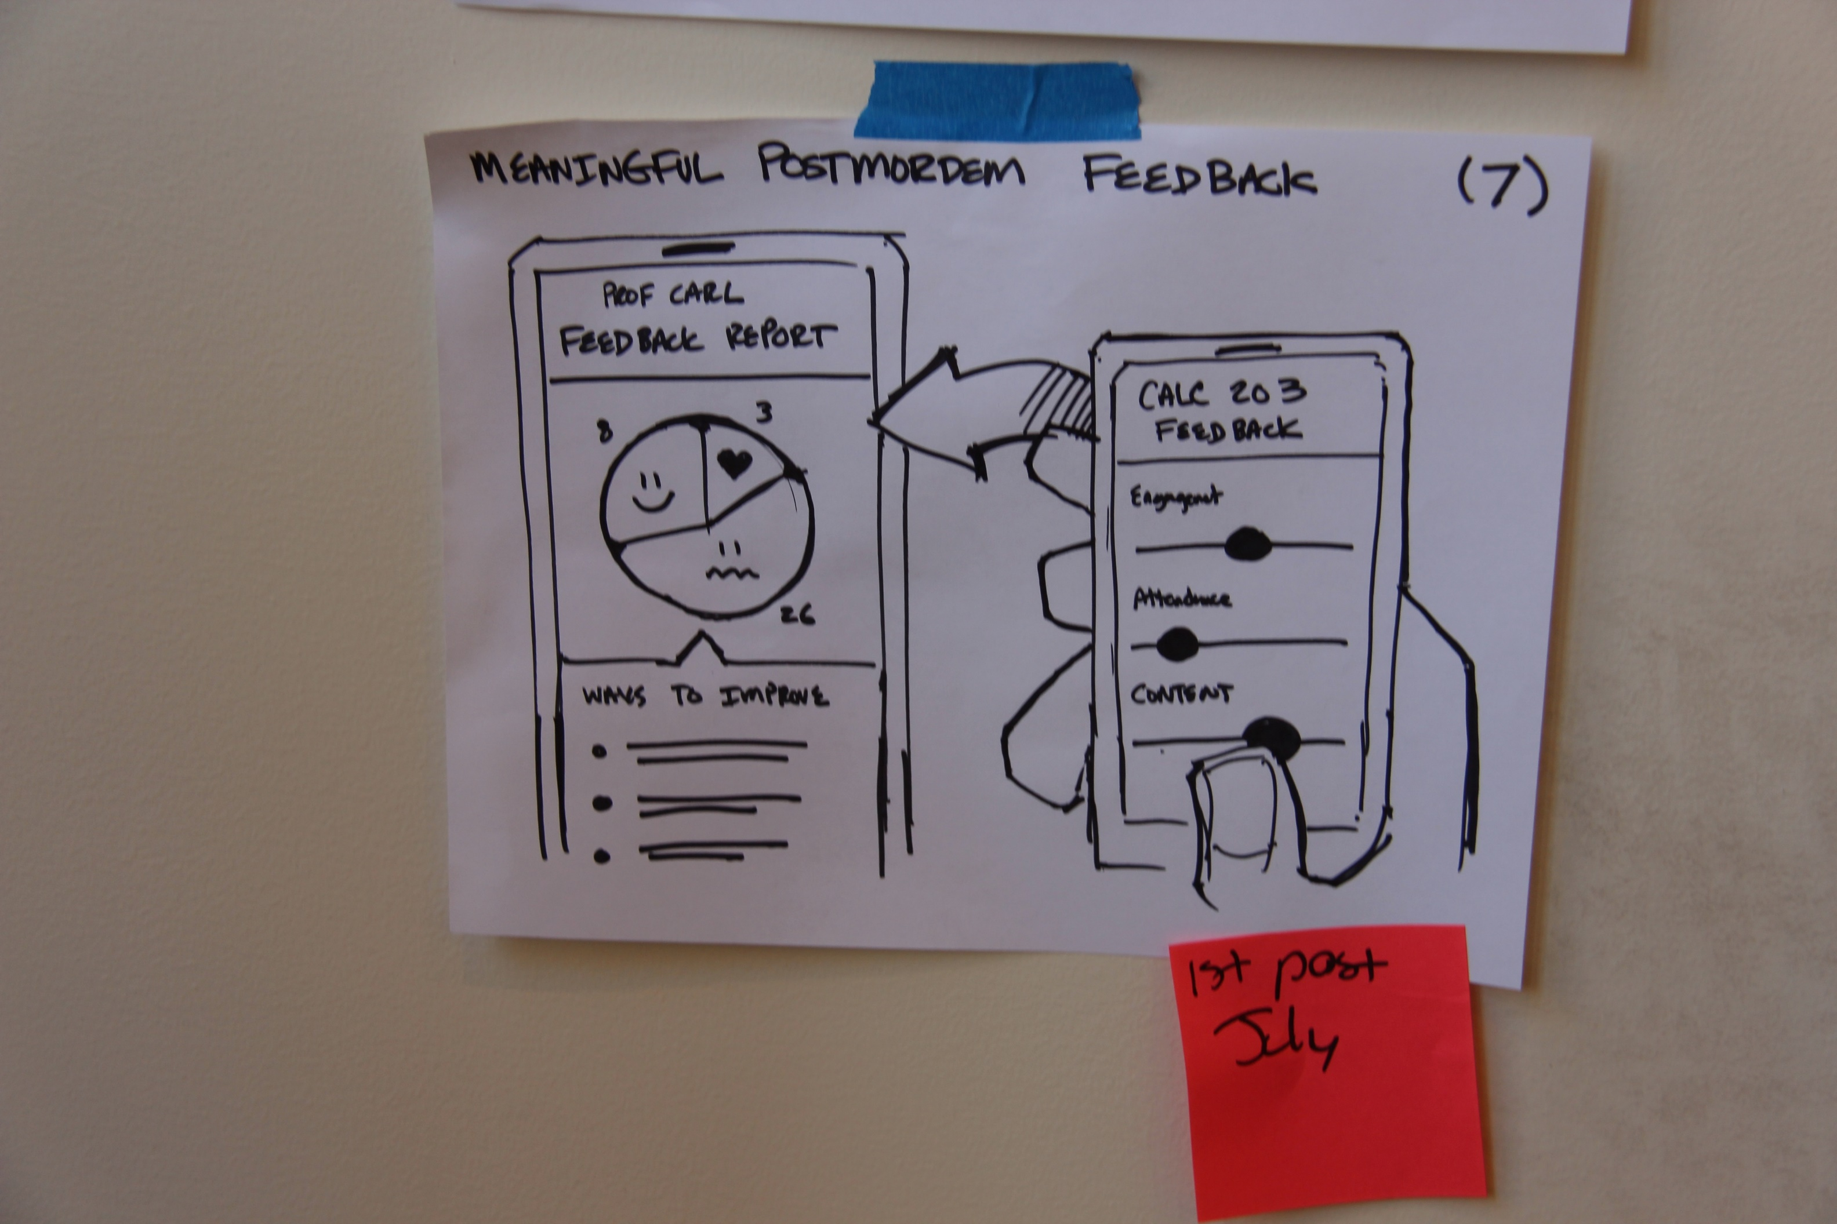

Slide 5
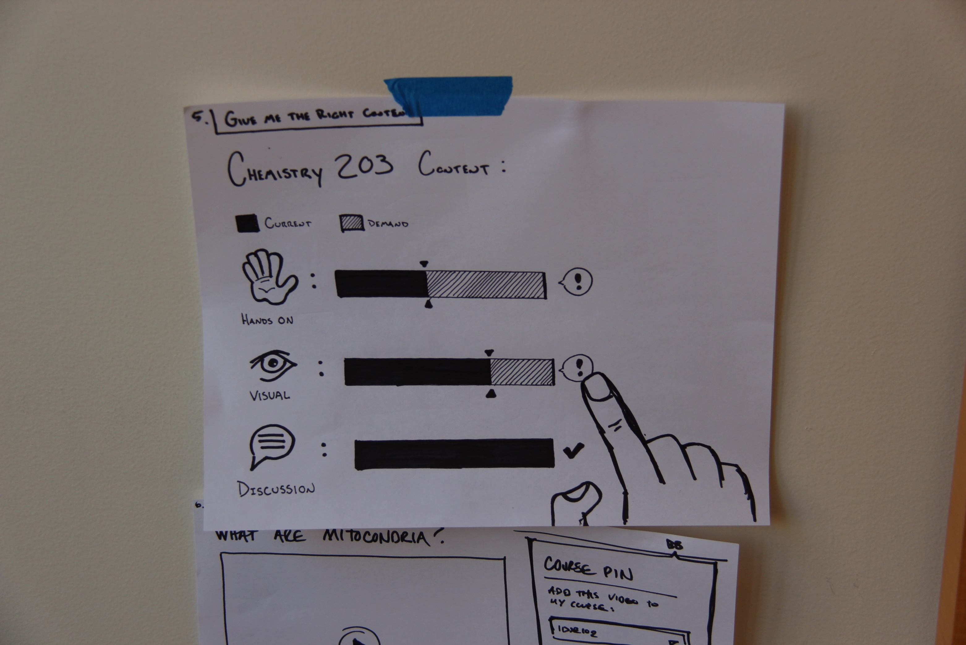

Slide 6
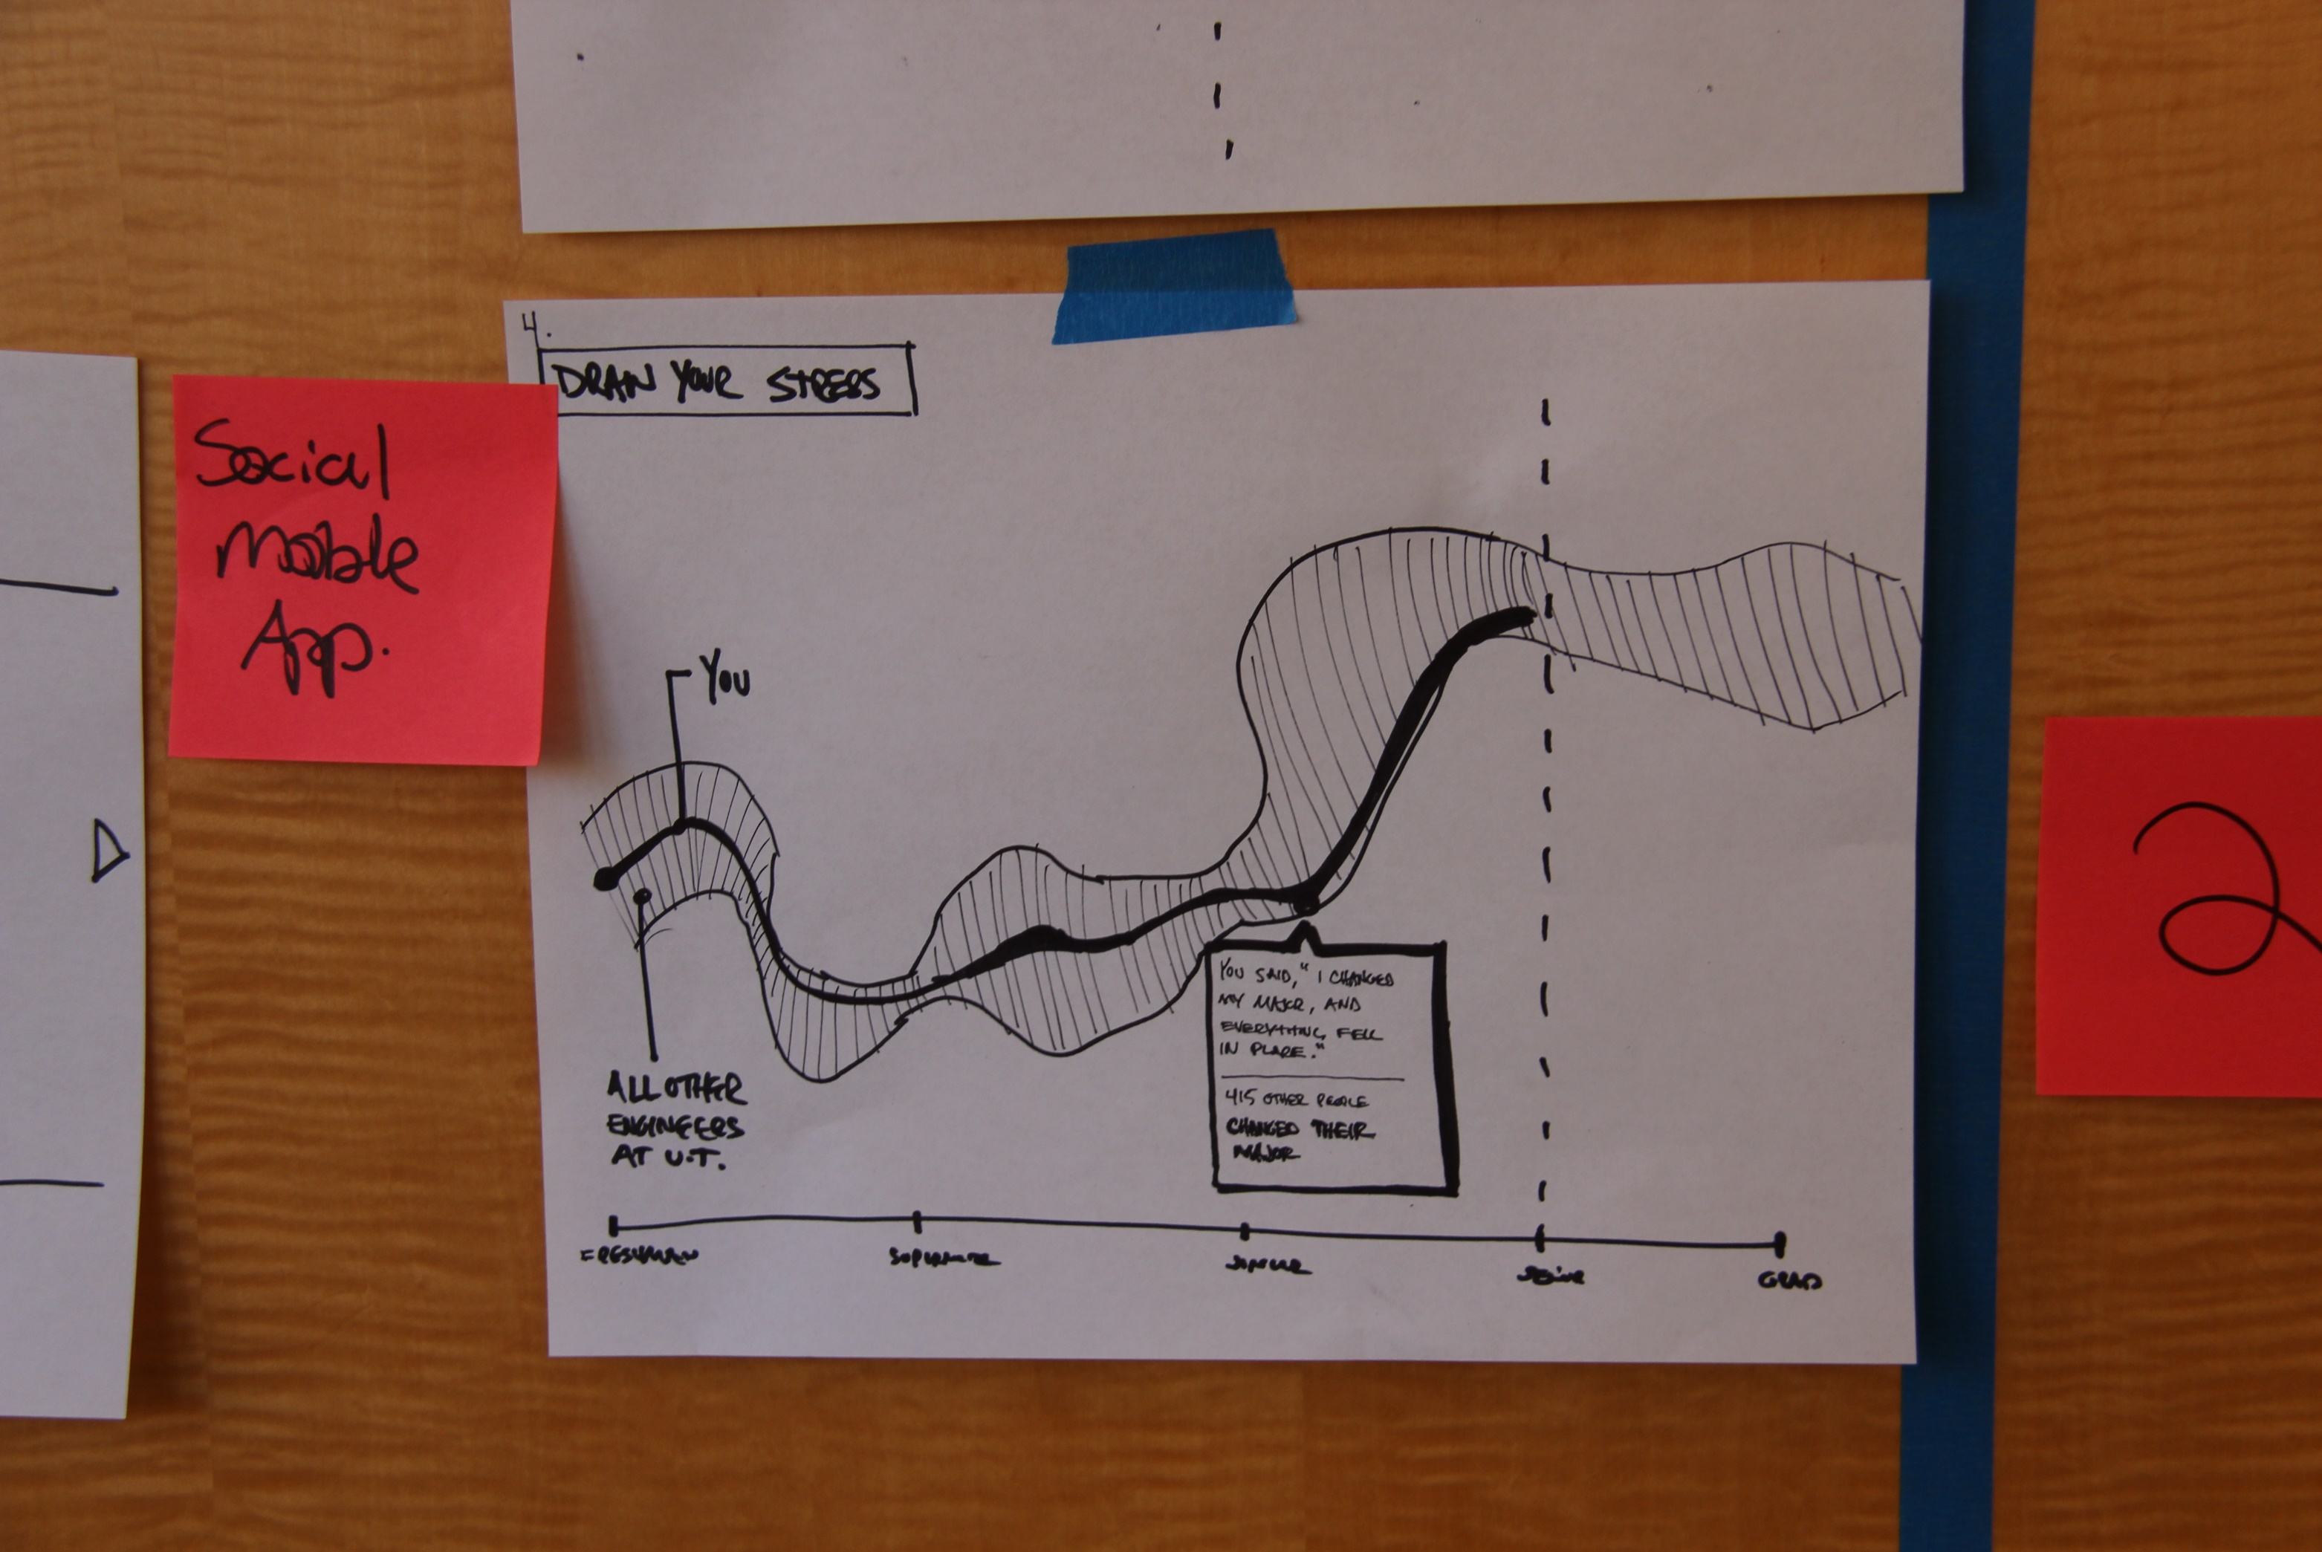

Slide 7
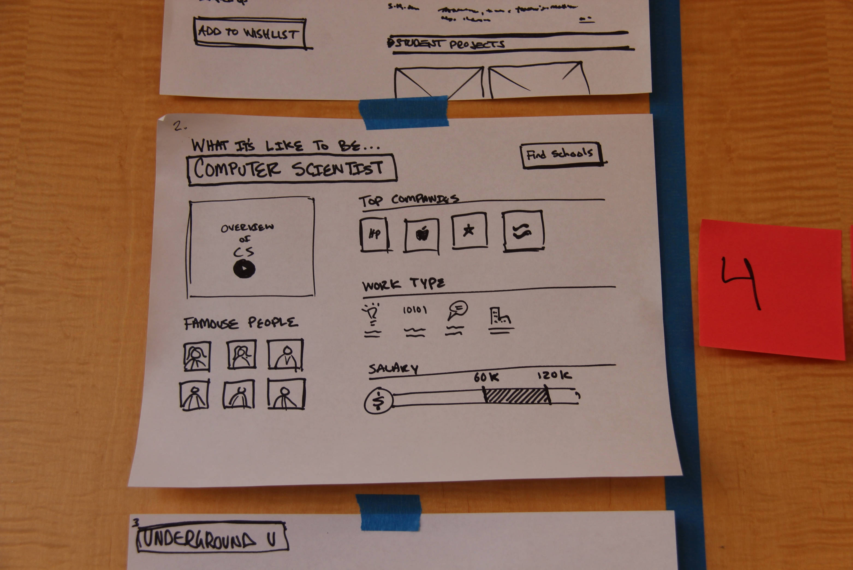

Slide 8
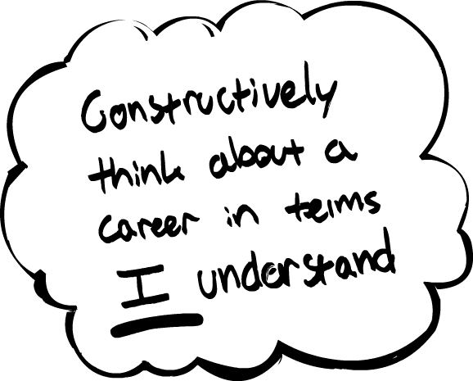
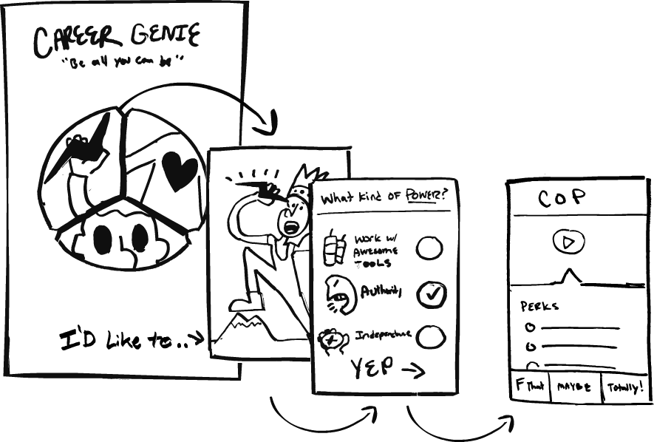
Career Explorer: Vignette

Slide 9
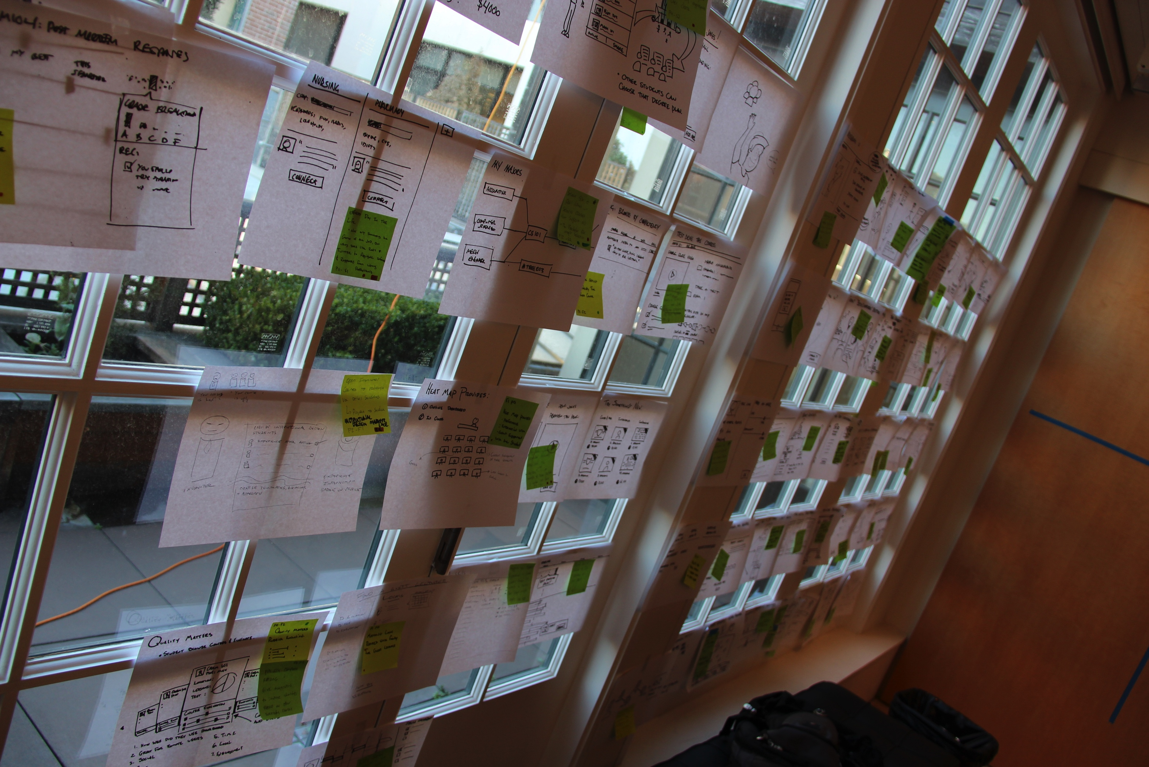

Slide 10
Moving Toward Product Requirements
Research
Transcription
Utterances
Patterns & Anomalies
Interpretation
Insights
Principles
Value
Promise
Stories
Story Vignettes
Like scenarios, our goal is to craft a breadth of manifestation options. These options are used to inform the product vision.
Our goal is still divergence: breadth.

Slide 11
Moving Toward Product Requirements
Research
Transcription
Utterances
Patterns & Anomalies
Interpretation
Insights
Principles
Value
Promise
Stories
Story Vignettes as Flows
Visualize the vignettes over time, to understand how people use a product to achieve a goal.

Slide 12
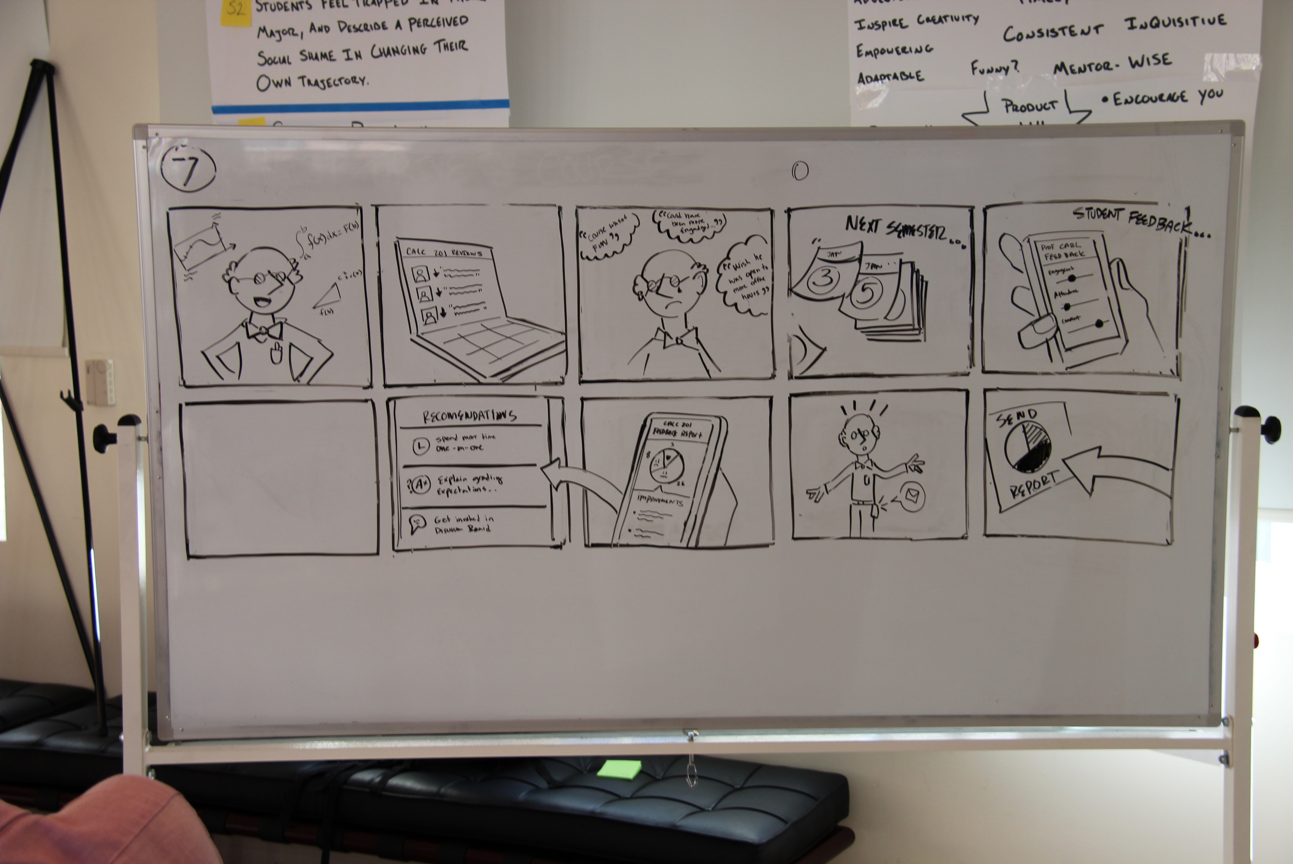

Slide 13
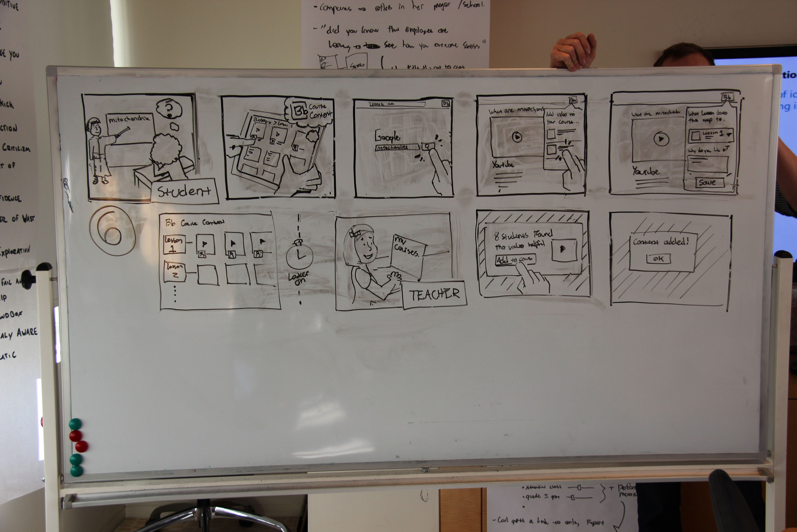

Slide 14
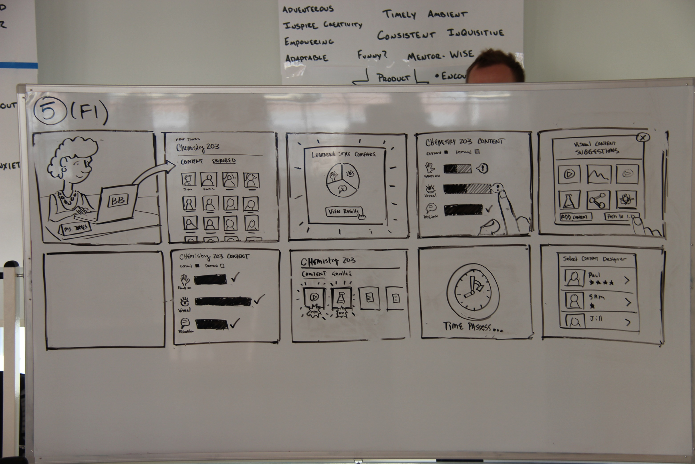

Slide 15
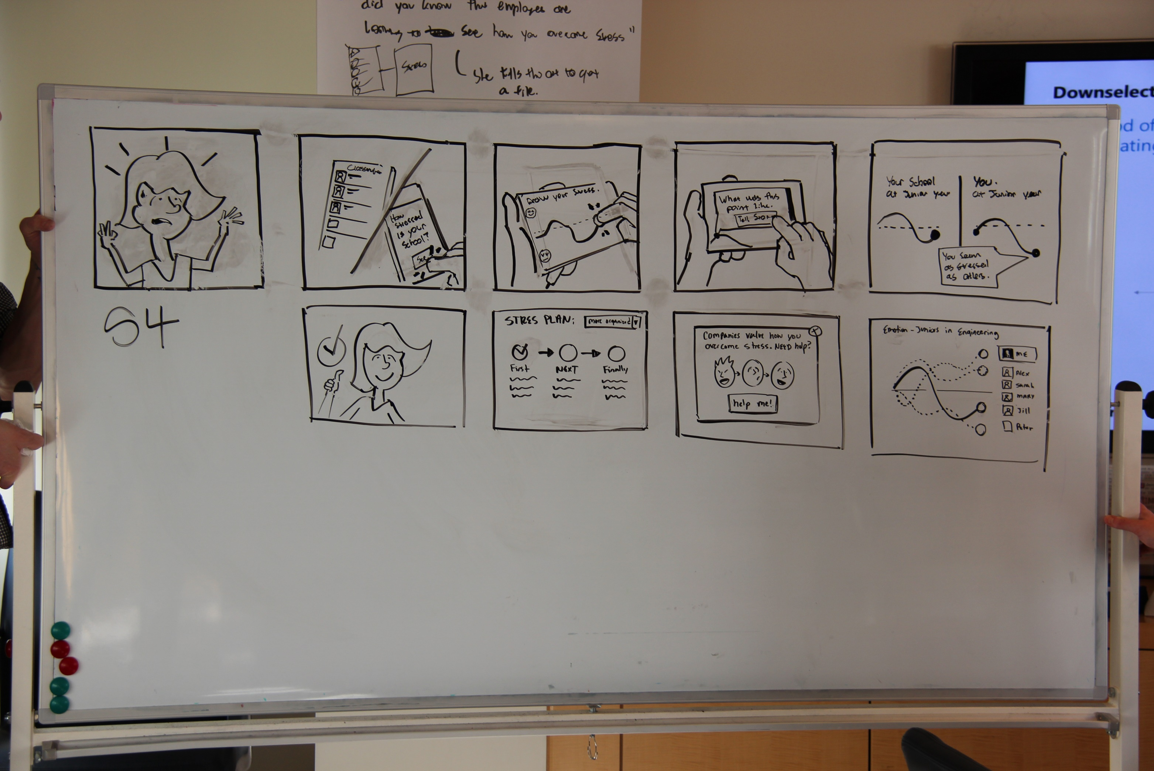

Slide 16
Moving Toward Product Requirements
Research
Transcription
Utterances
Patterns & Anomalies
Interpretation
Insights
Principles
Value
Promise
Stories
Product Definition – Vision
Once the team has crafted a collection of scenarios and vignettes (product pieces), they can begin evaluating and refining a subset of these components into a single cohesive system or service.
Focus on the ideal state rather than what can technically or organizationally be done today. This will help you craft a product / service roadmap that can be broken into manageable chunks later on.
Compare each concept / component against the value promise and key experience principals before introducing business or organizational goals.
Use the “existing state” customer journey map as a guide post (scope, priority, intercept point in the problem, etc..)
Consider bringing stakeholders to the table as these conversations typically have implications for the business and organization that supports it.

Slide 17
Moving Toward Product Requirements
Research
Transcription
Utterances
Patterns & Anomalies
Interpretation
Insights
Principles
Value
Promise
Stories
Product Definition – Vision
The selected components can be articulated as a product vision. This narrative describes the components of the system and how they are utilized to achieve a goal; they describe how we will deliver the value promise to the users.
The vision statement is typically accompanied by a storyboard, a frame-by-frame illustration of the product used to achieve the primary goal, and ideal state customer journey map.
Note: each component continuously evolves from its original scenario and vignette. There is generally some combination and continued ideation of product components during this step.

Slide 18
For example…
Job Genie is a fun, non-threatening way to explore potential career paths.
With Job Genie, students can browse career options in an easy, approachable way, and can view videos from practitioners that paint a realistic picture of the day to day activities at a job.

Slide 19
Moving Toward Product Requirements
Research
Transcription
Utterances
Patterns & Anomalies
Interpretation
Insights
Principles
Value
Promise
Stories
Product Requirements
An articulation of the vision, value promise, and key features or capabilities for each component within the product, system, or service. Product requirements maintain a focus how system components deliver the value promise over features or individual capabilities.
A product requirement contains the following:
A vignette – A medium to high quality illustration of the component
Value statement – A concise statement that describes the intent of the component as they supports the user’s goal. Includes a list of any secondary emotional or behavioral outcomes
Capability & feature breakdown

Slide 20
Career Explorer: Product Requirements
Value Statement
Promotes light hearted, emotionally rich interactions between a student and the qualitative data points they use to “imagine” themselves in a given career path.
Emotional & Behavioral Outcomes
Learn about different career paths
Find schools and courses relevant to a selected vocation or career choice
Connect with celebrities, alumni, employers, and other students in a particular career area
Minimize anxiety around career selection
Make empowered, considered choices about the future

Slide 21
Career Explorer: Product Requirements
V1 Capabilities:
Enter or select a human quality, and explore career paths related to that quality
Pivot between potential career paths using related human qualities
View short, candid videos about a given career path (vine / instagram style)
View salary information about a given career path in a context that makes sense to a student
View degrees that can help the student achieve a given career path
View actionable activities that aid in the process of selecting a given career path
Save, print, or share career path options for future reference

