Slide 1
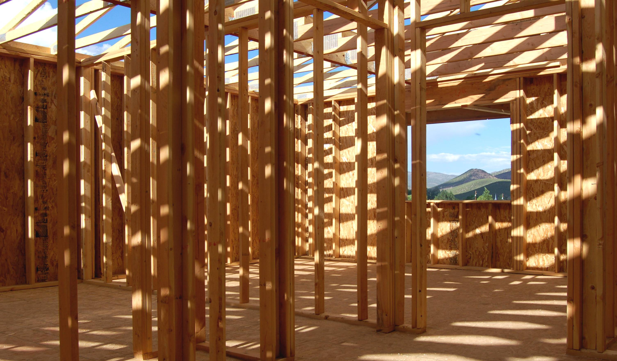
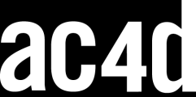
Reframing
Jon Kolko Professor, Austin Center for Design

Slide 2
A Frame
A perspective, or viewpoint
“Even though frames define what count as data, they themselves actually shape the data (for example, a house fire will be perceived differently by the homeowner, the fire fighters, and the arson investigator).”
Klein, Moon & Hoffman
Notes:
2

Slide 3
Reframing
Forcing a shift in semantic perspective in order to see things in a new way.
Notes:
3

Slide 4
Reframing
Forcing a shift in semantic perspective in order to see things in a new way.
Notes:
4

Slide 5
Reframing
Forcing a shift in semantic perspective in order to see things in a new way.
Notes:
5

Slide 6
Reframing
Forcing a shift in semantic perspective in order to see things in a new way.
Notes:
6

Slide 7
Reframing
Forcing a shift in semantic perspective in order to see things in a new way.
REFRAMING/
“Re-embeds” a product, system or service in a new (and not necessarily logical) context
Explores associations and hidden links to and from the center of focus
Posits a “what if” scenario implicitly
Is primarily semantic (a tool for cognition)
Encourages empathy
Forces understanding of the various touchpoints
Identifies implications and insights
Notes:
7

Slide 8
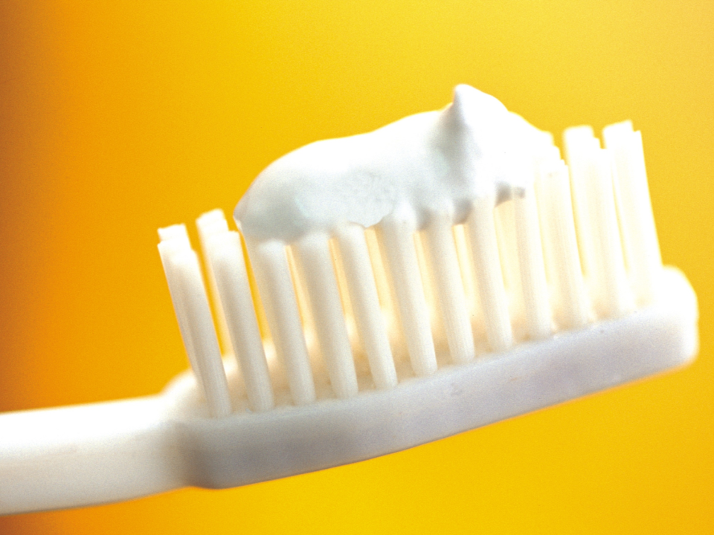
Consider a toothbrush …

Slide 9
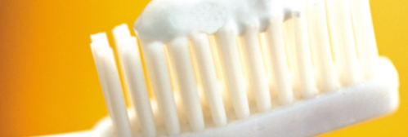
environment
perspective
embodiment
in the bathroom
consumer
object

Slide 10
environment
perspective
embodiment
in the bathroom
consumer
object
reframed in a new environment:
primary user goal:
implications and insights:

Slide 11
environment
perspective
embodiment
in the bathroom
consumer
object
reframed in a new environment:
primary user goal:
implications and insights:
In the kitchen
In an airplane
At a conference

Slide 12
environment
perspective
embodiment
in the bathroom
consumer
object
reframed in a new environment:
primary user goal:
implications and insights:
In the kitchen
Remove food
Teeth cleaning should allow for a way to quickly get pieces out of hard to reach places, and shouldn’t require a mirror
In an airplane
Remove smells
Provide a way to quickly and nonchalantly freshen breath in close quarters and without being offensive to other passengers
At a conference
Remove lettuce before giving a talk
Teeth cleaning should include some form of sharp picking object, and should clearly indicate when you missed a chunk

Slide 13
environment
perspective
embodiment
in the bathroom
consumer
object
reframed from a new perspective:
primary user goal:
implications and insights:

Slide 14
environment
perspective
embodiment
in the bathroom
consumer
object
reframed from a new perspective:
primary user goal:
implications and insights:
dentist
hotel housekeeper
Blind date

Slide 15
environment
perspective
embodiment
in the bathroom
consumer
object
reframed from a new perspective:
primary user goal:
implications and insights:
dentist
Clean teeth & prevent future problems
Teeth cleaning should be as rigorous as possible, and should be “future proof” for some period of time
hotel housekeeper
Clean the hotel room
Teeth cleaning should have as small a disposal footprint as possible, and shouldn’t generate any extra work, trash, or waste
Blind date
Look attractive
There should be a way to casually alert the date that they have something nasty in their teeth.

Slide 16
environment
perspective
embodiment
in the bathroom
consumer
object
reframed as a new embodiment:
primary user goal:
implications and insights:

Slide 17
environment
perspective
embodiment
in the bathroom
consumer
object
reframed as a new embodiment:
primary user goal:
implications and insights:
A Plant
A Spray
A Service

Slide 18
environment
perspective
embodiment
in the bathroom
consumer
object
reframed as a new embodiment:
primary user goal:
implications and insights:
A Plant
Clean teeth while feeling closer to nature
There should be a plant with teeth cleaning properties, that can live peacefully in one of the
aforementioned environments
A Spray
Clean teeth quickly without friction
A portable spray should freshen breath but should also clean teeth; instant or quick acting timeframe, through a fine mist.
A Service
Gain “dentist visit” cleanliness in between visits
Provide a quick-stop for interim dentist appointments – at the mall. Should be trustworthy and clean; legal implications…

Slide 19
Reframing
Identify the product, service or system that is being reframed. It’s not always what your client asked for. Try to articulate the entity in a succinct statement.

Slide 20
Reframing
Create blank reframing charts on large paper. Create three charts, one each for environments, users, and embodiments.
reframed as a new environment:
primary user goal:
implications and insights:
reframed as a new environment:
primary user goal:
implications and insights:
reframed as a new environment:
primary user goal:
implications and insights:

Slide 21
Reframing
Free associate new items for the left column of each chart. Work on all three charts at once. There are no bad ideas: criticism is completely suspended.

Slide 22
Reframing
Begin to fill in Primary Goal for all items in all charts. Try to paint a picture of a credible story; judge responses and add criticism as appropriate, but only in relationship to the primary goal column.

Slide 23
Reframing
Begin to fill in the Implications and Insights column in all charts. There are no bad ideas; criticism is completely suspended. An item can generate more than one implication or insight; if it does, create a new row to capture it.

Slide 24
Reframing
Extract implications and insights that are relevant. Consider the specific constraints of your project, and list the new implications or insights that you’ve identified: these can then be integrated with the rest of your design criteria.

