Slide 1
Presenting
Professor Jon Kolko

Slide 2
Overview (Top Three Things!)
Notes:
2

Slide 3
1/
Every presentation is a chance for you to gain or lose something.
Notes:
3

Slide 4
2/
Every presentation is a structured conversation – even if you are the only one talking.
Notes:
4

Slide 5
3/
You feed the energy in the room. Your participants consume it.
Notes:
5

Slide 6
content
semantics
audience
Notes:
6

Slide 7
Content
Notes:
7

Slide 8
What you say:
preparing
Notes:
8

Slide 9
Set up the room.
Notes:
9

Slide 10
Know your technology.
Notes:
10

Slide 11
Tailor your material to your audience.
Notes:
11

Slide 12
Remember what it’s like not to know.
Notes:
12

Slide 13
Build a narrative arc to support learning.
Notes:
13

Slide 14
Sign post.
Notes:
14

Slide 15
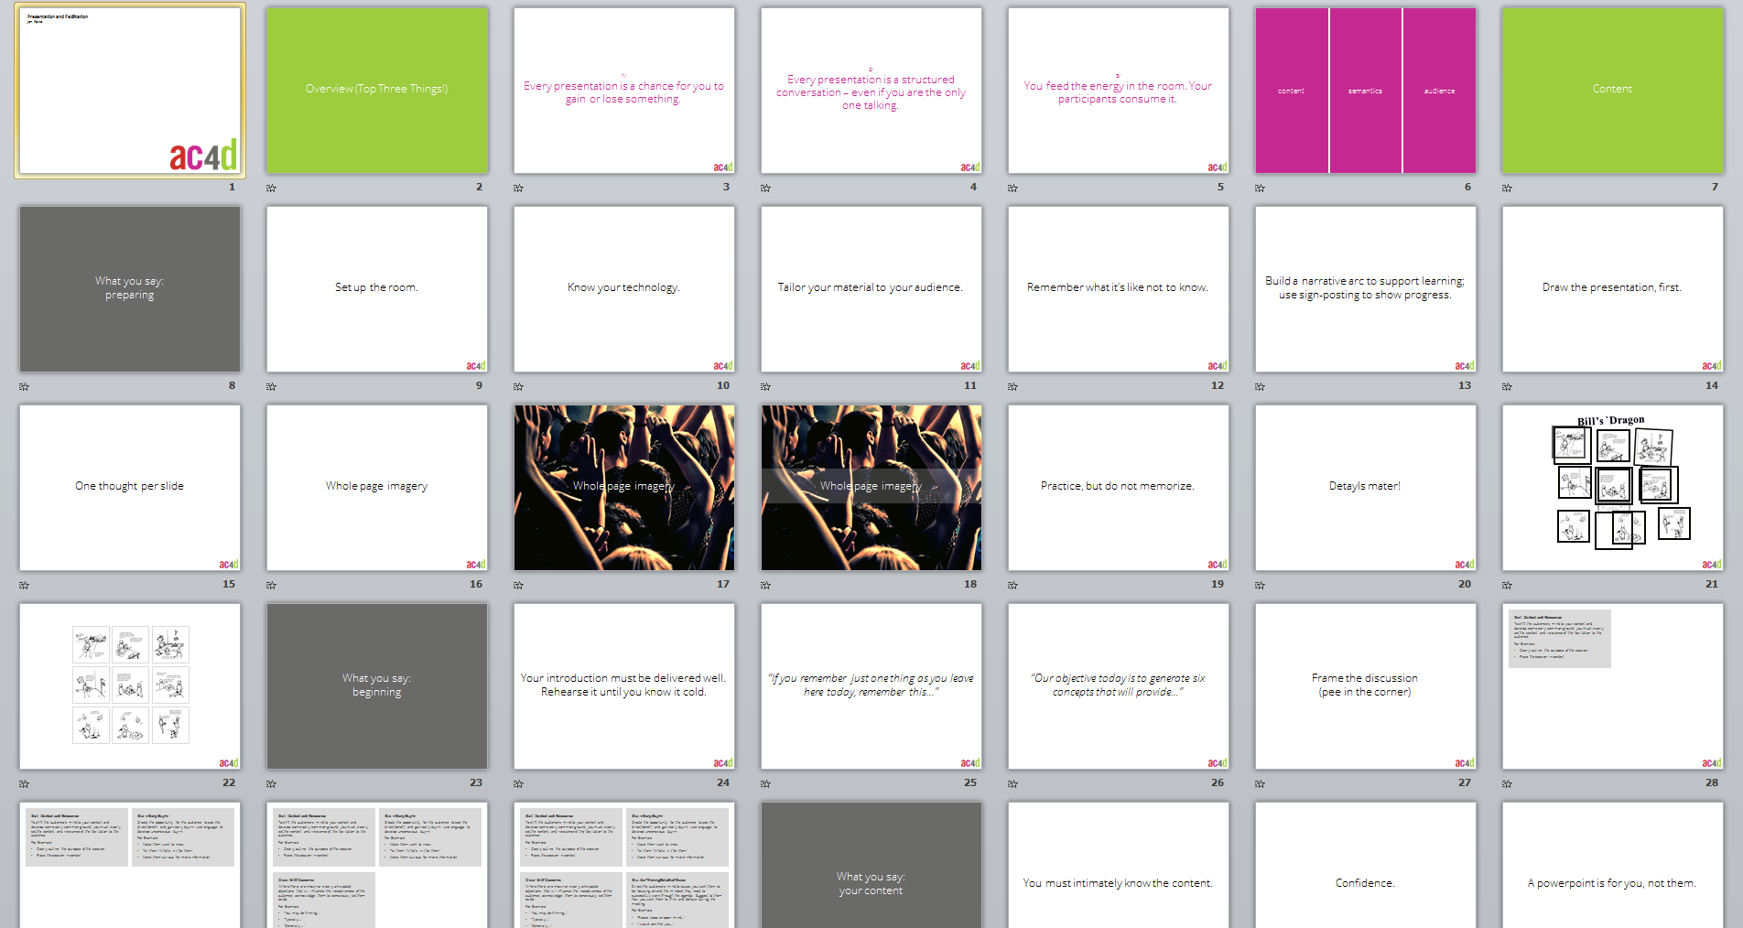
Notes:
15

Slide 16
Draw the presentation, first.
Notes:
16

Slide 17
One thought per slide
Notes:
17

Slide 18
Whole page imagery
Notes:
18

Slide 19
Whole page imagery
Notes:
19

Slide 20
Whole page imagery
Notes:
20

Slide 21
Practice, but do not memorize.
Notes:
21

Slide 22
Detayls mater!
Notes:
22

Slide 23
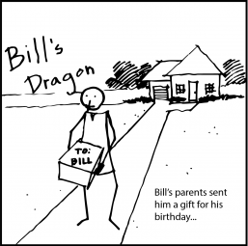
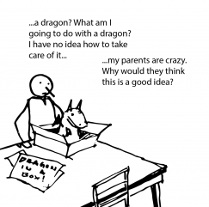
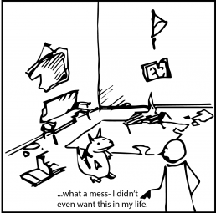
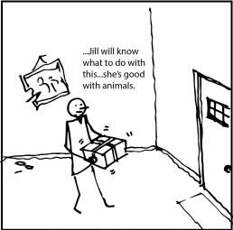
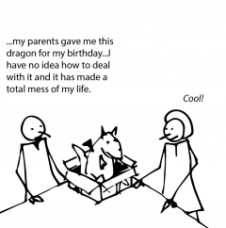
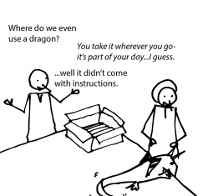
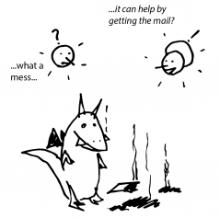
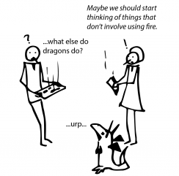
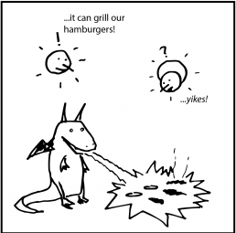
Bill’s `Dragon
Notes:
23

Slide 24
Notes:
24

Slide 25
Notes:
25

Slide 26
What you say:
beginning
Notes:
26

Slide 27
Your introduction must be delivered well. Rehearse it until you know it cold.
Notes:
27

Slide 28
“If you remember just one thing as you leave here today, remember this…”
Notes:
28

Slide 29
“Our objective today is to generate six concepts that will provide…”
Notes:
29

Slide 30
Frame the discussion
(pee in the corner)
Notes:
30

Slide 31
Set Context and Relevance
To shift the audience’s mind to your context and develop some early common ground, you must clearly set the context and relevance of the facilitation to the audience.
For Example:
Clearly outline the purpose of the session
Place the session in context
Notes:
31

Slide 32
Set Context and Relevance
To shift the audience’s mind to your context and develop some early common ground, you must clearly set the context and relevance of the facilitation to the audience.
For Example:
Clearly outline the purpose of the session
Place the session in context
Gain Early Buy-In
Create the opportunity for the audience to see the direct benefit and gain early buy-in. Use language to develop unconscious buy-in.
For Example:
Make them want to know
Tell them “What’s in it for them”
Make them curious for more information
Notes:
32

Slide 33
Set Context and Relevance
To shift the audience’s mind to your context and develop some early common ground, you must clearly set the context and relevance of the facilitation to the audience.
For Example:
Clearly outline the purpose of the session
Place the session in context
Gain Early Buy-In
Create the opportunity for the audience to see the direct benefit and gain early buy-in. Use language to develop unconscious buy-in.
For Example:
Make them want to know
Tell them “What’s in it for them”
Make them curious for more information
Deal With Concerns
Where there are known or clearly anticipated objections that will influence the receptiveness of the audience, acknowledge them to consciously set them aside.
For Example:
“You may be thinking…”
“Typically…”
“Generally….”
Notes:
33

Slide 34
Set Context and Relevance
To shift the audience’s mind to your context and develop some early common ground, you must clearly set the context and relevance of the facilitation to the audience.
For Example:
Clearly outline the purpose of the session
Place the session in context
Gain Early Buy-In
Create the opportunity for the audience to see the direct benefit and gain early buy-in. Use language to develop unconscious buy-in.
For Example:
Make them want to know
Tell them “What’s in it for them”
Make them curious for more information
Deal With Concerns
Where there are known or clearly anticipated objections that will influence the receptiveness of the audience, acknowledge them to consciously set them aside.
For Example:
“You may be thinking…”
“Typically…”
“Generally….”
Guide Thinking/Establish Rules
Direct the audience’s mind to issues you want them to be focusing on and the mindset they need to successfully work through the agenda. Suggest to them how you want them to think and behave during the meeting.
For Example:
“Please keep an open mind…”
“I would ask that you…”
Notes:
34

Slide 35
What you say:
your content
Notes:
35

Slide 36
You must intimately know the content.
Notes:
36

Slide 37
Confidence.
Notes:
37

Slide 38
A powerpoint is for you, not them.
Notes:
38

Slide 39
Do. Not. Read. Your. Slides.
Notes:
39

Slide 40
What you say:
ending
Notes:
40

Slide 41
Conclude in control.
Notes:
41

Slide 42
Encourage questions throughout,
but be ready to defer.
Understand the question, or don’t answer it.
Ask for clarification.
Repeat or rephrase the question.
Notes:
42

Slide 43
Do not get defensive.
Notes:
43

Slide 44
Take the applause.
Notes:
44

Slide 45
What you say:
emergencies
Notes:
45

Slide 46
Cool and collected
Notes:
46

Slide 47
Backup presentation on usb
Notes:
47

Slide 48
Backup presentation as pdf
Notes:
48

Slide 49
Backup presentation on your phone
Notes:
49

Slide 50
Backup presentation printed
Notes:
50

Slide 51
Backup presentation in your head
Notes:
51

Slide 52
Hostility
Notes:
52

Slide 53
Semantics
Notes:
53

Slide 54
Posture
Notes:
54

Slide 55
Posture
Facial Expression
Notes:
55

Slide 56
Posture
Facial Expression
Eye Contact
Notes:
56

Slide 57
Posture
Facial Expression
Eye Contact
Movement
Notes:
57

Slide 58
Posture
Facial Expression
Eye Contact
Movement
Voice
Notes:
58

Slide 59
Posture
Facial Expression
Eye Contact
Movement
Voice
Gesture
Notes:
59

Slide 60
Posture
Facial Expression
Eye Contact
Movement
Voice
Gesture
Competence
Notes:
60

Slide 61
Audience
Notes:
61

Slide 62
What do they know?
Notes:
62

Slide 63
What do they want?
Notes:
63

Slide 64
What do they fear?
Notes:
64

Slide 65
Do your homework.
Notes:
65

Slide 66
Watch their body language.
Notes:
66

Slide 67
In Summary
Notes:
67

Slide 68
content
semantics
audience
Notes:
68

Slide 69
1/
Every presentation is a chance for you to gain or lose something.
Notes:
69

Slide 70
2/
Every presentation is a structured conversation – even if you are the only one talking.
Notes:
70

Slide 71
3/
You feed the energy in the room. Your participants consume it.
Notes:
71

