Slide 1
Moderation & Facilitation Techniques
Matt Franks
Professor, Austin Center for Design

Slide 2
Understanding Facilitation
Facilitation is a structured conversation. A facilitator leads a group through designed activities in order to achieve a predetermined goal.
Notes:
2

Slide 3
Successful Facilitation Requires…
adequate preparation and materials,
a structured goal, complete stakeholder attendance, an appropriate venue, and a passionate host.
Notes:
3

Slide 4
Successful Facilitation Requires…
adequate preparation and materials,
a structured goal, complete stakeholder attendance, an appropriate venue, and a passionate host.
Notes:
4

Slide 5
Successful Facilitation Requires…
adequate preparation and materials,
a structured goal, complete stakeholder attendance, an appropriate venue, and a passionate host.
Notes:
5

Slide 6
Successful Facilitation Requires…
adequate preparation and materials,
a structured goal, complete stakeholder attendance, an appropriate venue, and a passionate host.
Notes:
6

Slide 7
Successful Facilitation Requires…
adequate preparation and materials,
a structured goal, complete stakeholder attendance, an appropriate venue, and a passionate host.
Notes:
7

Slide 8
Successful Facilitation Requires…
adequate preparation and materials,
a structured goal, complete stakeholder attendance, an appropriate venue, and a passionate host.
Notes:
8

Slide 9
Facilitation
Understand the participants
Develop clear and relevant focus areas with supporting activities
Organize materials and logistics
Facilitate the session
Recap, related to expectations
Before:
During:
After:

Slide 10
1/ Understand the participants

Slide 11
Answer the following questions:
Who will be in attendance? How many?
Get a list of names, titles, roles and responsibilities.
Will the decision-maker be in the room? Will they be there for the entire time or just part of the session?
Define the critical decision points they must be a part of.
What are their expectations? What needs to be done to meet their expectations?
Do the participants get along? Are there political tensions between departments or divisions?
Notes:
11

Slide 12
Answer the following questions:
What are the starting and ending times of the session?
Define the time blocks of the day – don’t forget to include breaks and opportunities for causal conversation. Role-play the flow of the day.
What is the seating arrangement and can it be changed?
Is it a neutral, friendly, or hostile audience?
Consider the emotional state of the audience. What do they wish for? What do they fear?
Notes:
12

Slide 13
2/ Develop clear and relevant focus areas with supporting activities

Slide 14
Developing a clear and relevant focus
It is important to articulate the focus and goals of your facilitated session, and select methods based on the client needs and your project needs.
Notes:
14

Slide 15
“Soft” goals might include:
To build trust and gain respect.
In all client relationships, but particularly with new clients, it’s critical to establish a positive working relationship that’s built upon trust and mutual respect (both of process and people).
To develop a shared understanding of strategy
While a strategy may already exist, stakeholders may not be aligned on a trajectory.
To understand client personalities
The individual wants and needs of clients can be one of the most significant factors in describing the cadence of a project and predicting success.
Notes:
15

Slide 16
“Hard” goals might include:
To define scope, boundaries and methodology
While these are typically listed and negotiated in a statement of work, an alignment session can ensure that everyone realizes what deliverables will actually be produced, and what value these deliverables offer. An alignment session can uncover important nuances in a client’s development process that may conflict the with design process. Mitigating these risks early on is critical to the success of the project.
To define success criteria
Frequently, a client has an explicit business goal they are hoping to achieve and a company culture that may or may not support that business goal. An alignment session can ensure that everyone is using the same language to define and measure success.
Notes:
16

Slide 17
Method Selection
Once you have identified a clear focus and set of goals for you session, you can pick, create and refine methods that will support achieving your goals.
Notes:
17

Slide 18
Method Selection
ALIGNMENT GOAL
POTENTIAL METHODS TO LEVERAGE
Build trust and gain respect | Build something together, in order to foster a creative relationship based on shared ideas Go on a field trip, to better empathize with the problems they are trying to solve and build a sense of team respect
Develop a strategy | Build an innovation ranking to understand how much risk can be implicit in a design Build a customer journey map to help identify obstructions to achieving a given strategy
Understand client personalities | Build something together, in order to learn more about how the client thinks about problems
Define scope and boundaries | Create success criteria together to ensure that everyone understands the project timeline, scope, methodology, and boundaries of engagement
Notes:
18

Slide 19
Innovation Ranking

Slide 20
Innovation Ranking
Clients have a varying appetite for innovation, and the word itself can be difficult to define. Innovation ranking provides a step-by-step process to define expectations related to level of “risk.”
Why should I use it?
To create an innovation profile of key client stakeholders
To understand better the perception of current ideas / concepts (if concepts already exist, or a range of concepts have been created for the client to reflect on)
To define specific expectations around the current design challenge
When should I use it?
During program kick off before research begins (this exercises is most helpful for programs involving design research)
Notes:
20

Slide 21
Full Size Image
Notes:
21

Slide 22
Individual notes, pre-printed, are placed on the continuum by the group
Full Size Image
Continuum offers relative positioning
The client collectively defines the range of innovation from which ideas/concepts would be acceptable.
Notes:
22

Slide 23
Innovation Ranking
Innovation Ranking requires a pre-generated set of ideas and concepts. These should be created prior to beginning.
Generate a list of ideas/concepts that range from conservative to revolutionary. Place each idea on a large Post-it.
Create an Innovation Continuum on the wall – a line anchored by “Conservative” on one end, and “Revolutionary” on the other.
Schedule 1 – 2 hours for this exercise depending on the number of items and the size of the group.
Read out each idea/concept and have the group collectively define where the idea should be plotted on an innovation continuum. Facilitate discussion around each item.
Once all ideas/concepts are plotted, have each member of the client team plot their acceptable innovation range using stick dots. Have them verbalize this process.
Finally, have the group establish an acceptable range of innovation for the project.
Notes:
23

Slide 24
Success Criteria

Slide 25
Success Criteria
Metrics and criteria that define success have subtle, often unspoken nuances. A focused activity on defining success criteria can help to ensure that clients understand what will be achieved in the program – and ensure accountability across the project team.
Why should I use it?
To understand how the program impacts the broader client’s business
To define broad program objectives, and better understand business drivers behind the program
To define specific evaluation criteria around the design challenge
To set a prioritized focus for the program – potential tradeoffs can be identified by having the client prioritize the list of program objects and concept criteria
When should I use it?
Success Criteria should be facilitated at the beginning of a program
Results of this exercise will be used during the concept evaluation phase of the program
Notes:
25

Slide 26
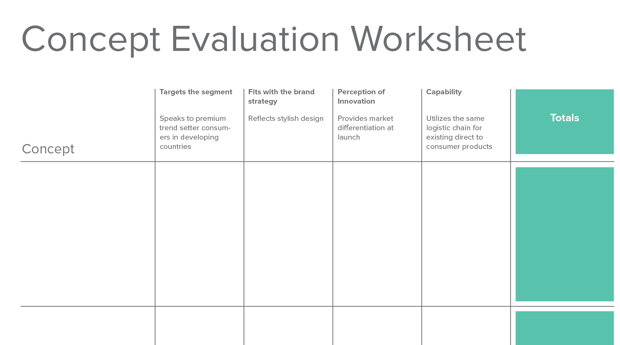
Notes:
26

Slide 27
Concept evaluation worksheet that can be used to compare concepts across prioritized criteria
Notes:
27

Slide 28
Success Criteria
Steps to defining success criteria:
Gather initial success criteria that were established during the business development process (if any).
Provide each stakeholder with a homework assignment prior to the kickoff meeting: “Please come to the meeting ready to share three items related to the following points:
What are the long term Program Objectives?
What are the specific Constraints that are limiting our ability to execute?
Create a large axis on the wall, describing priority (from low to high).
Go around the room, and have the participants position their success criteria on the axis.
Notes:
28

Slide 29
Success Criteria
Steps to defining success criteria:
Facilitate the conversation by identifying conflicts and hosting a brief discussion about them.
As categories of success criteria emerge, define them using a different color post it note.
After the meeting is over, formalize and distribute the list of categorized and ranked success criteria to the group.
Ensure the success criteria is used later in the program as an evaluation tool.
Notes:
29

Slide 30
Competitive Landscape

Slide 31
Competitive Landscape
During an alignment meeting or kickoff session, it can be energizing and provocative to explore how the competition might try and steal market share. Competitive Landscape is a method for describing how key competitors might approach a problem and the advantages the client may have in the space.
Why should I use it?
To discover how the client approaches and thinks about an opportunity
To learn about internal, latent perceptions surrounding competitive advantage
When should I use it?
When kicking off a project with a new client or new group of stakeholders
When arriving at a point of conflict related to features, functions, or services
Notes:
31

Slide 32
Notes:
32

Slide 33
Competitive Landscape
Steps to creating a competitive landscape:
Schedule 1 – 2 hours to complete this activity.
As a group, create a list of both direct (obvious) and indirect competitors.
Divide into small groups, splitting the list of direct and indirect competitors.
Provide a competitive landscape worksheet to each group.
Give groups 5 – 10 minutes to complete the worksheets for each of their competitors
Have each group present the worksheet. Pin the sheets to a board for other participants to see.
Hold a retrospective conversation to extract the main implications, and list them.
Notes:
33

Slide 34
Go to Market

Slide 35
Go To Market
During an alignment meeting, kickoff session or ideation session, it can be effective to explore alternative go to market strategies. This highlights shortcomings in the clients process or capabilities, and can help build strategy.
Why should I use it?
To extract success criteria from the client
To discover how the client approaches a problem
To begin planning a strategic approach to product or service rollout
When should I use it?
When kicking off a project with a new client or new group of stakeholders
When the client is considering a product, system, or service that is outside of their current set of offerings / capabilities.
Notes:
35

Slide 36
Notes:
36

Slide 37
Go To Market
Steps to creating a go to market list:
Schedule 2-3 hours to complete this activity.
As a group, create a list of current and possible go to market channels for a given product or service.
As a group, define the minimum go to market capabilities for each channel that has been listed. There will likely be a common core of functions and features across channels, and then unique capabilities per channel.
Stack-rank the list of channels, based on likely success.
Starting with the least-likely to be successful, define and discuss the roadblocks and challenges that stand in the way of execution.
Notes:
37

Slide 38
3/ Organize materials and logistics

Slide 39
Create an Agenda
Your agenda should include an overview of the session goals, in addition to:
A schedule of the activities that support the goal
Try to create a cohesive plan for each day of facilitation. List one day per page.
Expectations of participation
Define the critical decision points participants must be a part of and the guidelines for participation (should they be vocal? withhold judgment? etc..).
Homework or other preparations
Identify things you need the participant to do prior to the facilitated session. Note that they may not actually do it. Simple work sheets are a great way to encourage participation.

Slide 40
Space
Facilitation is an energetic process that requires room to move around and wall space to pin up artifacts.
Find a room that is large enough for people to move
Get 4x8 sheets of foam core to pin up materials
Sometimes you can’t adhere materials to the client’s walls. Bring your own!

Slide 41
Materials
A blank canvas is intimidating. Provide the participants with a starting point for each activity and exercise.
Print out and organize worksheets and activities
Make sure you also have plenty of pens, markers, post-its and stickers

Slide 42
Practice
Conduct a pilot test of your facilitated session, and encourage your teammates to role-play.

Slide 43
Provide Ground Rules
Don’t judge ideas
Build on the ideas of others
Stay focused on the topic
One conversation at a time
Encourage wild ideas
Be visual
Go for quantity
Notes:
43

Slide 44
4/ Facilitate the session

Slide 45
Facilitation Requires Focus
Focus your facilitation on one key purpose. Worksheets and activities are a great tool to contain the focus of your participants.
Make sure you clearly outline the goal of each activity, expectations for participation, and the steps of the activity before beginning.
Constantly verbalize the relationship between the activity and the goal.
Help participants understand why you are asking them to do various things.

Slide 46
Facilitation Requires Connection
Connect with your audience. The facilitator’s focus should be on the participants; the participant’s focus should be on the activities.
Be sure to include a simplified set of instructions on each of your activities.
Check the “emotional temperature” of the room constantly. Are people engaged? Are they checking email? Do they look tired?

Slide 47
Facilitation Requires Passion
You feed the energy in the room.
Your participants consume it.
Great facilitation comes from passion. You are taking the participants on an emotional journey. You need to give just as much thought to preparing an emotional story line as an intellectual one.

Slide 48
Facilitation
The process needs to be emotionally supportive, offering participants places for “sanity checks.”

Slide 49
5/ Recap, related to expectations

Slide 50
Recap the day
Create and distribute a recap of each day that was facilitated. This helps your client reflect on what just happened and reinforces the value of participating.
Consider adding photos of anything you built together
Include memorable quotes or moments from the day
Include a brief synopsis of where you are in the process and what they can expect in the upcoming days / weeks

