Slide 1
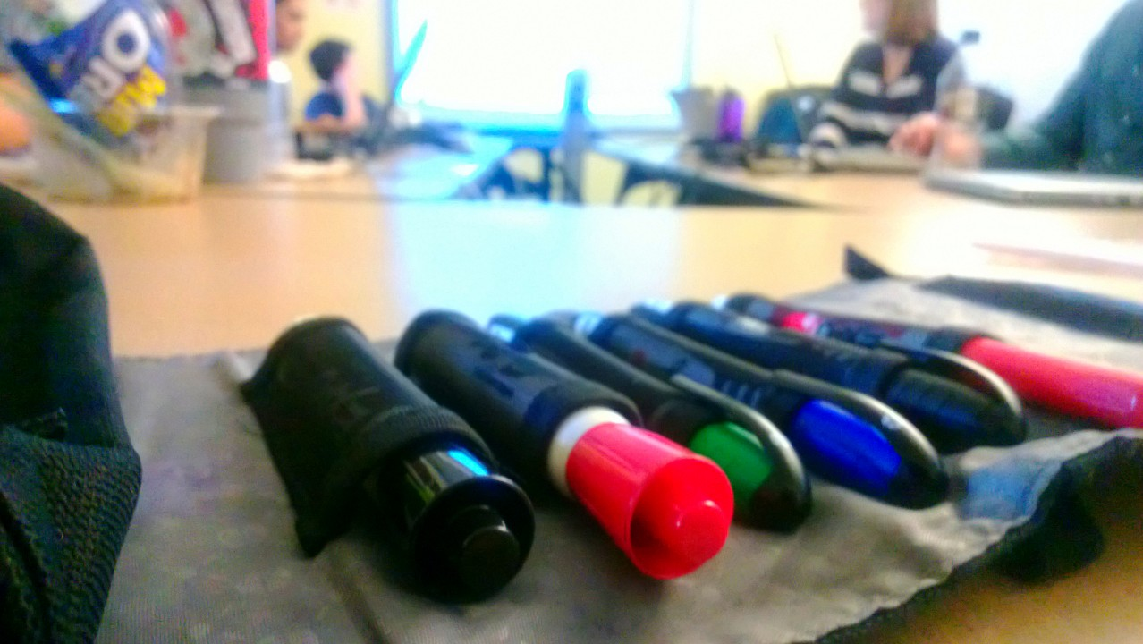
Facilitated Sketching
Matt Franks
Professor, Austin Center for Design

Slide 2
Facilitated Sketching
Where participants generate visual artifacts to communicate ideas, solve problems, visualize something over time & create alignment.
Notes:
2

Slide 3
Facilitated Sketching
Where participants generate visual artifacts to communicate ideas, solve problems, visualize something over time & create alignment.
Notes:
3

Slide 4
Facilitated Sketching
Where participants generate visual artifacts to communicate ideas, solve problems, visualize something over time & create alignment.
Notes:
4

Slide 5
Facilitated Sketching
Where participants generate visual artifacts to communicate ideas, solve problems, visualize something over time & create alignment.
Notes:
5

Slide 6
Facilitated Sketching
Where participants generate visual artifacts to communicate ideas, solve problems, visualize something over time & create alignment.
Notes:
6

Slide 7
Why is Sketching Useful?
Notes:
7

Slide 8
Why is Sketching Useful?
By visualizing ideas, you lower the risk of misinterpretation. Thus, dramatically increasing the shared understanding of your audience.
Talking
Potential for misinterpretation
Writing
Sketching
Notes:
8

Slide 9
The challenge of a facilitated sketching session is getting participants over the fear of visualizing their ideas.
Notes:
9

Slide 10
A Facilitated Sketching Session
Is similar to other types of facilitated activities. It will be successful with adequate preparation, a structured goal, adequate stakeholder attendance, a conducive venue, material to support the facilitated exercises, and passionate facilitation.
Notes:
10

Slide 11
A Facilitated Sketching Session
Is similar to other types of facilitated activities. It will be successful with adequate preparation, a structured goal, adequate stakeholder attendance, a conducive venue, material to support the facilitated exercises, and passionate facilitation.
Getting participants over the fear of
judgment requires a lot more energy
Notes:
11

Slide 12
Preparation for Facilitation
Understand the participants
Develop clear and relevant focus areas with supporting activities
Preparation and logistics
Facilitating the session
Recap and expectation setting

Slide 13
Preparation for Facilitation
Understand the participants
Develop clear and relevant focus areas with supporting activities
Preparation and logistics
Facilitating the session
Recap and expectation setting

Slide 14
2/ Supporting activities

Slide 15
Creating / refining a process

Slide 16
Creating / refining a process
Products and services often exist as part of a larger system (i.e. manufacturing, logistics, application of product, etc.). Teams can be broken up into groups to concept variations of a process, from start to finish, or focus on refining nuanced aspects.
Why should I use it?
To create an innovation profile of key client stakeholders
To create an understanding of the larger eco-system that supports a given product.
To understand better the perception of current ideas / concepts (if concepts already exist, or a range of concepts have been created for the client to reflect on)
To define specific expectations around the current design challenge
When should I use it?
Any time
An alternate version of this activity allows the team to define a process as a group. This is generally useful for creating alignment amongst stakeholders and SMEs for processes that traverse multiple business units.
Notes:
16

Slide 17
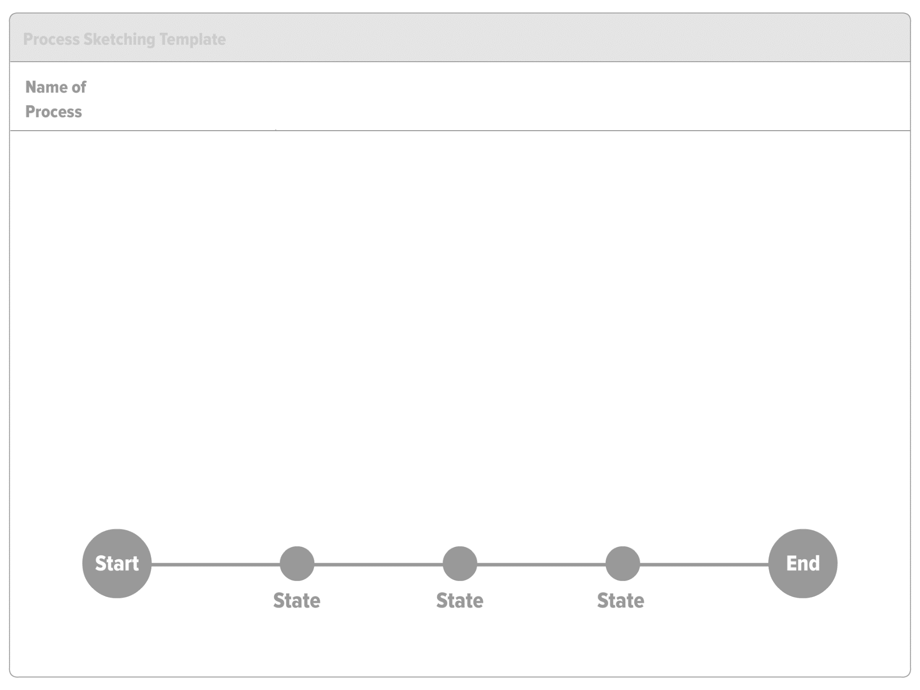
Notes:
17

Slide 18
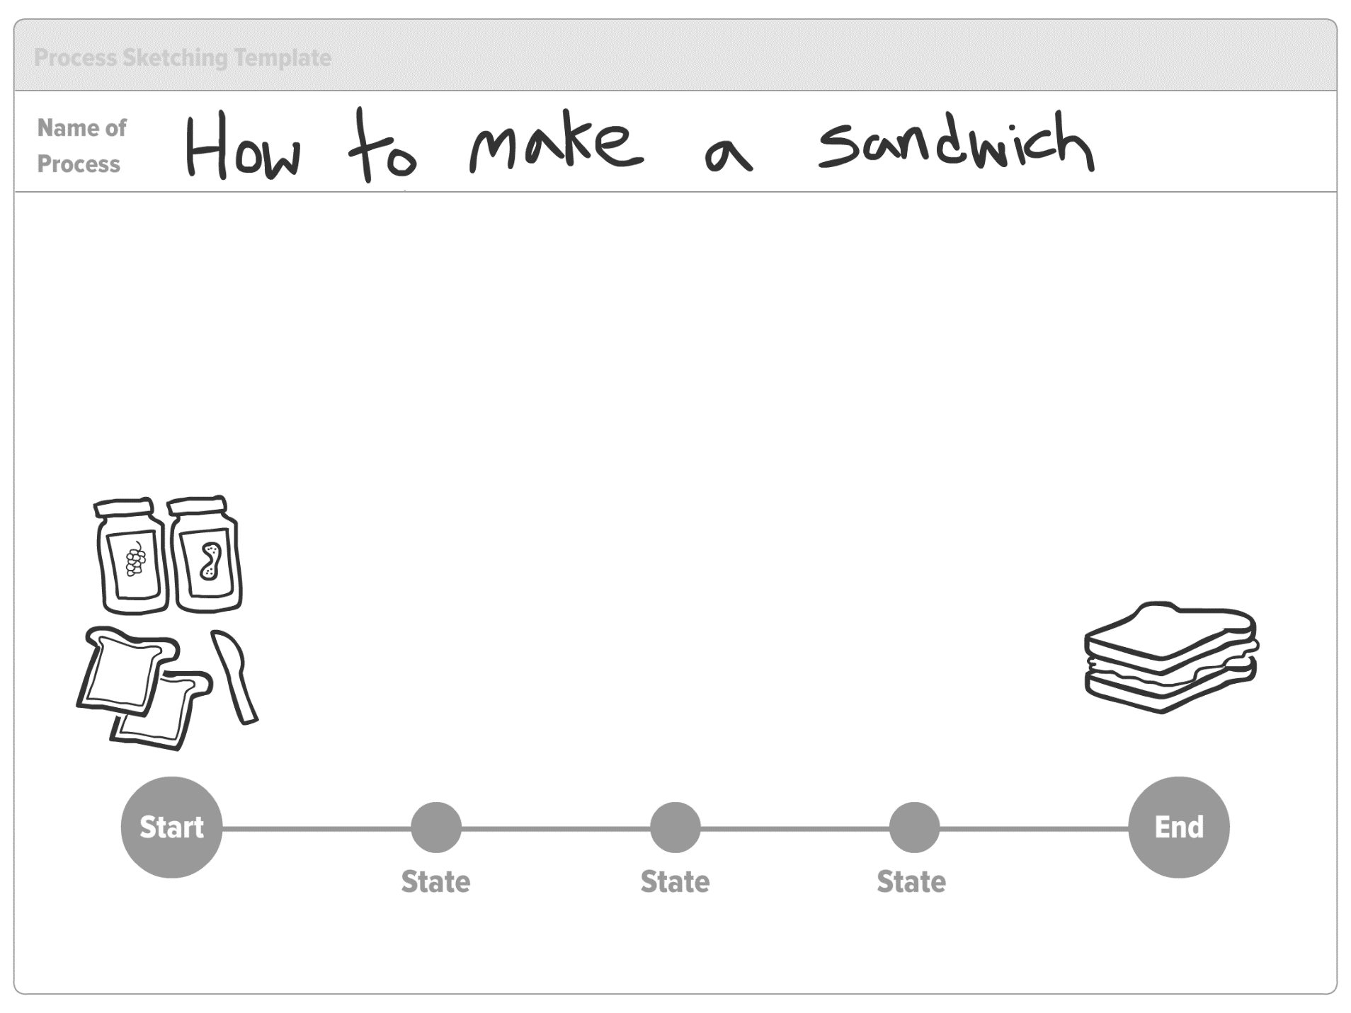
Notes:
18

Slide 19
Creating / refining a process
Steps to facilitating this session:
Schedule 1.5 – 2.5 hours to complete this activity
After completing the warmup framework divide into groups and hand out the activity. Each group should receive multiple copies of the activity worksheet if they are to create multiple concepts.
Explain the activity in full after everyone has received the materials.
Allow for 10 – 15 min per iteration. After the allotted time, encourage the group to move onto the next iteration.
After 45 – 60 min, come back together and have a representative from each team present ideas. Pin up each idea.
As a group, vote on the top 5 or 6 ideas with colored dots or post-it notes.
Divide into groups again. Instruct each group to do an iteration of one of the top 5 or 6 ideas (or an element of the idea).
After 25 – 30 min, come back together and present again.
Notes:
19

Slide 20
Generating Ideas

Slide 21
Generating Ideas
A facilitated sketching session around a product or service provides a lot of material for teams to explore, refine, and validate.
Why should I use it?
To understand better the perception of current ideas / concepts (if concepts already exist, or a range of concepts have been created for the client to reflect on)
To create a variety of ideas for a design or development team.
To engage stakeholders in the creative process as a means to facilitate buy-in.
When should I use it?
During program kick off before research begins (this exercises is most helpful for programs involving design research)
After the research readout when a variety of concept directions are useful.
After narrowing down design concepts – to provide additional variances on the same idea.
Notes:
21

Slide 22
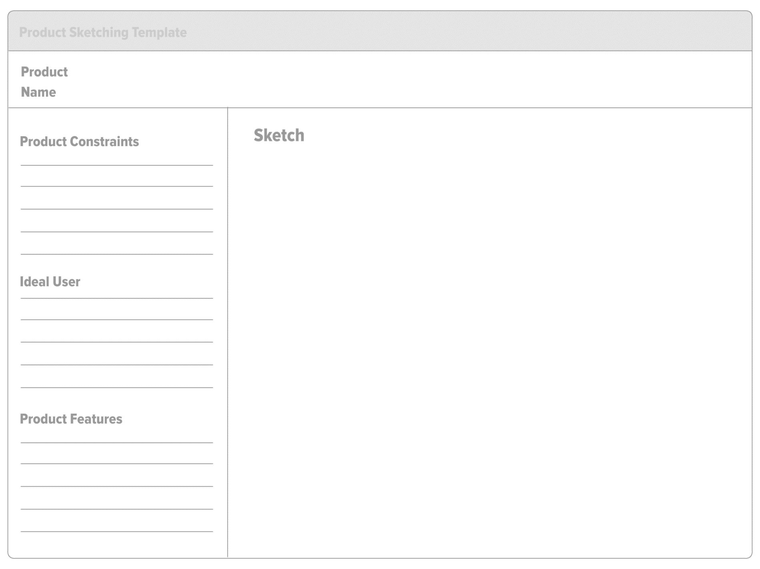
Notes:
22

Slide 23
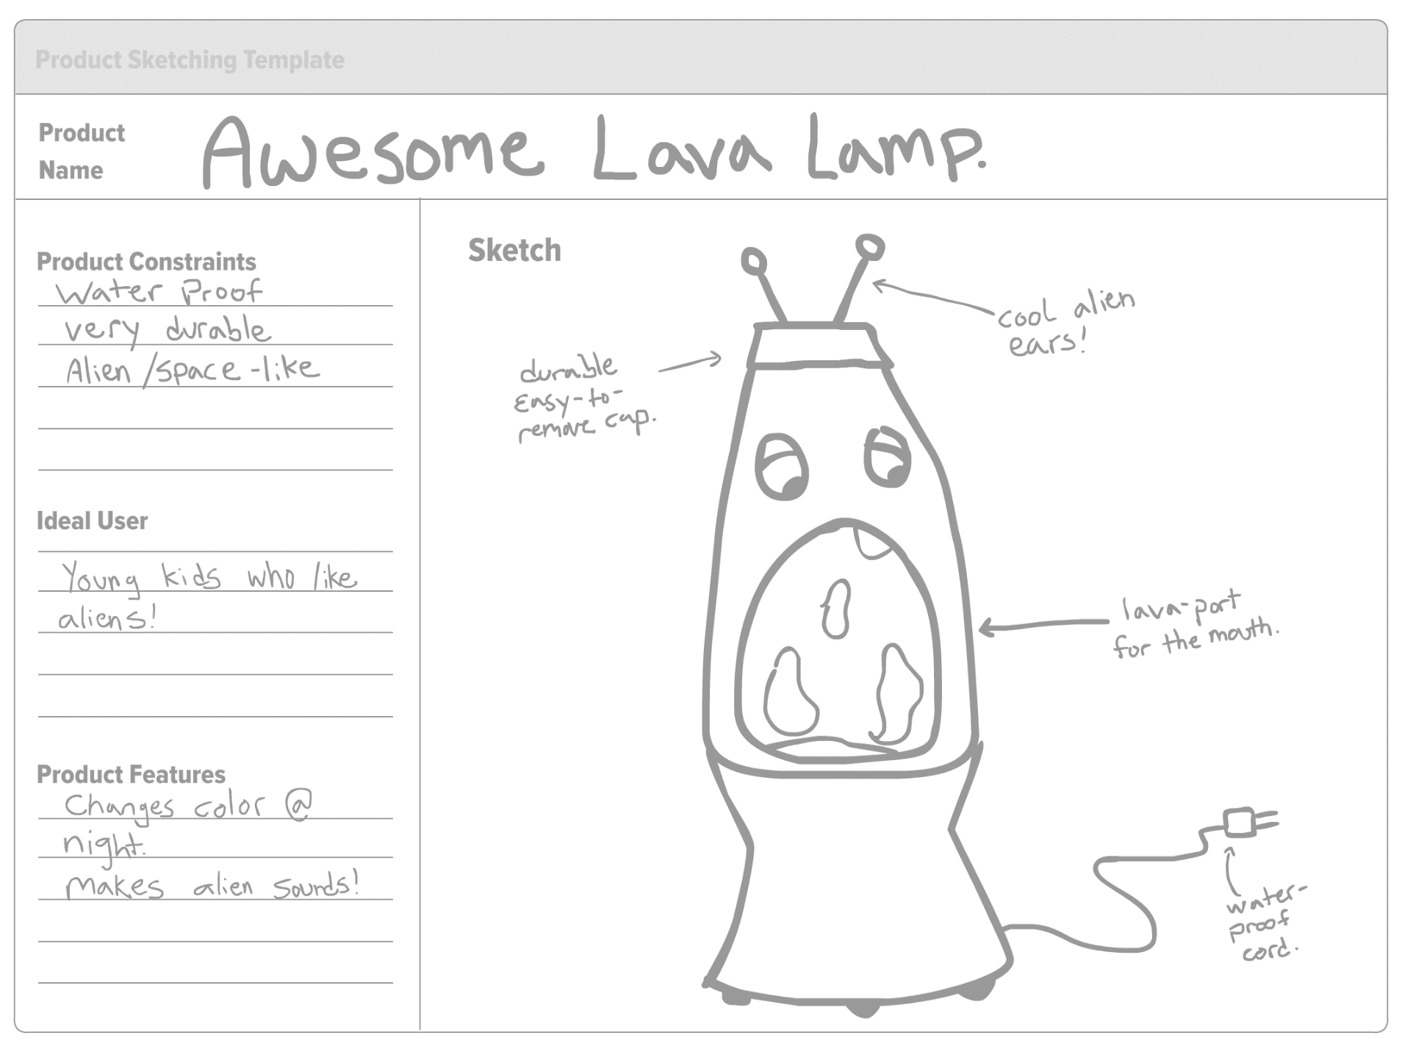
Notes:
23

Slide 24
Generating Ideas
Steps to facilitating this session:
Schedule 1 – 1.5 hours to complete this activity
After completing the warmup framework divide into groups and hand out the activity. Each group should receive multiple copies of the activity worksheet if they are to create multiple concepts.
Explain the activity in full after everyone has received the materials.
Allow for 5 – 10 min per iteration. After the allotted time, encourage the group to move onto the next iteration.
After 40 -50 min, come back together and have a representative from each team present ideas. Pin up each idea.
As a group, vote on the top 5 or 6 ideas with colored dots or post-it notes.
Divide into groups again. Instruct each group to do an iteration of one of the top 5 or 6 ideas (or an element of the idea).
After 25 – 30 min, come back together and present again.
Notes:
24

Slide 25
4/ Facilitating the session

Slide 26
Start with a Framework
Participants aren’t going to start drawing unless you provide them with a framework and a starting point.
Practice drawing all of the things on the following framework as a warm up exercise, in an area where participants can see
After drawing each object, encourage each participant to try it themselves – don’t take no for an answer!
While participants are practicing, walk the room and offer encouragement.
Plan for 10 – 20 min of warm up before handing out the activity.

Slide 29
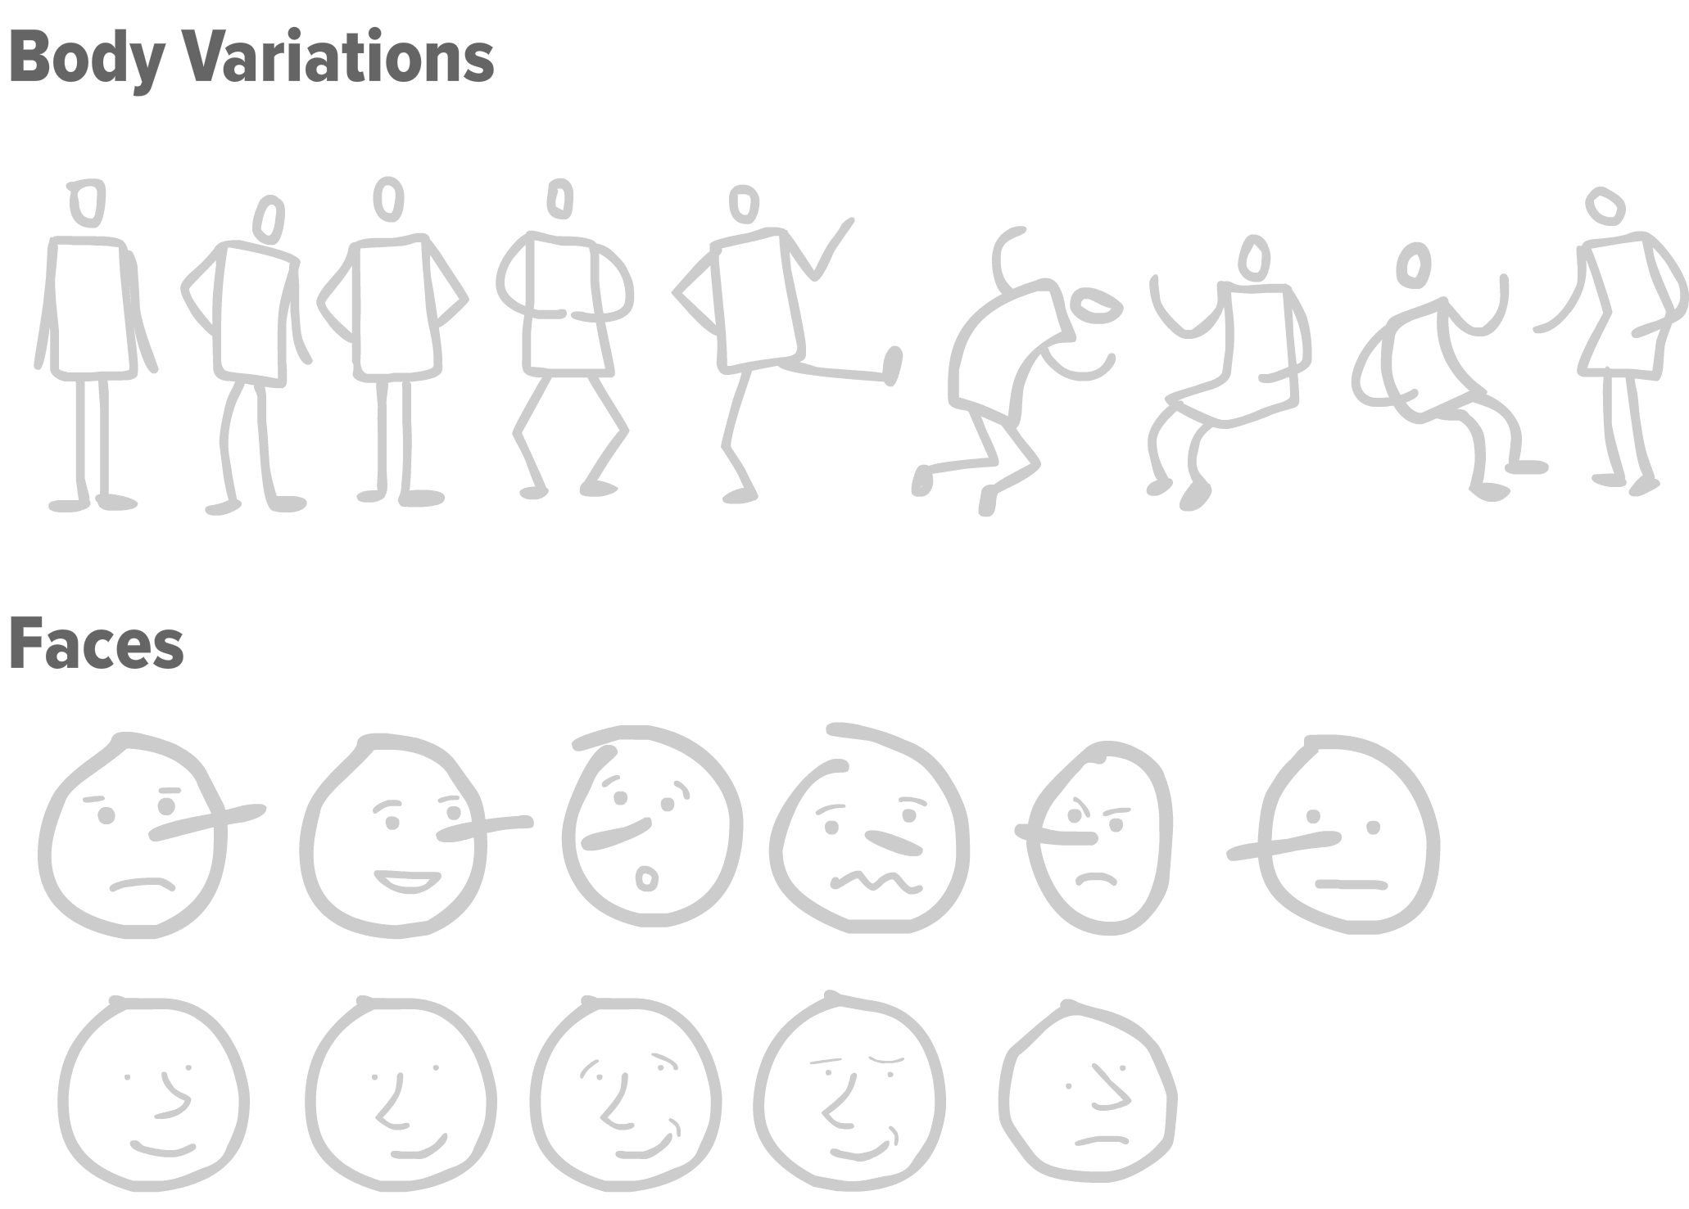

Slide 30
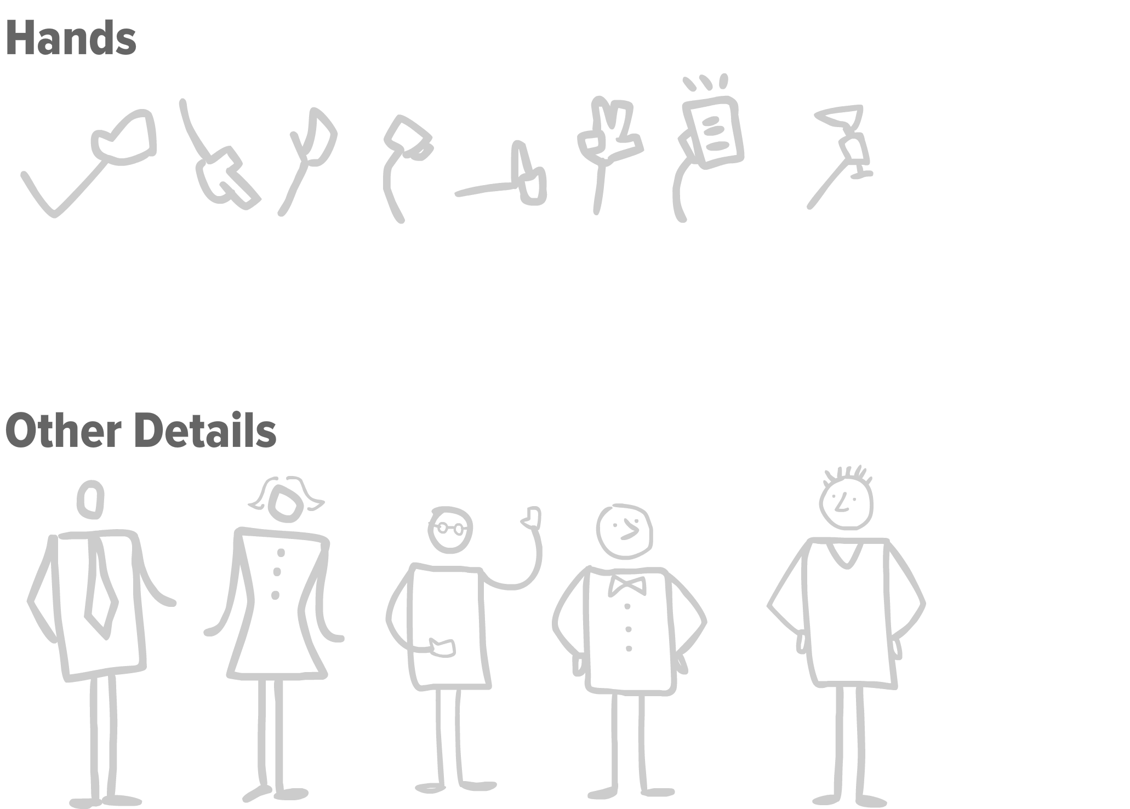

Slide 31
Provide the exercise
Only do this when you feel like participants are ready to begin. If they are struggling, take a few extra minutes for practice.
Sometimes it helps to seed each group with a facilitator who is comfortable sketching.

Slide 32
Facilitation Requires Passion
You feed the energy in the room.
Your participants consume it.

