Slide 1
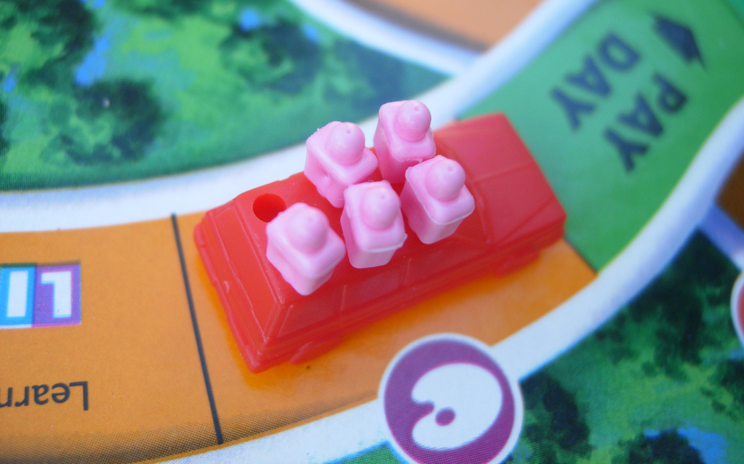
Customer Journey Mapping
Professor Jon Kolko

Slide 2
Where We Left Off
Research
Transcription
Utterances
Patterns & Anomalies
Interpretation
Insights
Principles
Value
Promise
Stories
Ethnography
Synthesis
Prototyping
Immersion in the cultural context of a wicked problem
Making meaning through inference and reframing
Hypothesis validation through generative, form-giving activities

Slide 3
Where We Left Off
Research
Transcription
Utterances
Patterns & Anomalies
Interpretation
Insights
Principles
Value
Promise
Stories
Ethnography
Synthesis
Prototyping
Immersion in the cultural context of a wicked problem
Making meaning through inference and reframing
Hypothesis validation through generative, form-giving activities
Affinity
(grouping data by similarity & extracting new meaning)

Slide 4
Where We Left Off
Research
Transcription
Utterances
Patterns & Anomalies
Interpretation
Insights
Principles
Value
Promise
Stories
Ethnography
Synthesis
Prototyping
Immersion in the cultural context of a wicked problem
Making meaning through inference and reframing
Hypothesis validation through generative, form-giving activities
Affinity
(grouping data by similarity & extracting new meaning)
Visual Modeling
(interpreting relationships of data with a focus on layering visual information)

Slide 5
What is a Customer Journey Map?
A visual model that describes touchpoints between the system and the people using the system.

Slide 6
What is a Customer Journey Map?
A customer journey map forces you to think about sequence & the details that happen over time.
Start
End

Slide 7
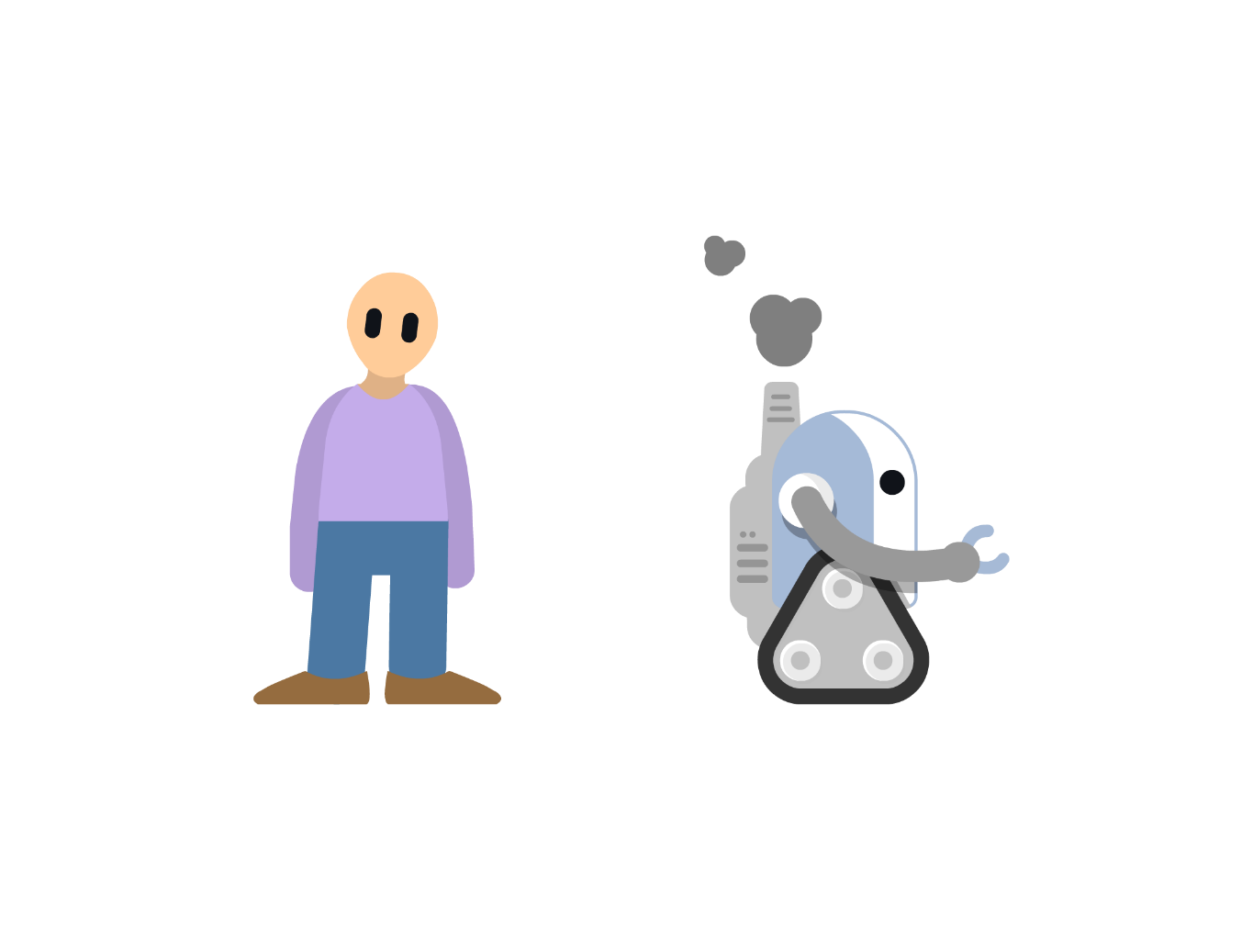
The details reside in people & the system…
People
System

Slide 8
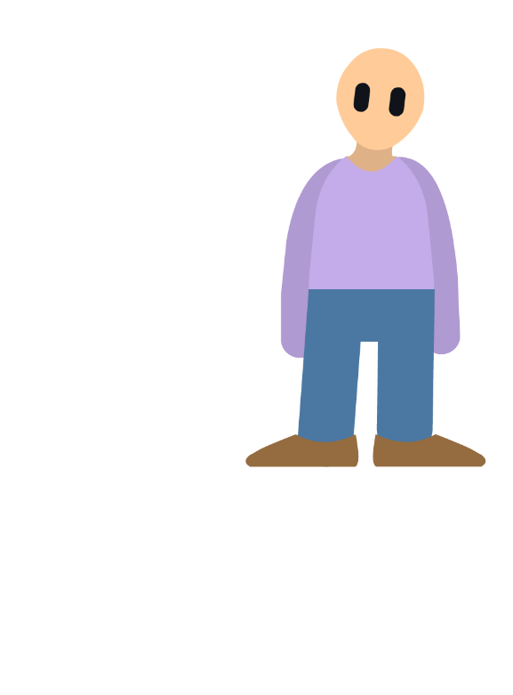
Thinking about people…
Thoughts / Perceptions
How do users understand what is going on? What are they aware of? What information do they need?

Slide 9
Thinking about people…
Thoughts / Perceptions
How do users understand what is going on? What are they aware of? What information do they need?
Feelings & Reaction
How do users feel? What kind of reaction are they having to the system?

Slide 10
Thinking about people…
Thoughts / Perceptions
How do users understand what is going on? What are they aware of? What information do they need?
Feelings & Reaction
How do users feel? What kind of reaction are they having to the system?
Actions & Behaviors
What are the users doing? What do they perceive that they should be doing?

Slide 11
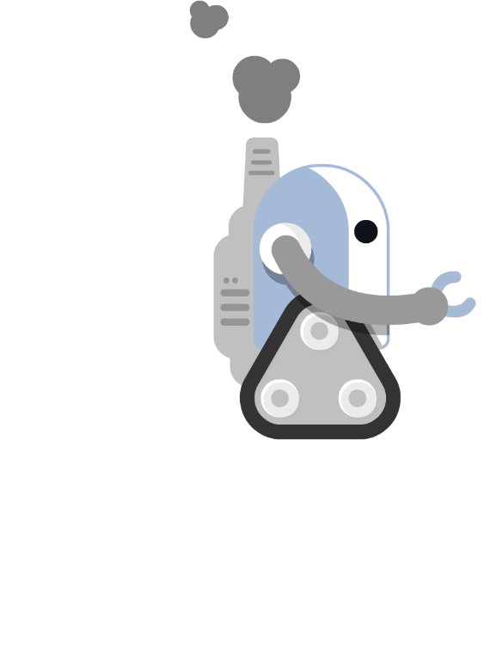
Thinking about the system…
Environment
Where is the system taking place? What implications does the environment have on users and the system?

Slide 12
Thinking about the system…
Environment
Where is the system taking place? What implications does the environment have on users and the system?
Recognition & Response
Does the system identify what the user needs? How is the system responding?

Slide 13
Thinking about the system…
Environment
Where is the system taking place? What implications does the environment have on users and the system?
Recognition & Response
Does the system identify what the user needs? How is the system responding?
Affordance & Indication
What is the system expecting from users? Is the system providing an indication?

Slide 15
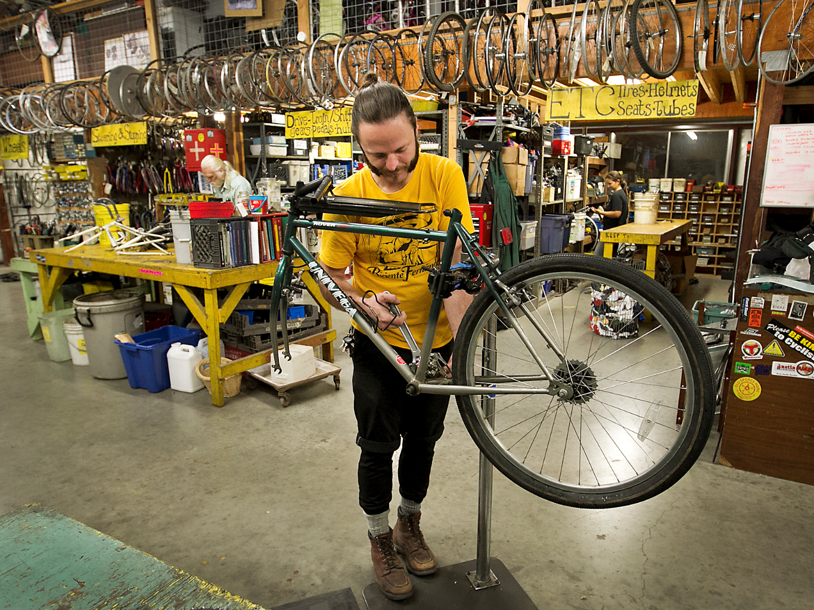
Yellow Bike Project

Slide 16
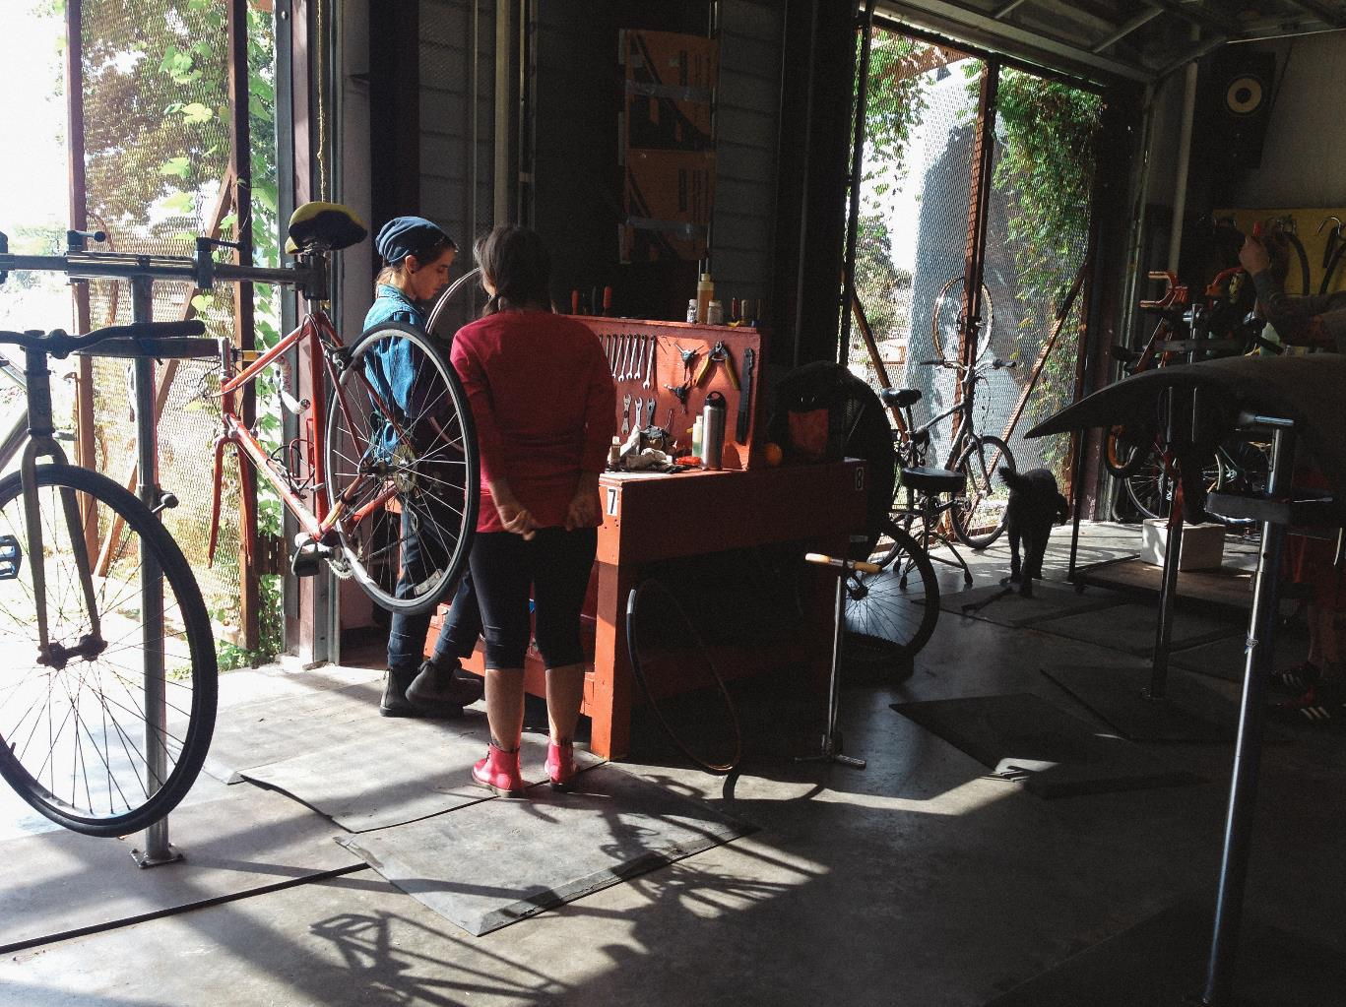
“Getting people together to make Austin a better place to bike is really what it’s all about.”
Volunteer Coordinator
Founder YBP

Slide 17
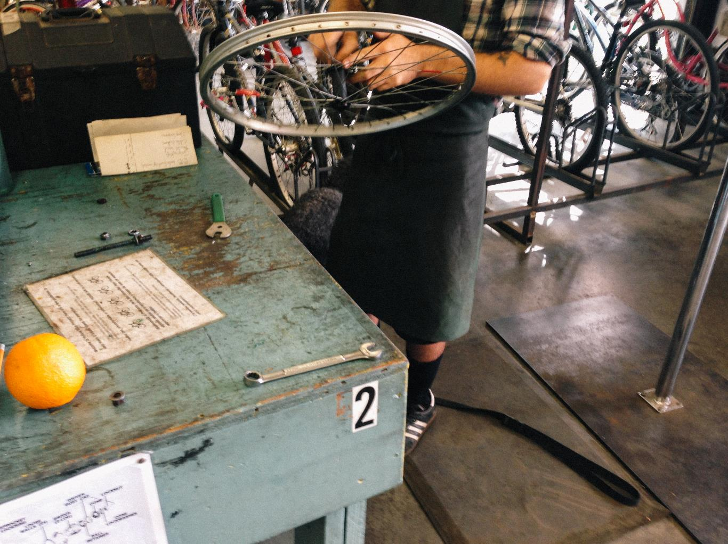
“It’s my reason for getting up in
the morning…”
Volunteer Coordinator
Founder YBP

Slide 18
How they think their business works…
Customer journey maps can be used to clarify the perceived state of a system…

Slide 19
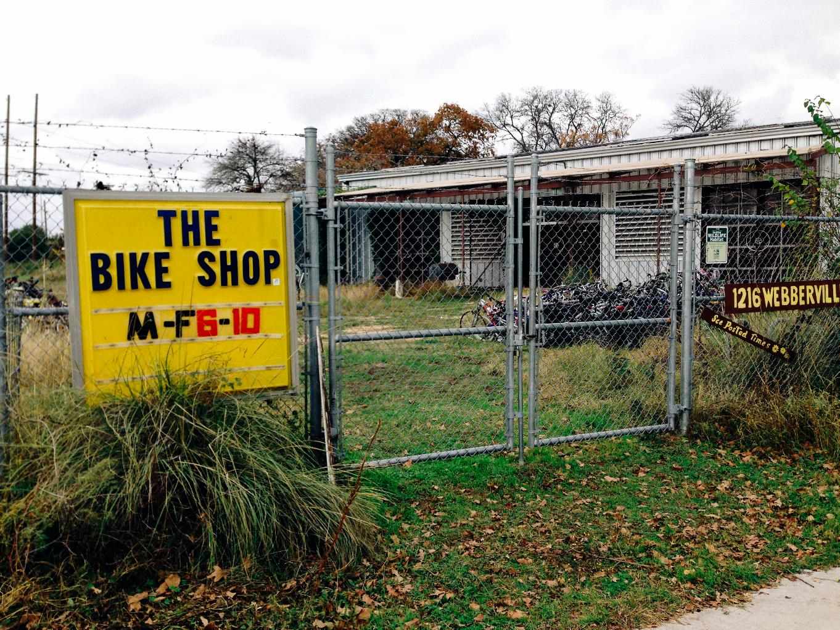

Slide 20
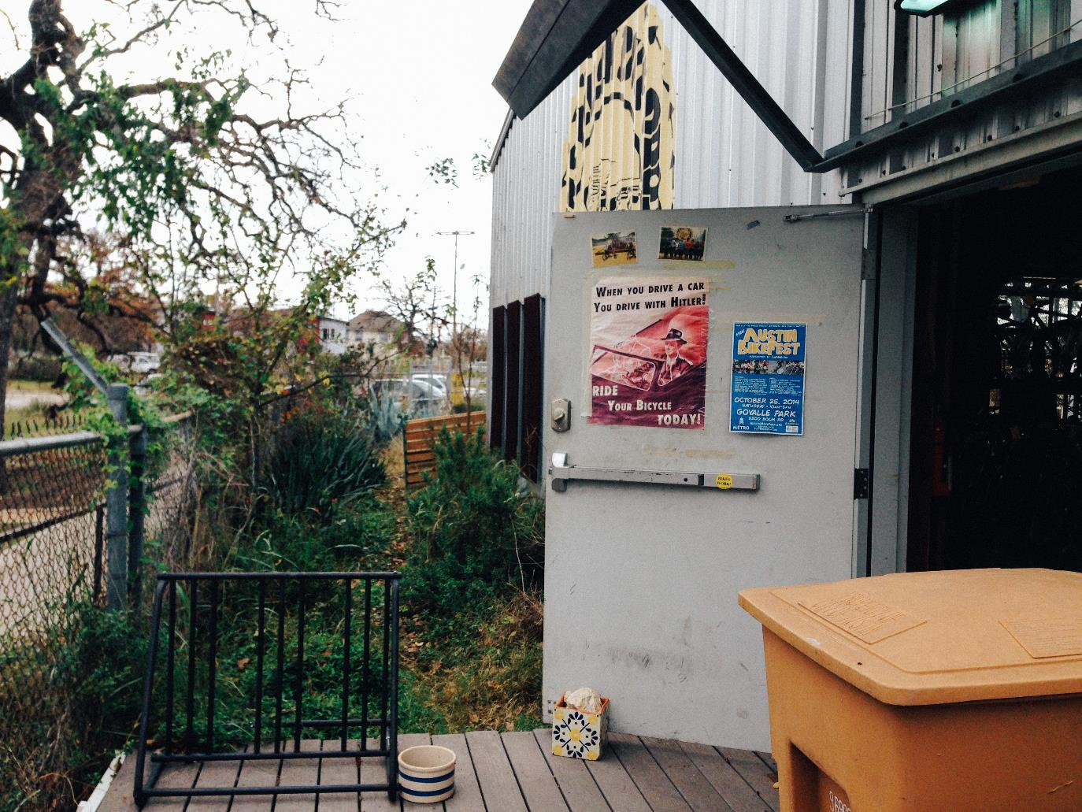

Slide 21
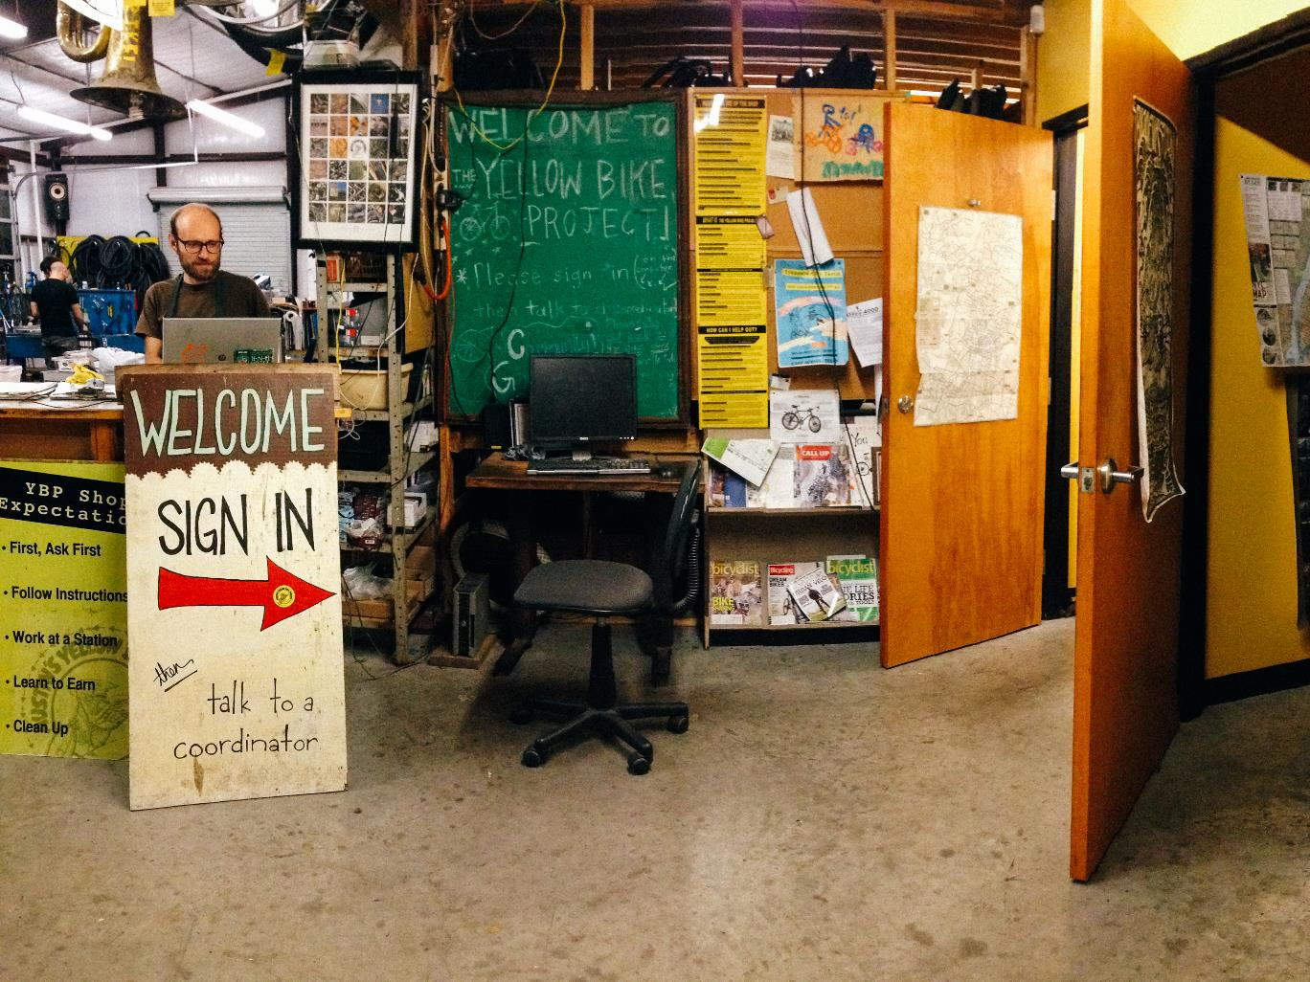

Slide 22
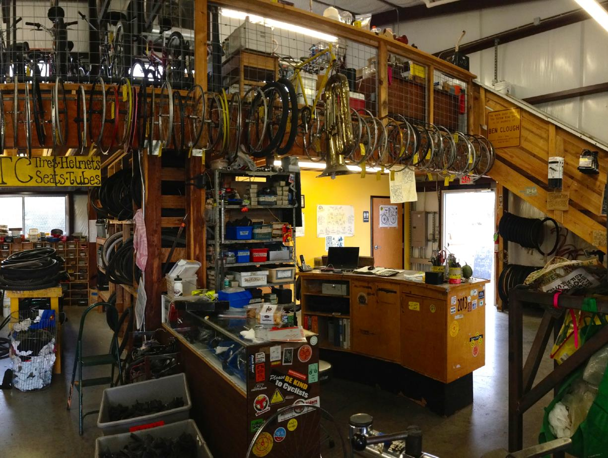

Slide 23
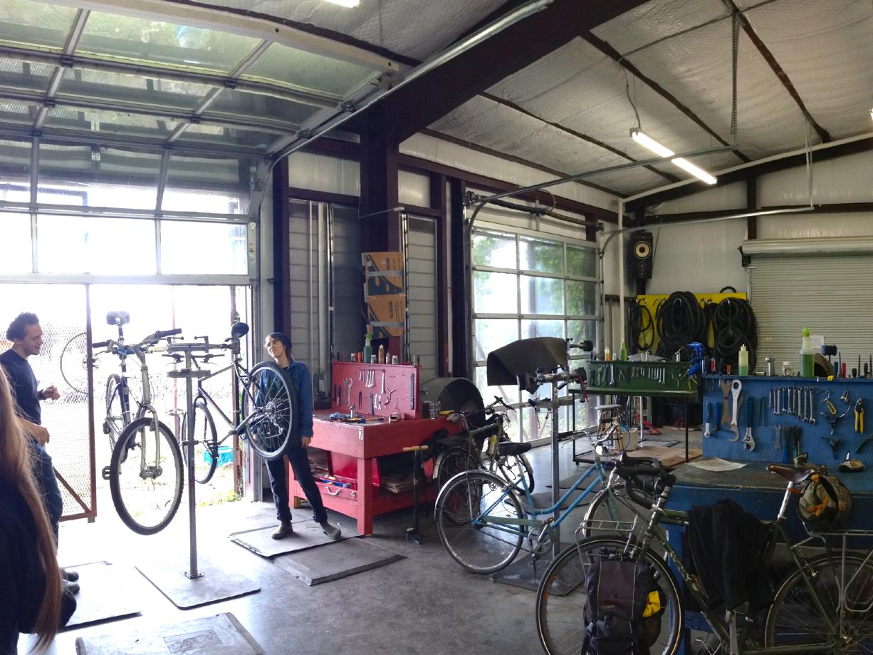

Slide 24
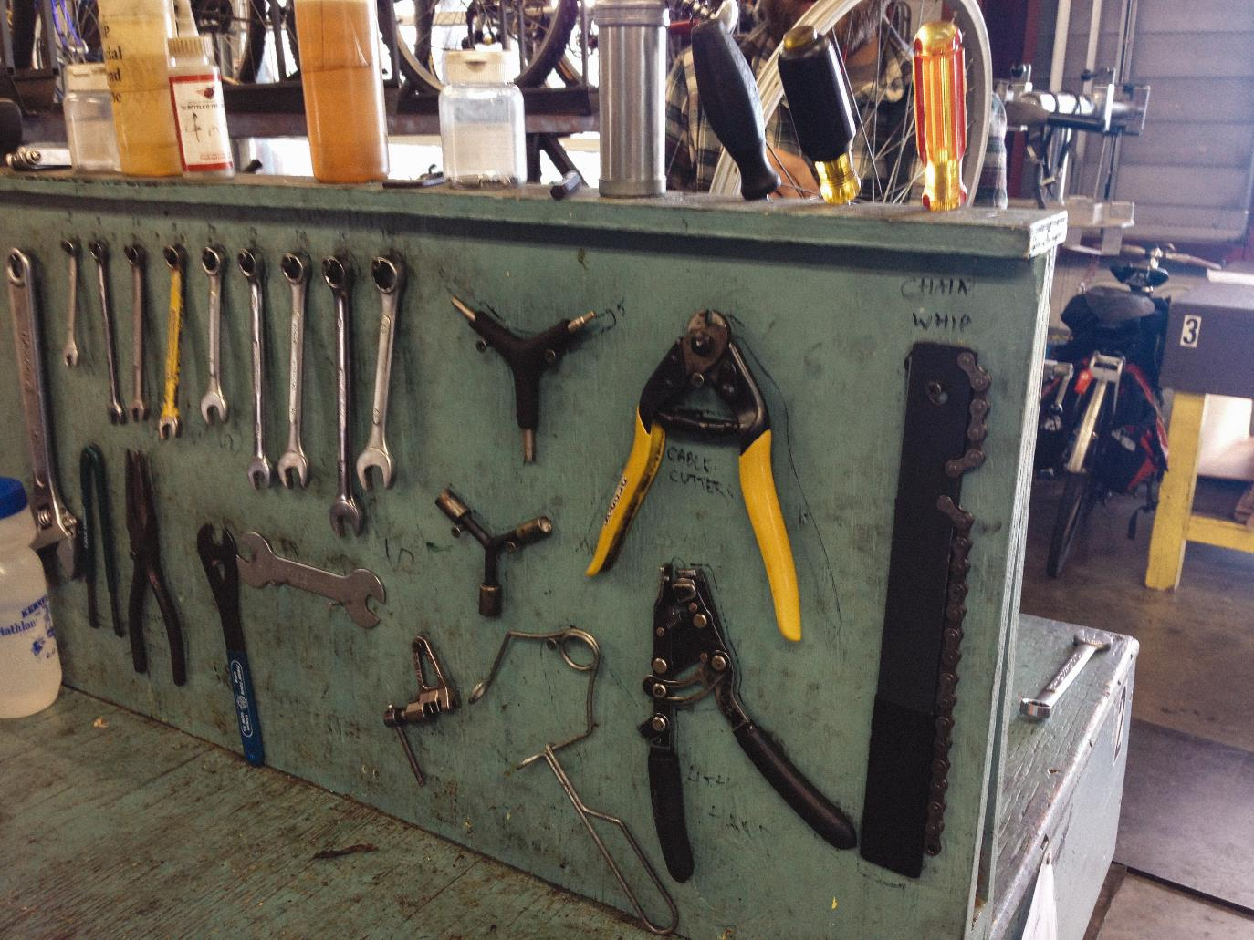

Slide 25
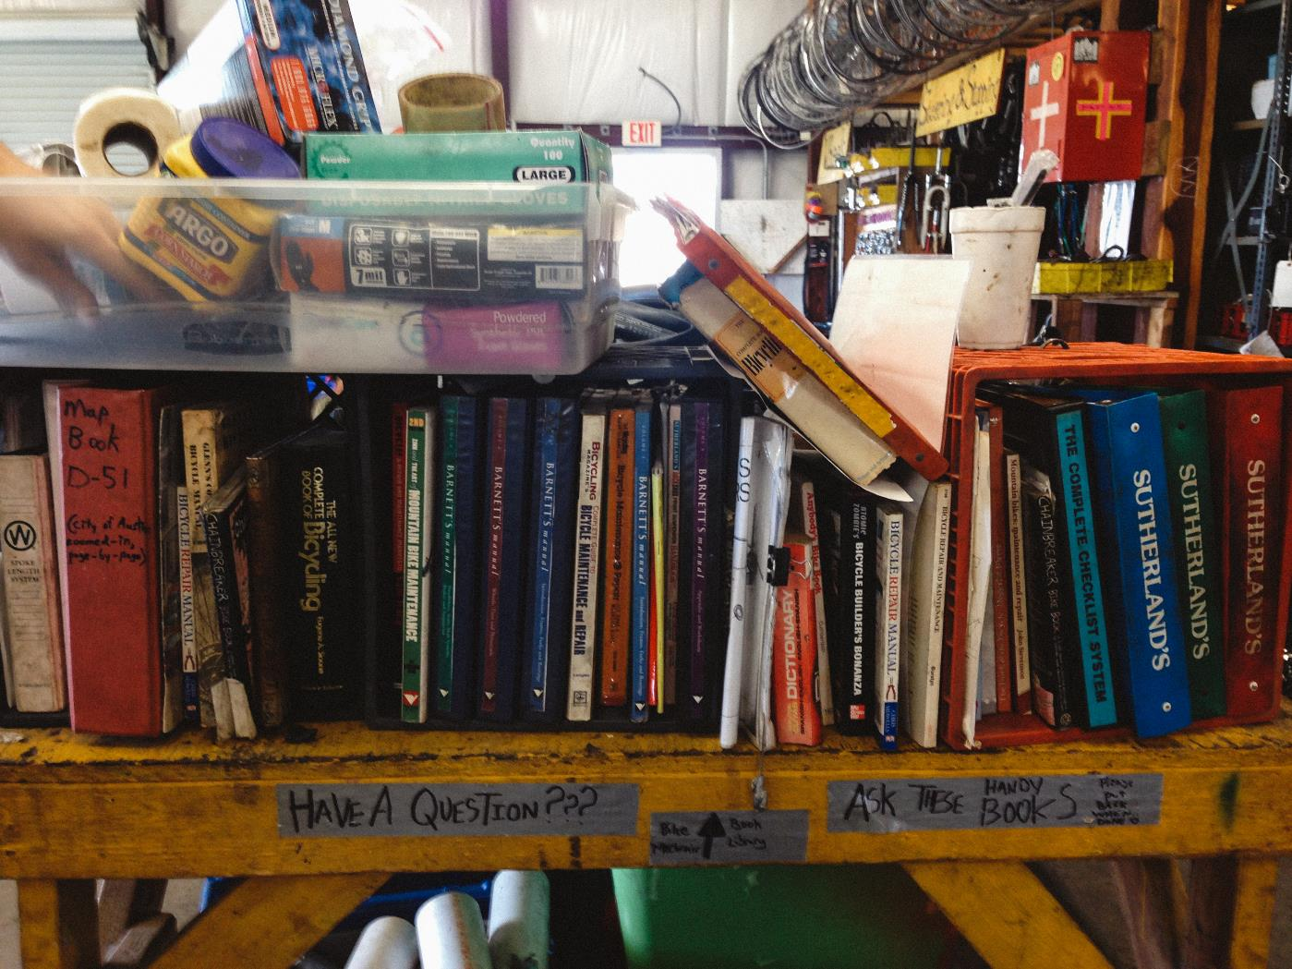

Slide 26
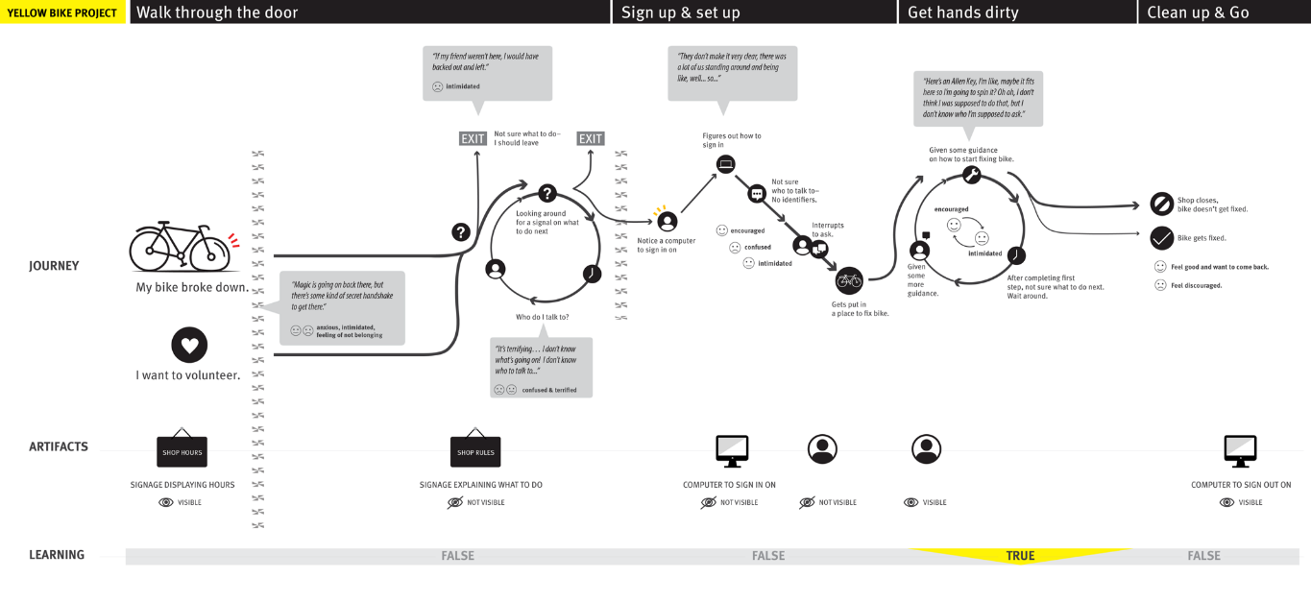
How it actually works…
When used with a perceived state, the juxtaposition with the actual state gives a clear direction to areas of improvement.

Slide 27
Customer Journey Maps represent…
Perception
Based on the thoughts of those who have knowledge of the system.
(usually stakeholders)

Slide 28
Customer Journey Maps represent…
Perception
Reality
Based on the thoughts of those who have knowledge of the system.
(usually stakeholders)
Based on personal experience & or field research. Using data from people who are using the system.

Slide 29
Customer Journey Maps represent…
Perception
Reality
Ideal
Based on the thoughts of those who have knowledge of the system.
(usually stakeholders)
Based on personal experience & or field research. Using data from people who are using the system.
A vision for what the system should be.
Most effective when based on inspiration from the way the actual system works.

Slide 30
Our focus for today…
Ideal
A vision for what the system should be.
Most effective when based on inspiration from the way the actual system works.

Slide 31
Create a timeline.

Slide 32
Add utterances and observations, in time.
MD01
I'm addicted to technology. I'm on it 24/7. I try not to be on it during social situations, with like family, because I think it's rude. I know that teenagers have that stereotype of being so addicted, and I am, but I don't like to be the typical on facebook on the time, not being able to communicate in person.
MD08
I think getting an A or a B - keeping on the deans list - having above a 3. something - I have a 3.6 right now and If I fail this class [calc] it will all be for nothing. It will make my GPA plummet. I'm working so hard and I’m not getting good results. It makes me feel not good about myself.
MD02
I'm a teenager, but I can be an adult if I need to. Teenagers don't get listened to that often - they only care about their social life and what not, but I know when to put social life away. [an adult] means knowing when to disengage from the social stuff like drama, it's not going to consume my whole day.
O14
Drives to Yellow Bike
MD09
I do my homework in the student learning center at the library. I also go to my prof office hours and stuff. I tell them I'm working hard, but sometimes it doesn't click for me
O56
Signs in
O109
Gets a bike to work on
MD06
I haven't discovered what I'm passionate about. It's disappointing. I've discovered the things that I'm not passionate about, so I guess that is good. Next semester I'm taking my first marketing course, so I hope that ends up well.
MD03
It's sad that social life is all about technology. I like to try and communicate without it - so I don't end up like those people who cant communicate in person. I guess I learned a lot of that from my mom because she points that out to me.
O24
Enters
MD44
If I don’t get good grades, I’m not sure how I would get a good job. Here, look at my transcript, see that B-? It’s terrible..
O102
Finally gets help
O12
Is looking for something to do on the weekend
O114
Continues working
MD05
When I was first looking up what I wanted to do [before switching to business] I was searching careers in business. I searched administrative assistant and stuff - my mom talked about that - she said there is so many job for this. I wanted to see what other jobs were out there; how much they make and how in demand they are.
O114
Works unattended
MD04
My parents are paying for all of my school. I don't have any financial aid or anything. I applied for some scholarships, but I didn't get any of those. I also applied for the Texas state general application but I didn't get any of that either. I feel guilty about that a lot of times.
MD35
This is my assignment pad, I use it for keeping track of homework. Like, this is what I have to do for tomorrow (shows) but I haven’t started any of it yet.
MD07
I'll get an internship somewhere after picking my major. That happens sometime next year.
O19
Parks
O54
Asks someone what to do
MD22
The school sometimes sends me a bill like this, but I don’t usually open it, I just send it to my parents…
MD47
Yea, it’s hard, because there’s so much pressure on you. I mean, like, it’s just pressure all the time, and everyone else seems like they have it figured out…

Slide 33
Define major journey sections.
Yellow Bike Project
Enters
Signs In
Gets Set up
Begins Working
Finishes
Leaves
MD01
I'm addicted to technology. I'm on it 24/7. I try not to be on it during social situations, with like family, because I think it's rude. I know that teenagers have that stereotype of being so addicted, and I am, but I don't like to be the typical on facebook on the time, not being able to communicate in person.
MD08
I think getting an A or a B - keeping on the deans list - having above a 3. something - I have a 3.6 right now and If I fail this class [calc] it will all be for nothing. It will make my GPA plummet. I'm working so hard and I’m not getting good results. It makes me feel not good about myself.
MD02
I'm a teenager, but I can be an adult if I need to. Teenagers don't get listened to that often - they only care about their social life and what not, but I know when to put social life away. [an adult] means knowing when to disengage from the social stuff like drama, it's not going to consume my whole day.
O14
Drives to Yellow Bike
MD09
I do my homework in the student learning center at the library. I also go to my prof office hours and stuff. I tell them I'm working hard, but sometimes it doesn't click for me
O56
Signs in
O109
Gets a bike to work on
MD06
I haven't discovered what I'm passionate about. It's disappointing. I've discovered the things that I'm not passionate about, so I guess that is good. Next semester I'm taking my first marketing course, so I hope that ends up well.
MD03
It's sad that social life is all about technology. I like to try and communicate without it - so I don't end up like those people who cant communicate in person. I guess I learned a lot of that from my mom because she points that out to me.
O24
Enters
MD44
If I don’t get good grades, I’m not sure how I would get a good job. Here, look at my transcript, see that B-? It’s terrible..
O102
Finally gets help
O12
Is looking for something to do on the weekend
O114
Continues working
MD05
When I was first looking up what I wanted to do [before switching to business] I was searching careers in business. I searched administrative assistant and stuff - my mom talked about that - she said there is so many job for this. I wanted to see what other jobs were out there; how much they make and how in demand they are.
O114
Works unattended
MD04
My parents are paying for all of my school. I don't have any financial aid or anything. I applied for some scholarships, but I didn't get any of those. I also applied for the Texas state general application but I didn't get any of that either. I feel guilty about that a lot of times.
MD35
This is my assignment pad, I use it for keeping track of homework. Like, this is what I have to do for tomorrow (shows) but I haven’t started any of it yet.
MD07
I'll get an internship somewhere after picking my major. That happens sometime next year.
O19
Parks
O54
Asks someone what to do
MD22
The school sometimes sends me a bill like this, but I don’t usually open it, I just send it to my parents…
MD47
Yea, it’s hard, because there’s so much pressure on you. I mean, like, it’s just pressure all the time, and everyone else seems like they have it figured out…

Slide 34
Identify areas that your value promise breaks down.
!
!
!
!
Yellow Bike Project
Enters
Signs In
Gets Set up
Begins Working
Finishes
Leaves
MD01
I'm addicted to technology. I'm on it 24/7. I try not to be on it during social situations, with like family, because I think it's rude. I know that teenagers have that stereotype of being so addicted, and I am, but I don't like to be the typical on facebook on the time, not being able to communicate in person.
MD08
I think getting an A or a B - keeping on the deans list - having above a 3. something - I have a 3.6 right now and If I fail this class [calc] it will all be for nothing. It will make my GPA plummet. I'm working so hard and I’m not getting good results. It makes me feel not good about myself.
MD02
I'm a teenager, but I can be an adult if I need to. Teenagers don't get listened to that often - they only care about their social life and what not, but I know when to put social life away. [an adult] means knowing when to disengage from the social stuff like drama, it's not going to consume my whole day.
O14
Drives to Yellow Bike
MD09
I do my homework in the student learning center at the library. I also go to my prof office hours and stuff. I tell them I'm working hard, but sometimes it doesn't click for me
O56
Signs in
O109
Gets a bike to work on
MD06
I haven't discovered what I'm passionate about. It's disappointing. I've discovered the things that I'm not passionate about, so I guess that is good. Next semester I'm taking my first marketing course, so I hope that ends up well.
MD03
It's sad that social life is all about technology. I like to try and communicate without it - so I don't end up like those people who cant communicate in person. I guess I learned a lot of that from my mom because she points that out to me.
O24
Enters
MD44
If I don’t get good grades, I’m not sure how I would get a good job. Here, look at my transcript, see that B-? It’s terrible..
O102
Finally gets help
O12
Is looking for something to do on the weekend
!
O114
Continues working
MD05
When I was first looking up what I wanted to do [before switching to business] I was searching careers in business. I searched administrative assistant and stuff - my mom talked about that - she said there is so many job for this. I wanted to see what other jobs were out there; how much they make and how in demand they are.
O114
Works unattended
MD04
My parents are paying for all of my school. I don't have any financial aid or anything. I applied for some scholarships, but I didn't get any of those. I also applied for the Texas state general application but I didn't get any of that either. I feel guilty about that a lot of times.
MD35
This is my assignment pad, I use it for keeping track of homework. Like, this is what I have to do for tomorrow (shows) but I haven’t started any of it yet.
MD07
I'll get an internship somewhere after picking my major. That happens sometime next year.
O19
Parks
O54
Asks someone what to do
MD22
The school sometimes sends me a bill like this, but I don’t usually open it, I just send it to my parents…
MD47
Yea, it’s hard, because there’s so much pressure on you. I mean, like, it’s just pressure all the time, and everyone else seems like they have it figured out…

Slide 35
Fix it, based on your value promise.
!
!
!
!
Yellow Bike Project
Enters
Signs In
Gets Set up
Begins Working
Finishes
Leaves
MD01
I'm addicted to technology. I'm on it 24/7. I try not to be on it during social situations, with like family, because I think it's rude. I know that teenagers have that stereotype of being so addicted, and I am, but I don't like to be the typical on facebook on the time, not being able to communicate in person.
MD08
I think getting an A or a B - keeping on the deans list - having above a 3. something - I have a 3.6 right now and If I fail this class [calc] it will all be for nothing. It will make my GPA plummet. I'm working so hard and I’m not getting good results. It makes me feel not good about myself.
MD02
I'm a teenager, but I can be an adult if I need to. Teenagers don't get listened to that often - they only care about their social life and what not, but I know when to put social life away. [an adult] means knowing when to disengage from the social stuff like drama, it's not going to consume my whole day.
O14
Drives to Yellow Bike
MD09
I do my homework in the student learning center at the library. I also go to my prof office hours and stuff. I tell them I'm working hard, but sometimes it doesn't click for me
O56
Signs in
O109
Gets a bike to work on
MD06
I haven't discovered what I'm passionate about. It's disappointing. I've discovered the things that I'm not passionate about, so I guess that is good. Next semester I'm taking my first marketing course, so I hope that ends up well.
MD03
It's sad that social life is all about technology. I like to try and communicate without it - so I don't end up like those people who cant communicate in person. I guess I learned a lot of that from my mom because she points that out to me.
O24
Enters
MD44
If I don’t get good grades, I’m not sure how I would get a good job. Here, look at my transcript, see that B-? It’s terrible..
O102
Finally gets help
O12
Is looking for something to do on the weekend
!
O114
Continues working
MD05
When I was first looking up what I wanted to do [before switching to business] I was searching careers in business. I searched administrative assistant and stuff - my mom talked about that - she said there is so many job for this. I wanted to see what other jobs were out there; how much they make and how in demand they are.
O114
Works unattended
MD04
My parents are paying for all of my school. I don't have any financial aid or anything. I applied for some scholarships, but I didn't get any of those. I also applied for the Texas state general application but I didn't get any of that either. I feel guilty about that a lot of times.
MD35
This is my assignment pad, I use it for keeping track of homework. Like, this is what I have to do for tomorrow (shows) but I haven’t started any of it yet.
MD07
I'll get an internship somewhere after picking my major. That happens sometime next year.
O19
Parks
O54
Asks someone what to do
MD22
The school sometimes sends me a bill like this, but I don’t usually open it, I just send it to my parents…
MD47
Yea, it’s hard, because there’s so much pressure on you. I mean, like, it’s just pressure all the time, and everyone else seems like they have it figured out…
Keep asking: how does this relate to my data, and fulfill my value promise?

Slide 36
Enhance the visualization

