Slide 1
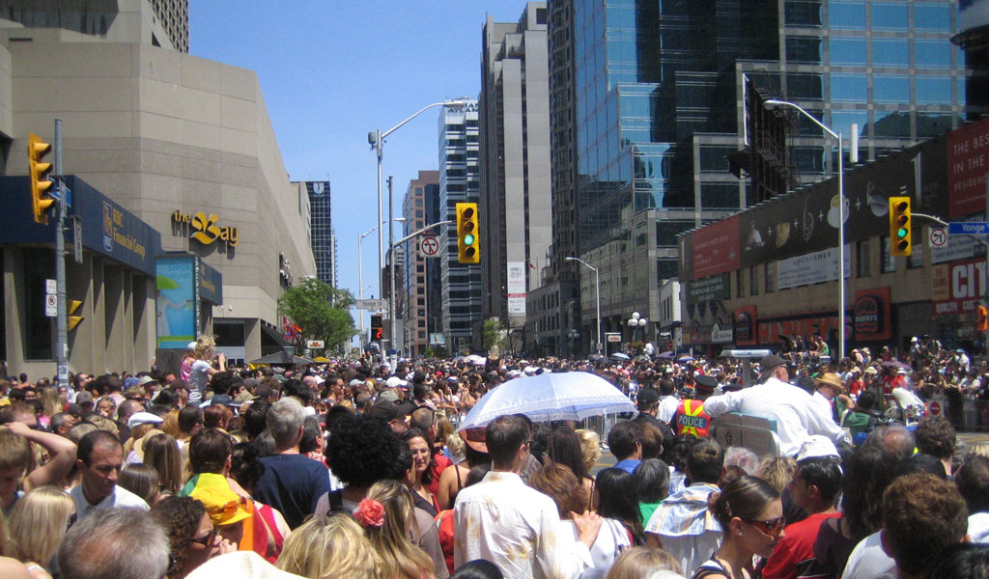
Ethnographic Design Research
Professor Jon Kolko

Slide 2
Our Design Process
Ethnography
Synthesis
Prototyping

Slide 3
Our Design Process
Ethnography
Synthesis
Prototyping
Immersion in the cultural context of a wicked problem
Making meaning through inference and reframing
Hypothesis validation through generative, form-giving activities

Slide 4
Zooming In…
Research
Transcription
Utterances
Patterns & Anomalies
Interpretation
Insights
Principles
Value Promise
Stories
Ethnography
Synthesis
Prototyping
Immersion in the cultural context of a wicked problem
Making meaning through inference and reframing
Hypothesis validation through generative, form-giving activities

Slide 5
Zooming In…
Research
Transcription
Utterances
Patterns & Anomalies
Interpretation
Insights
Principles
Value Promise
Stories
Ethnography
Synthesis
Prototyping
Immersion in the cultural context of a wicked problem
Making meaning through inference and reframing
Hypothesis validation through generative, form-giving activities

Slide 6
Ethnography
Research
Transcription
Utterances
Patterns & Anomalies
Interpretation
Insights
Principles
Value Promise
Stories
A qualitative description of the human social condition, based on fieldwork and observation.

Slide 7
Ethnography
Research
Transcription
Utterances
Patterns & Anomalies
Interpretation
Insights
Principles
Value Promise
Stories
A qualitative description of the human social condition, based on fieldwork and observation.
Watch people do things.

Slide 8
Ethnography
Research
Transcription
Utterances
Patterns & Anomalies
Interpretation
Insights
Principles
Value Promise
Stories
Our goal:
To build empathy and understanding.

Slide 9
Ethnography
Research
Transcription
Utterances
Patterns & Anomalies
Interpretation
Insights
Principles
Value Promise
Stories
Design research | Market research
Focuses on people. | Focuses on people.
Can be qualitative or quantitative. | Can be qualitative or quantitative.
Borrows from the social and behavioral sciences. | Borrows from the social and behavioral sciences.
Attempts to understand culture. Looks at the styles, words, tools, and workarounds people use, in an effort to inspire design. | Attempts to predict behavior. Looks at what people say they would do, or what they actually do, in an effort to predict what they would do in a new situation.
Celebrates the unique and peculiar. The rare or obscure in observations can lead to a new or interesting design idea. | Avoids the unique and peculiar. The goal is to understand mass responses; outliers are frequently ignored.
Avoiding bias is nearly irrelevant. The goal is not to be objective, but instead to be rigorous. | Avoiding bias is critical. The statistical analyses of data require an objective point of view.
Goal: Build Empathy | Goal: Build Understanding

Slide 10
Ethnography
Research
Transcription
Utterances
Patterns & Anomalies
Interpretation
Insights
Principles
Value Promise
Stories
The key to the whole thing:
Watch real behavior.

Slide 11
Ethnography: Our Method
Research
Transcription
Utterances
Patterns & Anomalies
Interpretation
Insights
Principles
Value Promise
Stories
Context
Go to the place where work is done.
Partnership
Build a master/apprentice relationship with the people you are serving.
Focus
Observe without an agenda – instead, select a focus.

Slide 12
Ethnography: Our Method
Research
Transcription
Utterances
Patterns & Anomalies
Interpretation
Insights
Principles
Value Promise
Stories
Context
“Being in context” means going to the place where the work is being done and watching it happen in real time.
Watching these things:
Their physical work space
Their work – tasks, sequences, intentions
Their language
Their tools
Their organizational structures and culture

Slide 13
Ethnography: Our Method
Research
Transcription
Utterances
Patterns & Anomalies
Interpretation
Insights
Principles
Value Promise
Stories
Partnership
A master/apprentice relationship: you are the apprentice. A humble mindset.
Let the user lead the conversation
Use open-ended questions, like “What are you doing?” or “Why are you doing that?”
Ask to try things
Downplay recording technology, like cameras

Slide 14
Ethnography: Our Method
Research
Transcription
Utterances
Patterns & Anomalies
Interpretation
Insights
Principles
Value Promise
Stories
Focus
An active perspective that guides a research trajectory, not agenda.
Embrace the ambiguity of a non-objective goal
Articulate your trajectory in a single sentence
Ability and willingness to quickly pivot and respond to a situation

Slide 15
Planning Ethnography
Research
Transcription
Utterances
Patterns & Anomalies
Interpretation
Insights
Principles
Value Promise
Stories
Create a preliminary focus statement
Determine what space you will focus on
Start broad, thinking about large concepts (food, nutrition, banking, etc)
Don’t assume a problem
Recognize that focus is a starting place, not an ending place
Your initial focus doesn’t matter that much, because wicked problems are so tangled together.

Slide 16
Planning Ethnography
Research
Transcription
Utterances
Patterns & Anomalies
Interpretation
Insights
Principles
Value Promise
Stories
Create a preliminary focus statement
We are conducting research into nutritional habits, hoping to feel what it’s like to try to lose weight.
We are conducting research into inner-city crime, hoping to feel what it’s like to raise children in a neighborhood that may be thought of as “unsafe.”
We are conducting research with college students, hoping to feel what it’s like to experience debt in the context of the community college academic journey.

Slide 17
Planning Ethnography
Research
Transcription
Utterances
Patterns & Anomalies
Interpretation
Insights
Principles
Value Promise
Stories
Identify participants
Identify the people who are closest to the circumstances you are exploring. What experiences will help you gain empathy, quickly?
Be as specific as possible – this is not a demographic/segmentation exercise. There is no person who is “25-35 years old.”
The people you are targeting may not want to talk to you. Who would be a next-best proxy?

Slide 18
Planning Ethnography
Research
Transcription
Utterances
Patterns & Anomalies
Interpretation
Insights
Principles
Value Promise
Stories
Identify participants
We are conducting research with college students, hoping to feel what it’s like to experience debt in the context of the community college academic journey.
We hope to spend time with sophomores and juniors at local community colleges.
We will work with both declared and undeclared students.
We will work with students who have large amounts of college debt.
We will work with students who have transferred from one program to anther, and students who have experienced a 5+ gap in their education.

Slide 19
Planning Ethnography
Research
Transcription
Utterances
Patterns & Anomalies
Interpretation
Insights
Principles
Value Promise
Stories
Identify context
Based on your focus and your participant description, identify where you will go in order to watch real behavior.
Be as specific as possible.
Consider that some contexts are dangerous, require permission, or are logistically too complicated to visit. What are next-best solutions?

Slide 20
Planning Ethnography
Research
Transcription
Utterances
Patterns & Anomalies
Interpretation
Insights
Principles
Value Promise
Stories
Identify context
We are conducting research with college students, hoping to feel what it’s like to experience debt in the context of the community college academic journey.
We hope to spend time with sophomores and juniors at local community colleges.
We will work with both declared and undeclared students.
We will work with students who have large amounts of college debt.
We will work with students who have transferred from one program to anther, and students who have experienced a 5+ gap in their education.
We will visit students who live on campus at UDC Community College, in their dorm rooms. We will also attend their classes with them.

Slide 21
Planning Ethnography
Research
Transcription
Utterances
Patterns & Anomalies
Interpretation
Insights
Principles
Value Promise
Stories
Draft a plan.
Create a plan for your research, and recognize up front that this plan will go sideways very quickly. It’s intended as a framing guide, not requirements for execution.
Write a verbose introduction that explains who you are, what you are doing, and what you hope to achieve.
Spend a lot of time considering how you will move from “question-answer” to watching behavior.
Craft open-ended questions related to your focus, context, and participants.
Write a research plan that describes what you will do, who you will do it with, where it will be done, and why you will do it.

Slide 22
Planning Ethnography
Research
Transcription
Utterances
Patterns & Anomalies
Interpretation
Insights
Principles
Value Promise
Stories
Role-play the research experience.
In your groups, pretend that one of you is the research participant, while the rest of you are the research team. Walk through the entire research plan.

Slide 23
Conducting Ethnography
Research
Transcription
Utterances
Patterns & Anomalies
Interpretation
Insights
Principles
Value Promise
Stories
Getting Organized
You can never be overly prepared.
Organize your equipment:
Video/audio recording
Tapes/memory cards
Batteries (and backup batteries)
Pens/paper
Digital camera
Print your script:
Your introduction
Questions you can use to initiate behavior
Consent form

Slide 24
Conducting Ethnography
Research
Transcription
Utterances
Patterns & Anomalies
Interpretation
Insights
Principles
Value Promise
Stories
Informed Consent
Like a scientific study, we need to inform participants of the research protocol. This will protect both you and the participant, but more importantly, creates an ethical boundary around your research.
An informed consent form should:
Explains any compensation that will occur
Explains the scope of the study
Explains how the results of the study will be used
Explains exactly how the individuals name, image, company, and words will be used
Explain that the participant can quit at any time

Slide 25
Conducting Ethnography
Research
Transcription
Utterances
Patterns & Anomalies
Interpretation
Insights
Principles
Value Promise
Stories
Roles & Responsibilities
Behavioral research works best with two people (a facilitator and a photographer). You can conduct research with three people (a facilitator, a photographer, and a note-taker), but more than three people is intimidating to the participant.
The facilitator runs the session, and manages the recording device.
The photographer captures any details related to people, artifacts, or the environment.
The note-taker captures key verbatims.

Slide 26
Conducting Ethnography
Research
Transcription
Utterances
Patterns & Anomalies
Interpretation
Insights
Principles
Value Promise
Stories
Roles & Responsibilities: Facilitator
As the facilitator, it is your responsibility to establish and maintain a master/apprentice relationship, where the participant trusts you and knows you are there to learn from them.
Make initial eye contact, but purposefully defer to set the participant at ease
Be conversational, but not chatty.
Ask 1 question at a time.
Be patient; count to 5.
Ask open-ended questions.
Ask “why,” even if you know the answer.
Never correct or contradict the participant.

Slide 27
Conducting Ethnography
Research
Transcription
Utterances
Patterns & Anomalies
Interpretation
Insights
Principles
Value Promise
Stories
Roles & Responsibilities: Note-taker
Write verbatim quotes from the participant.
You won’t be able to capture everything, so focus on specific quotes that the participant says.
Make sure you can read your own handwriting.

Slide 28
Conducting Ethnography
Research
Transcription
Utterances
Patterns & Anomalies
Interpretation
Insights
Principles
Value Promise
Stories
Roles & Responsibilities: Photographer
As the photographer, you are looking to capture the stories you hear and see in context. Visually document everything.
Know your equipment.
Makes sure everything is prepared ahead of time (batteries charged, settings, free space, etc).
Shoot from the hip; get out of their face.
Turn camera noises off.
Take portraits, with permission.
Over-shoot. Shoot literally everything.
Back-up every day.

Slide 29
Conducting Ethnography
Research
Transcription
Utterances
Patterns & Anomalies
Interpretation
Insights
Principles
Value Promise
Stories
Tips for Engaging with People
When you approach someone, have a plan for what you will do and say. Consider the difference in these approaches:
“Hi. I’m researching college debt. Can you spare some time to talk to me?”
“Hi, my name is Jon. I’m really interested in learning more about how people manage college debt. Got some time to talk to me?”
“Hi, I’m a student and I’m trying to learn as much as possible about college debt. I was hoping to learn a little about how you are paying for college.”
“Hey, can I talk to you about something?”

Slide 30
Remember…
Research
Transcription
Utterances
Patterns & Anomalies
Interpretation
Insights
Principles
Value Promise
Stories
It’s not an Interview!
It’s going to be really, really, really, really tempting to revert to a question/answer form of intervention. Try as hard as you can to watch real behavior:
Ask to see an example
Ask to see artifacts and tools
Ask to try it yourself
Ask to hear about the steps or flow of an activity (“Can you walk me through that step by step?”)

Slide 31
Zooming In…
Research
Transcription
Utterances
Patterns & Anomalies
Interpretation
Insights
Principles
Value Promise
Stories
Ethnography
Synthesis
Prototyping
Immersion in the cultural context of a wicked problem
Making meaning through inference and reframing
Hypothesis validation through generative, form-giving activities

Slide 32
High-Level Per-Person Themes
Research
Transcription
Utterances
Patterns & Anomalies
Interpretation
Insights
Principles
Value Promise
Stories
Representations of Your Participants
Once you get back from research, but before you’ve fully transcribed your data:
Identify the top 3-4 key takeaways from each participant, and write them down
Re-write the key quotes from your note-taker to make sure they are large and legible
Create a per-person theme wall to visualize these written items in the context of the participant

Slide 33
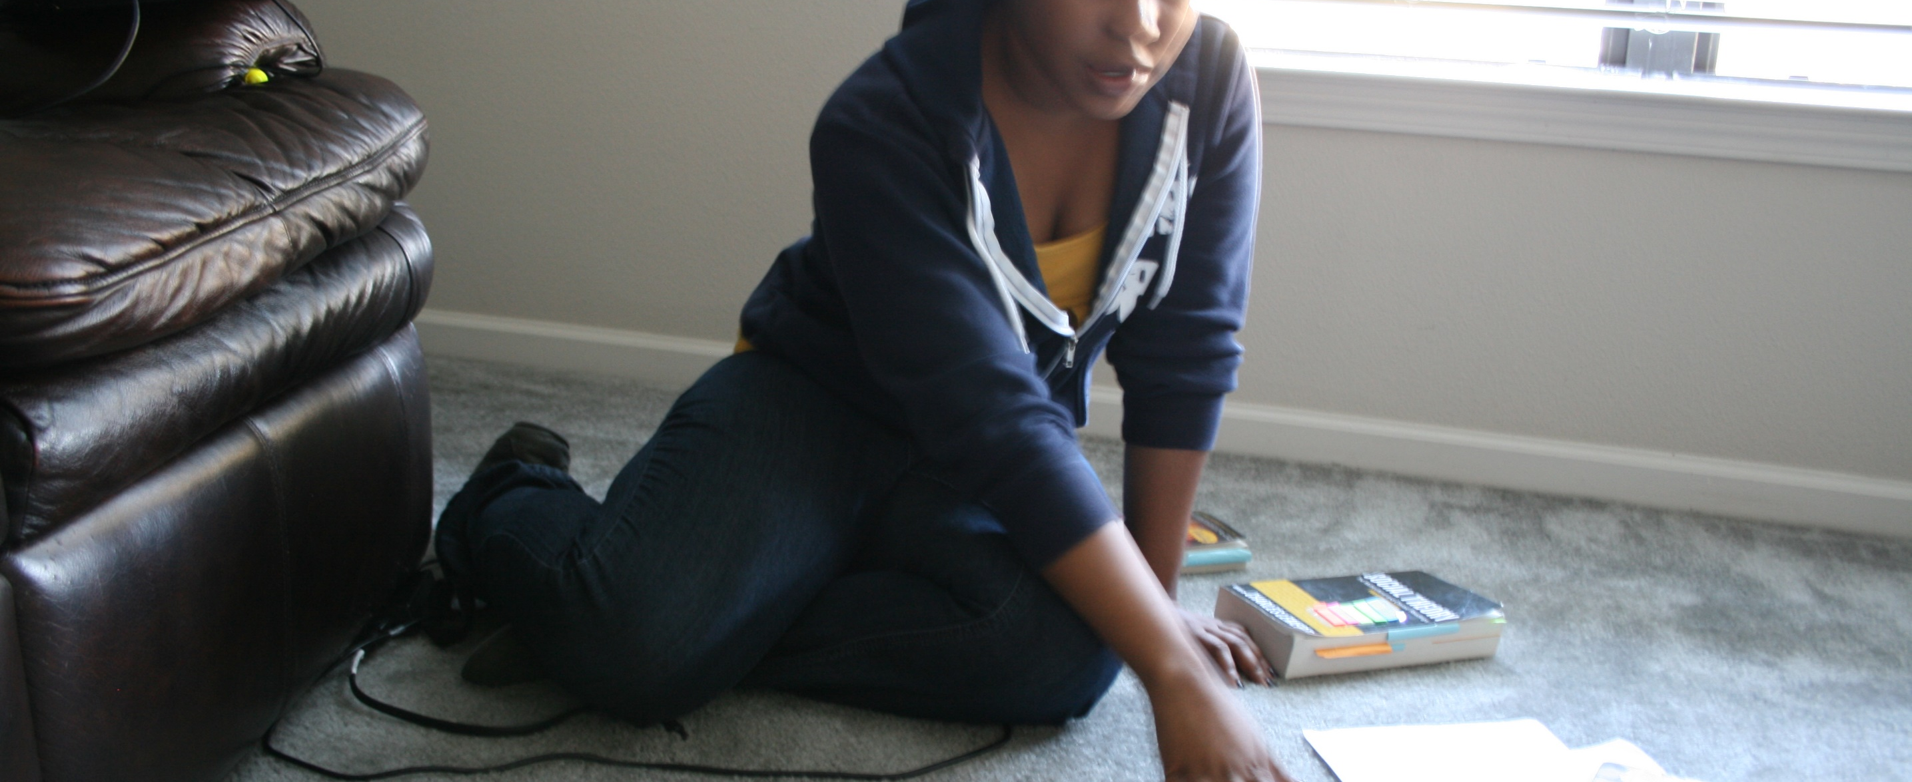
Marissa
Purchases a lot of electronics – seems strange, given her financial situation
“College feels like a maze. I don’t know where I’m at in it.”
“I didn’t even want to do MechE; I wanted to do biomedical engineering. When I got to UTSA, it wasn’t available. So I randomly picked mechanical engineering because I had a lot of mechanical engineering friends.”
Thinks she is the only one really suffering from debt, the only one who made poor financial decisions
Seems overly self-critical of her debt

Slide 34
Full Transcription
Research
Transcription
Utterances
Patterns & Anomalies
Interpretation
Insights
Principles
Value Promise
Stories
A 1:1 Representation of Your Research
As soon as possible, transcribe the entire session.
Expect a transcription to take four or five times as long as the session
Don’t outsource or intern this step!
Your goal is empathy; hearing the person’s voice over and over helps build an implicit relationship with them
We’ll use this data through the rest of the process, so don’t skip this step!

Slide 35
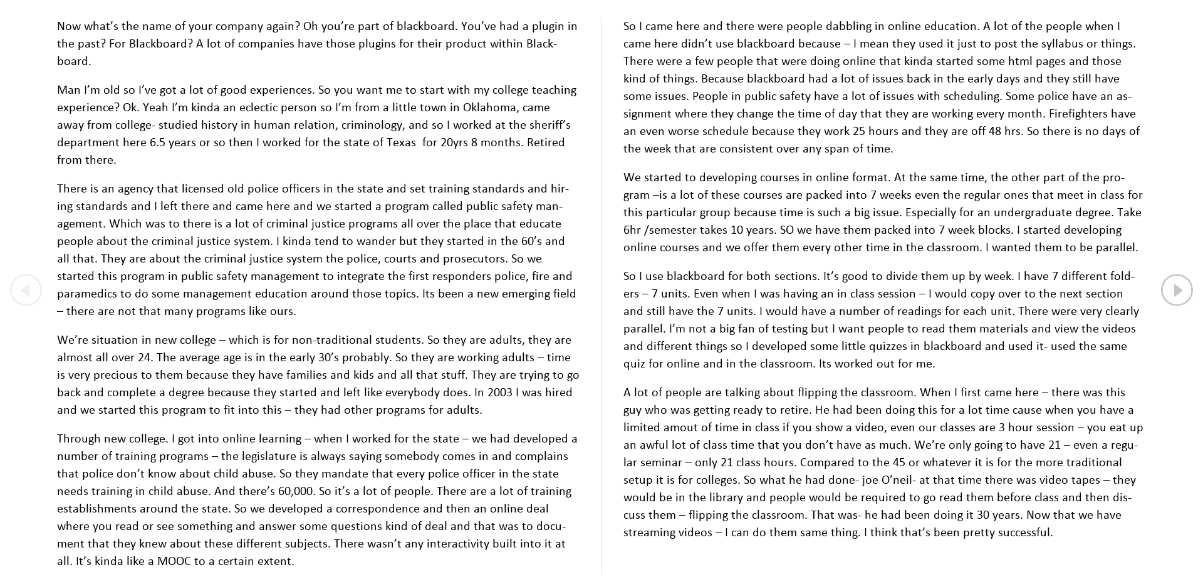
Full Transcription
Research
Transcription
Utterances
Patterns & Anomalies
Interpretation
Insights
Principles
Value Promise
Stories

Slide 36
Exploded Transcription
Research
Transcription
Utterances
Patterns & Anomalies
Interpretation
Insights
Principles
Value Promise
Stories
To a Malleable Format
Extract individual utterances from your transcript.
We’ll use the utterances to build diagrammatic representations of the data.
Use “mail merge”:
Put your written transcript in Excel
Add a column with an individual identifier per utterance
Mail merge to mailing labels

Slide 37
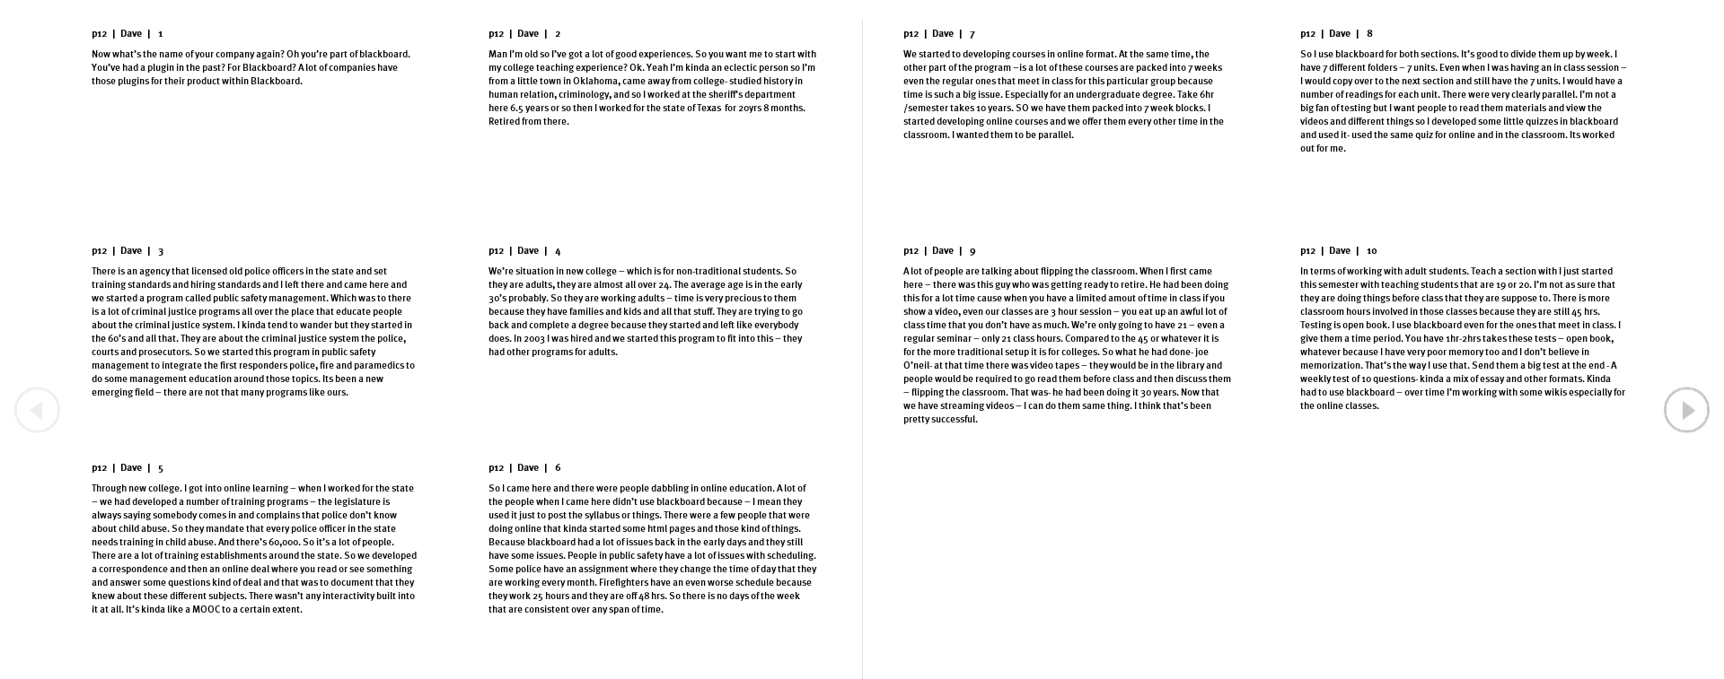
Full Transcription
Research
Transcription
Utterances
Patterns & Anomalies
Interpretation
Insights
Principles
Value Promise
Stories

