Slide 1
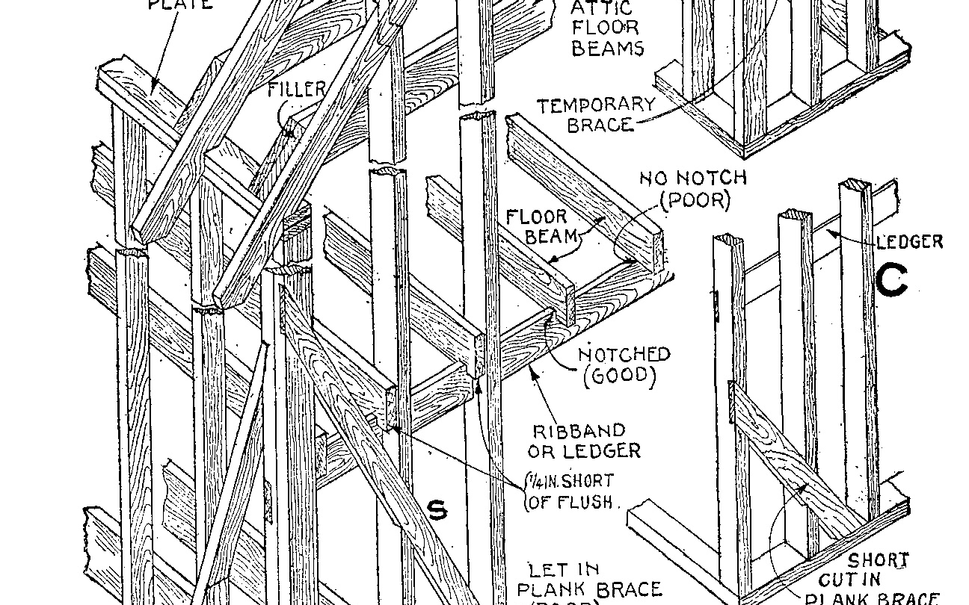
Product Design: Wireframes
Professor Jon Kolko

Slide 2
Prototyping
Research
Transcription
Utterances
Patterns & Anomalies
Interpretation
Insights
Principles
Value
Promise
Stories
Ethnography
Synthesis
Prototyping
Immersion in the cultural context of a wicked problem
Making meaning through inference and reframing
Hypothesis validation through generative, form-giving activities

Slide 3
Wireframing
A process of increasing fidelity
Wireframing is about creating a visual representation of a user-interface, abstracted to show behavior and controls instead of color or emotion.
A good set of wireframes:
Advances the fidelity of an idea
Stands on its own, without explanation
Describes every control
Uses actual content, not “filler” or “placeholder” content
Uses space in a realistic manner

Slide 4
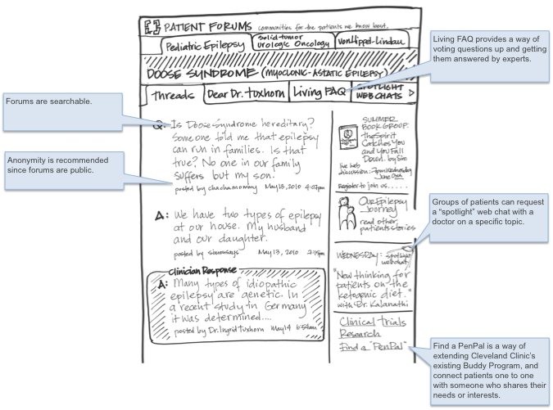

Slide 7
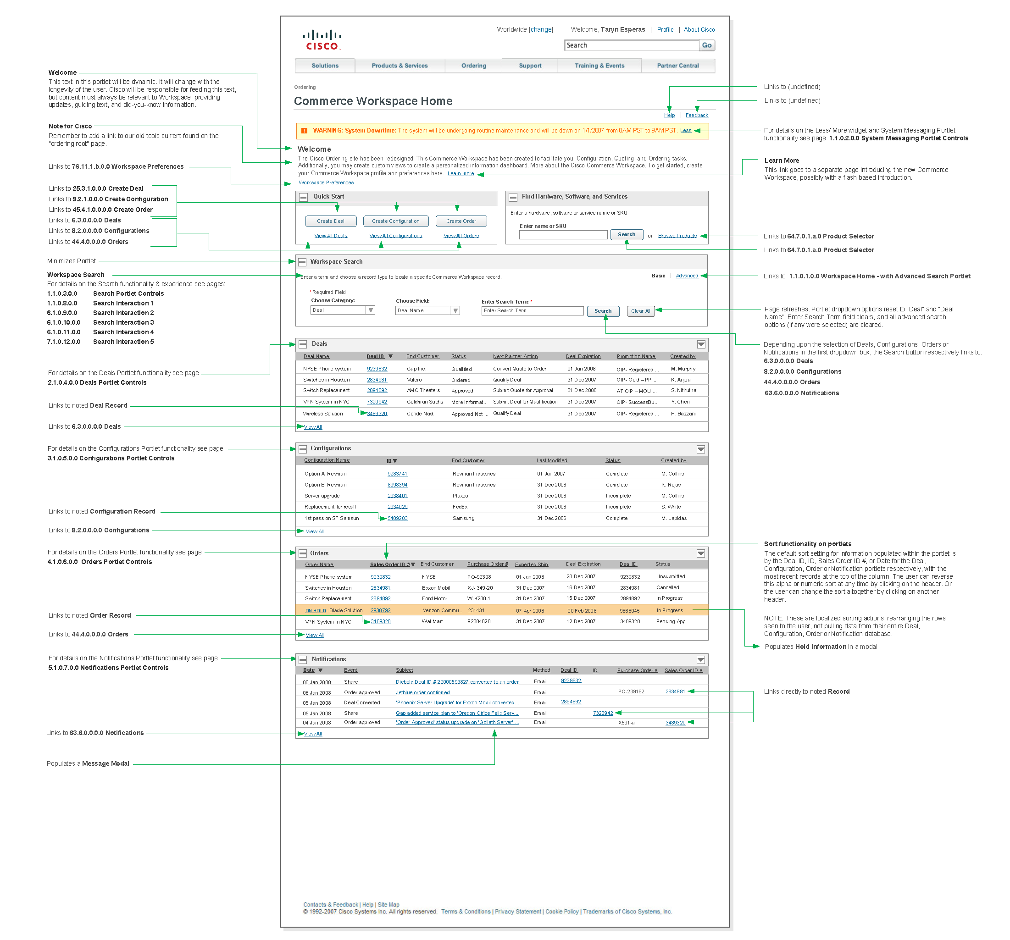

Slide 10
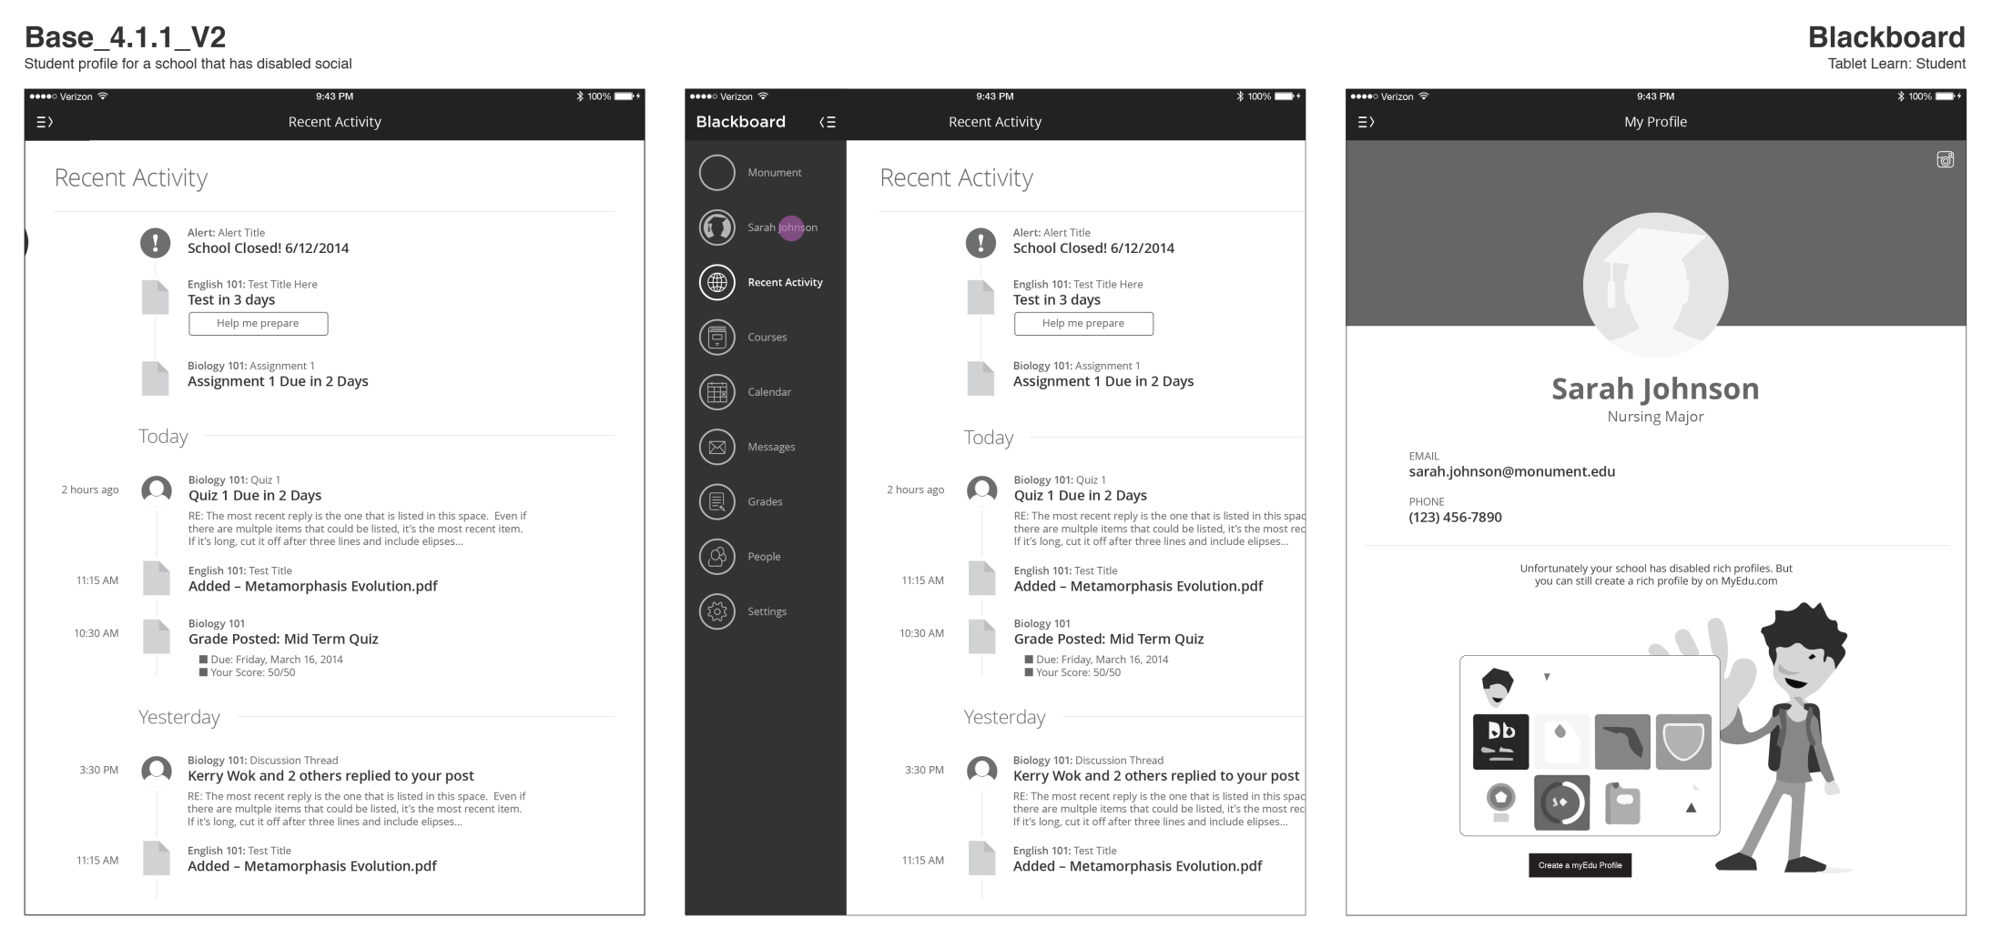

Slide 11
Creating Wireframes
Start with your scenarios.
Using the written scenarios, storyboards, and visualized vignettes as a starting point, sketch a loose wireframe for each screen the user will encounter. Acknowledge that this is a scrap copy and will be thrown away.
Consider elements that show up on every page (navigation, framing devices) as anchors for understanding, and make sure that the user can understand where they are, where they’ve been, and where they’re going.

Slide 12
Creating Wireframes
Sketch the story again.
Redraw the entire flow, increasing your attention to detail. Make your lines crisper and stronger, and make sure things line up clearly.
As you redraw the flow, begin to notice paths that haven’t been clearly defined – buttons, links, or controls that “lead nowhere”. Make a list of these dead ends.

Slide 13
Creating Wireframes
Sketch the dead ends.
Draw the screens that don’t exist. This will force you to extend your scenario; at this point, you no longer need to conform to the story, as you are completing the designed system.

Slide 14
Creating Wireframes
Refactor the flow.
Look at the entire set of wireframes, arranged on the wall in front of you.
Are there elements that you didn’t account for on some screens, that became important on other screens?
Is the navigation consistent?
Will someone know what to do on each screen?
Can someone find their way back?
Redraw the entire set of wireframes, again.

