Slide 1
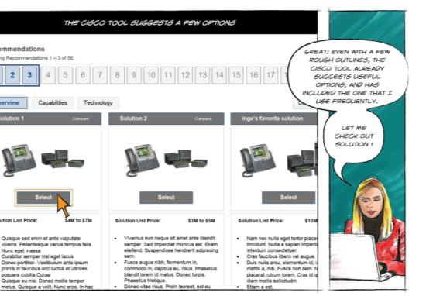
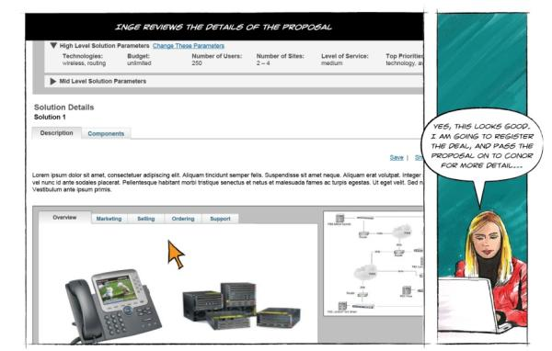
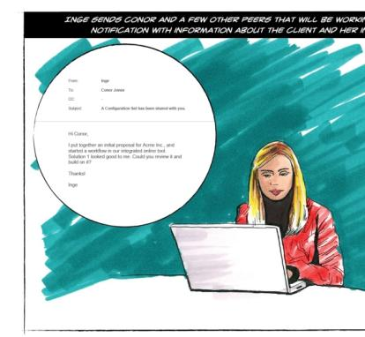
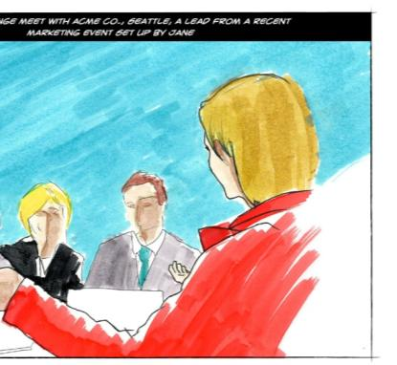
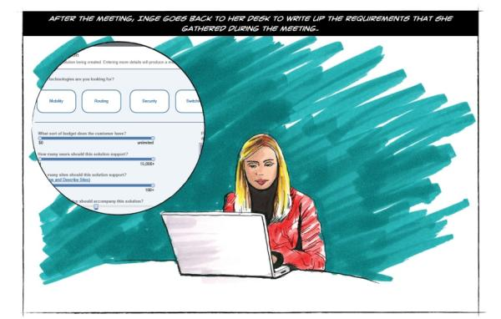
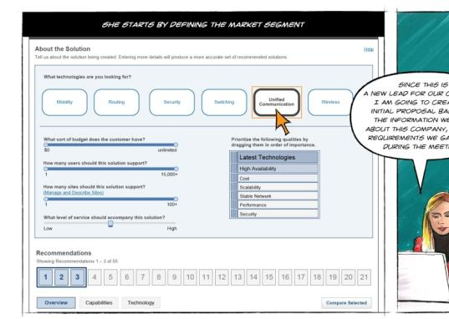
Scenarios, Storyboards, Wireframes, Critique
Jon Kolko Professor, Austin Center for Design

Slide 2
Scenarios
Creating a written story that explains how a person will use a product, service, or system to achieve a goal.
Notes:
2

Slide 3
Scenarios
Creating a written story that explains how a person will use a product, service, or system to achieve a goal.
A GOOD SCENARIO/
Acts as a bridge between an initial design idea or problem, and a solution
Advances the fidelity of an idea
Stands on its own, without explanation
Does not prescribe interface elements in any great detail
Includes a rich description of a person
Includes a rich description of a goal
Is credible
Notes:
3

Slide 4
Writing Scenarios
Identify the people involved.
What are their names?
Where do they work?
What level of technical experience do they have?
What level of technical competence can you assume with this system, specifically?
It’s often helpful to write a three or four sentence introduction to each person, describing their background and helping to humanize them.

Slide 5
Writing Scenarios
Identify the starting state/context
Where will the people using your system be, physically, when they encounter it?
What state is the actual product or service in when they first acknowledge it?

Slide 6
Writing Scenarios
List the goals a user may have, as they pertain to your product or service.
A goal is about a fundamental want, need, or desire that is presently unattained. Goals rarely change, even as technology progresses.
For example, when using a printer, my goal is not “to print” – it is “to communicate my intent to other people when I’m not there through a lasting artifact.”
List as many goals as you can think of.

Slide 7
Writing Scenarios
Prioritize the goals, based on your understanding of your users.
Stack rank the goals, putting them in order from “most important to achieve using this system or service” to “least important to achieve using this system or service.”

Slide 8
Writing Scenarios
Craft stories.
Using the people, context, and goals as a starting point, craft a narrative that explains how a person will use your system to achieve their goals. Don’t try to achieve all goals in a single epic story; instead, create multiple stories, one for each goal. Keep the conversation at a high, behavioral level, rather than a low, user interface level:
Good Fred grabs his phone. He opens the beer-finding app, and locates a beer nearby. He chooses to have it delivered, enters his payment information, and completes his order.
Not so good Fred grabs his phone. He tabs the beer-finding app. He taps the zipcode input box, and the onscreen keyboard appears. He taps the numbers for his zipcode, and then taps “find beer.” An hourglass appears on his screen, and after several seconds, search results begin showing up….

Slide 9
Scenarios – Recap
Creating a written story that explains how a person will use a product, service, or system to achieve a goal.
A GOOD SCENARIO/
Acts as a bridge between an initial design idea or problem, and a solution
Advances the fidelity of an idea
Stands on its own, without explanation
Does not prescribe interface elements in any great detail
Includes a rich description of a person
Includes a rich description of a goal
Is credible
WRITING SCENARIOS/
Identify the people involved.
Identify the starting state/context
List the goals a user may have, as they pertain to your product or service.
Prioritize the goals, based on your understanding of your users.
Craft stories.
Notes:
9

Slide 10
UI Storyboards
Sketching a comic-book style visualization of your written narrative, to illustrate scenes and screens.
Notes:
10

Slide 11
UI Storyboards
Sketching a comic-book style visualization of your written narrative, to illustrate scenes and screens.
A GOOD STORYBOARD/
Emphasizes screens over scenes
Advances the fidelity of an idea
Stands on its own, without explanation
Dedicates one panel to one idea, and uses panels generously
Notes:
11

Slide 12
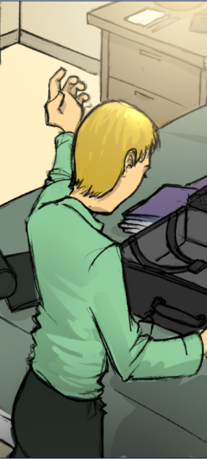
Melvin is packing for vacation; he’s going to Mardi Gras, where he’s planning on meeting some friends.
As they wander the streets, they keep bumping into new and interesting people – and because they have our software installed, they are able to both find new parties, and log the experiences they have easily and seamlessly.
When Melvin’s having a particularly interesting time at a party, he grabs his phone and points it at the crowd. A number of the people at the event start to crowd around..

Slide 13
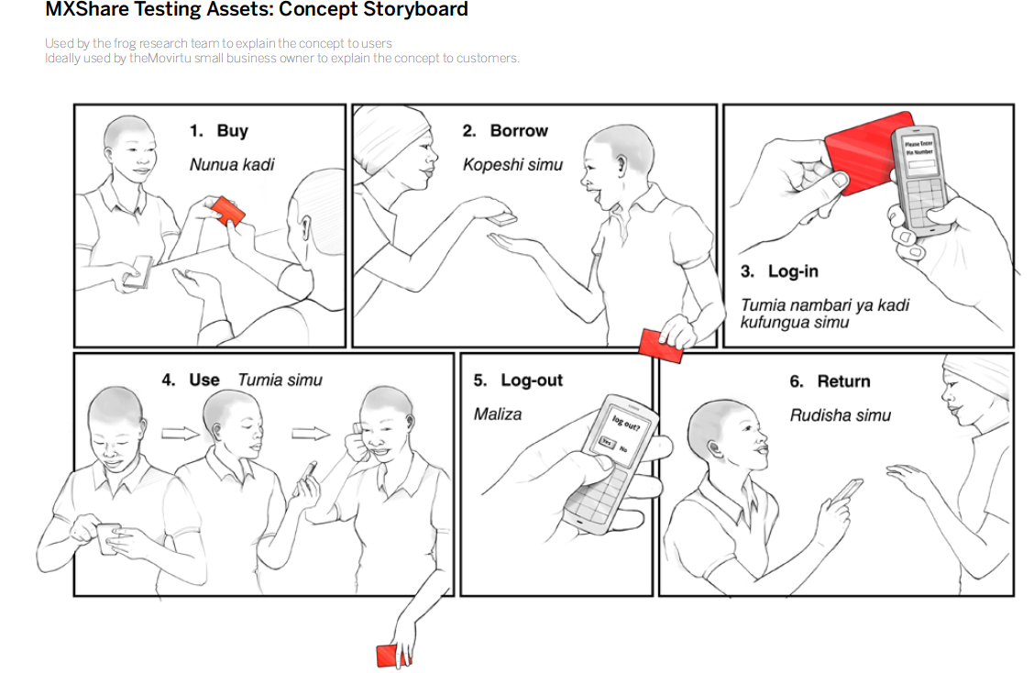

Slide 14
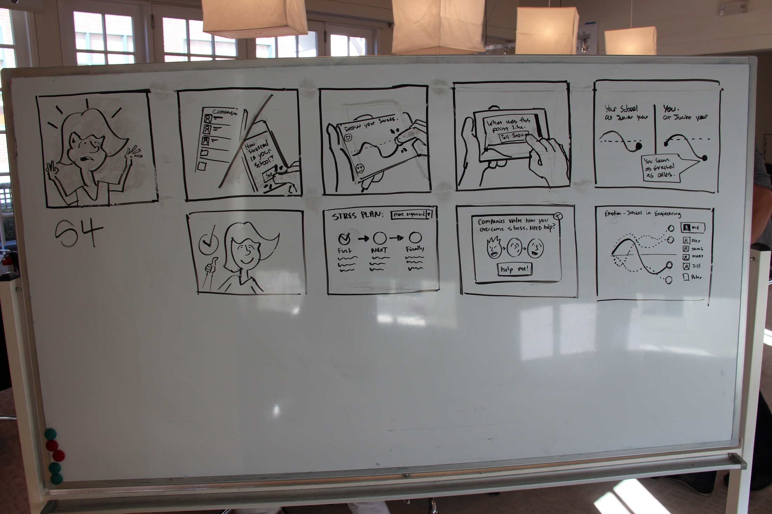

Slide 15
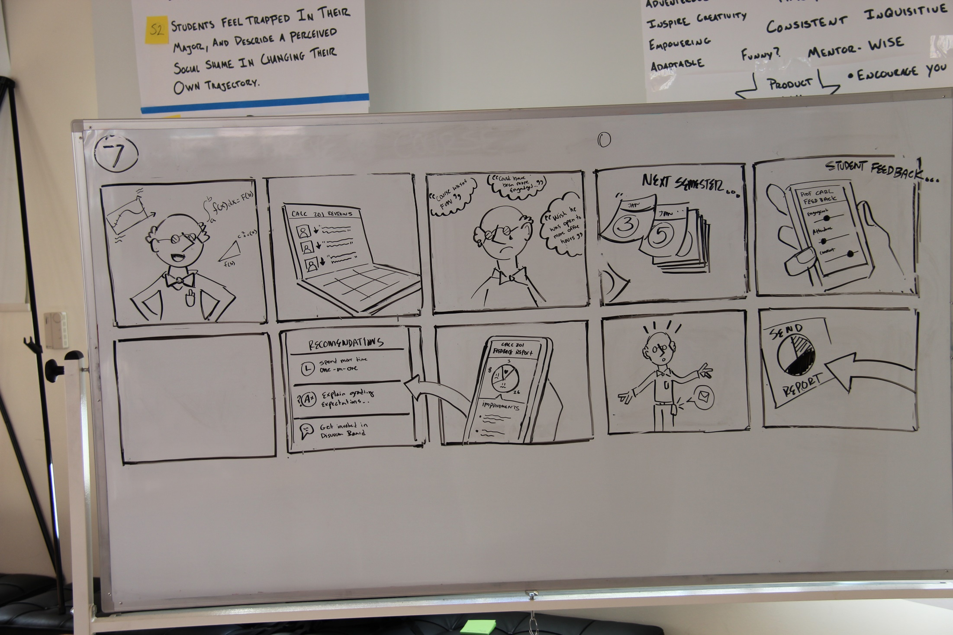

Slide 16
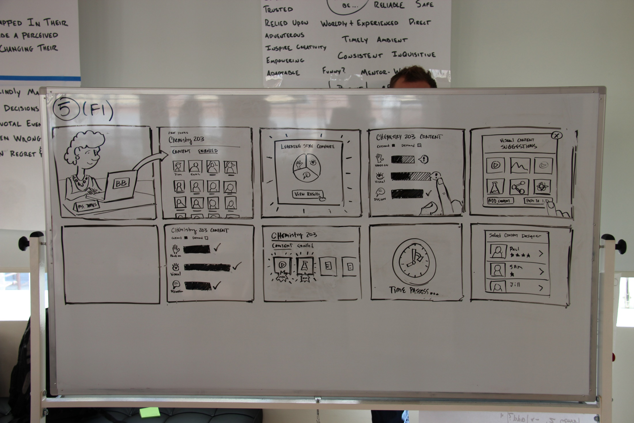

Slide 17
Sketching Storyboards
Sketch the frame.
Each sentence in your scenario becomes a frame in the storyboard. Using your scenario as a starting point, draw empty boxes (approximately 4” x 4”) for each sentence. Number the boxes.

Slide 18
Sketching Storyboards
Transfer the scenario.
Directly below each box, write the sentence from your scenario.

Slide 19
Sketching Storyboards
Sketch.
Inside of each box, sketch what happens in the scenario.
When you sketch people, emphasize their hands and eyes.
When you sketch human touchpoints, show both humans in the frame at once.
When you sketch digital products, first introduce the product in context (in someone’s hand), and then sketch what the user actually sees on the screen.

Slide 20
Sketching Storyboards
Enhance with selective use of color.
Use color only to make a point – to emphasize a particular element in each frame (such as a device or handoff of information), or to differentiate characters from one another.

Slide 21
UI Storyboards – Recap
Sketching a comic-book style visualization of your written narrative, to illustrate scenes and screens.
A GOOD STORYBOARD/
Emphasizes screens over scenes
Advances the fidelity of an idea
Stands on its own, without explanation
Dedicates one panel to one idea, and uses panels generously
WRITING STORYBOARDS/
Sketch the frame.
Transfer the scenario.
Sketch.
Enhance with selective use of color.
Notes:
21

Slide 22
Wireframes
Creating a visual representation of a user-interface, abstracted to show behavior and controls instead of color or emotion.
Notes:
22

Slide 23
Wireframes
Creating a visual representation of a user-interface, abstracted to show behavior and controls instead of color or emotion.
A GOOD SET OF WIREFRAMES/
Advances the fidelity of an idea
Stands on its own, without explanation
Describes every control
Uses actual content, not “filler” or “placeholder” content
Uses space in a realistic manner
Notes:
23

Slide 24
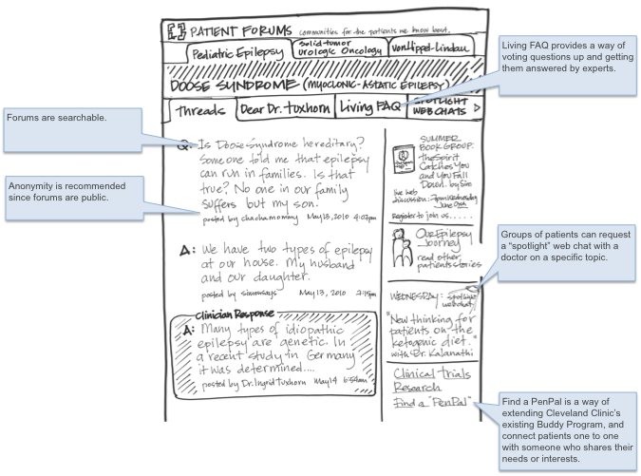

Slide 27
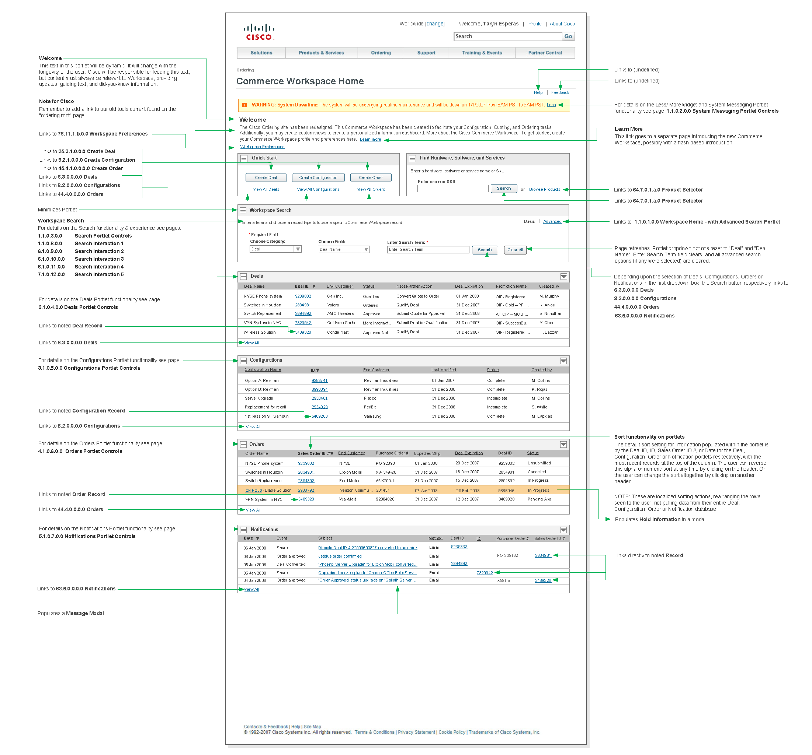

Slide 30
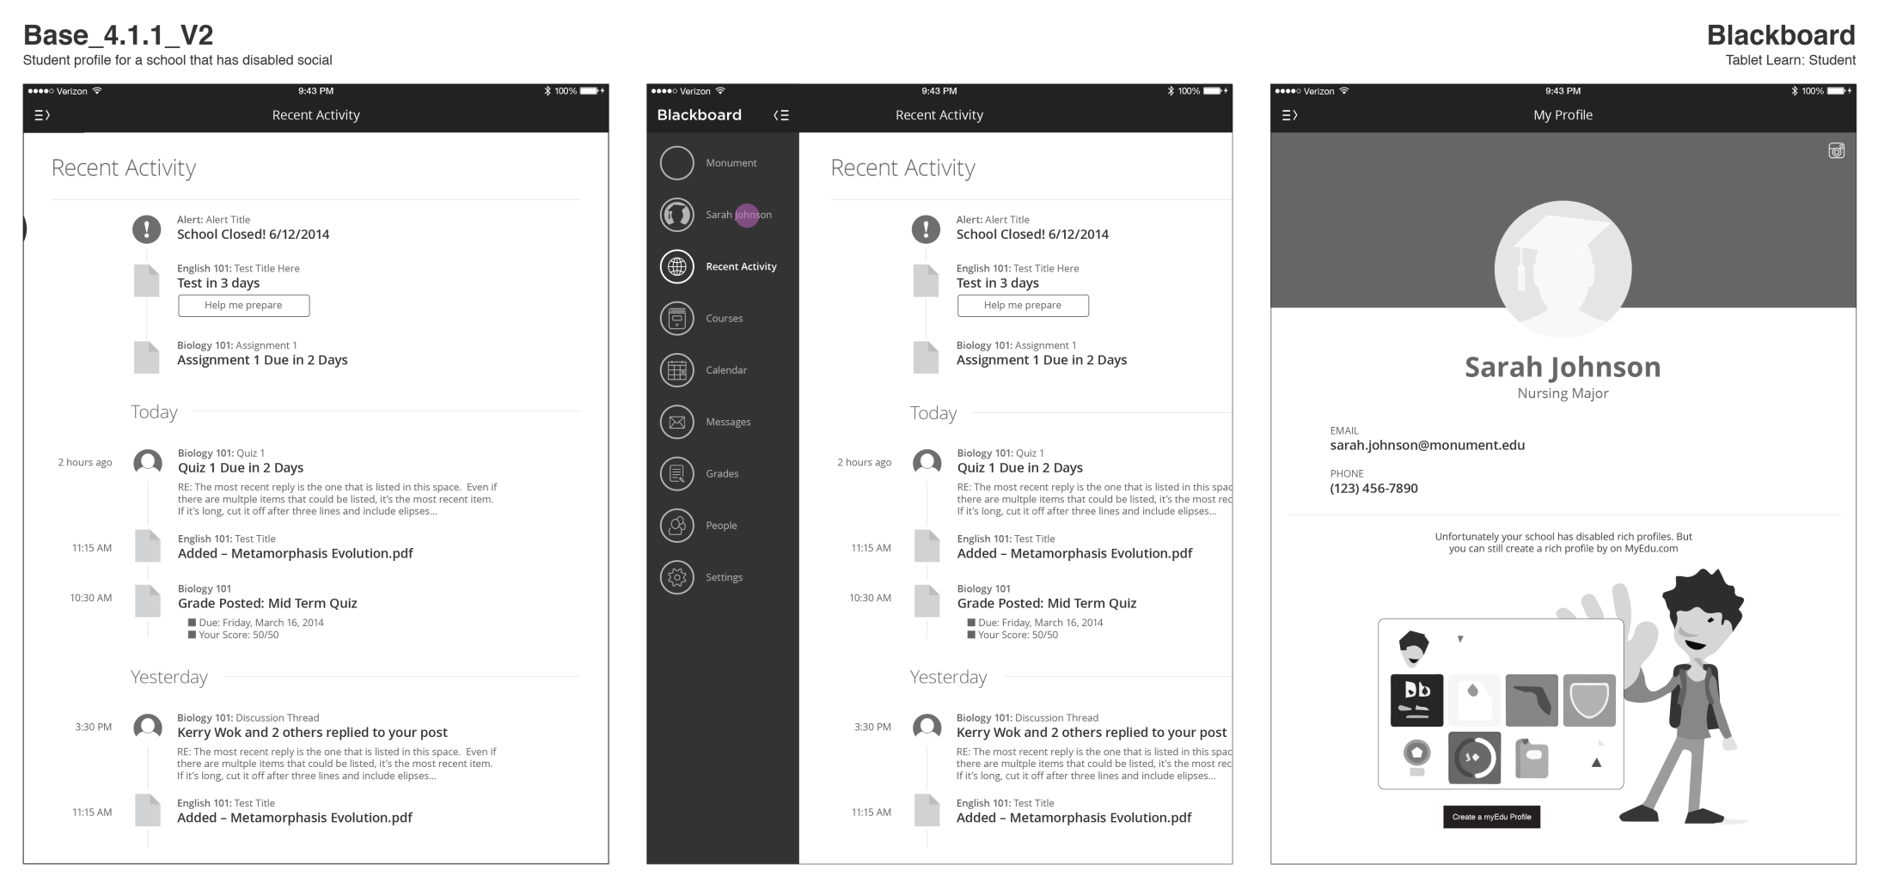

Slide 31
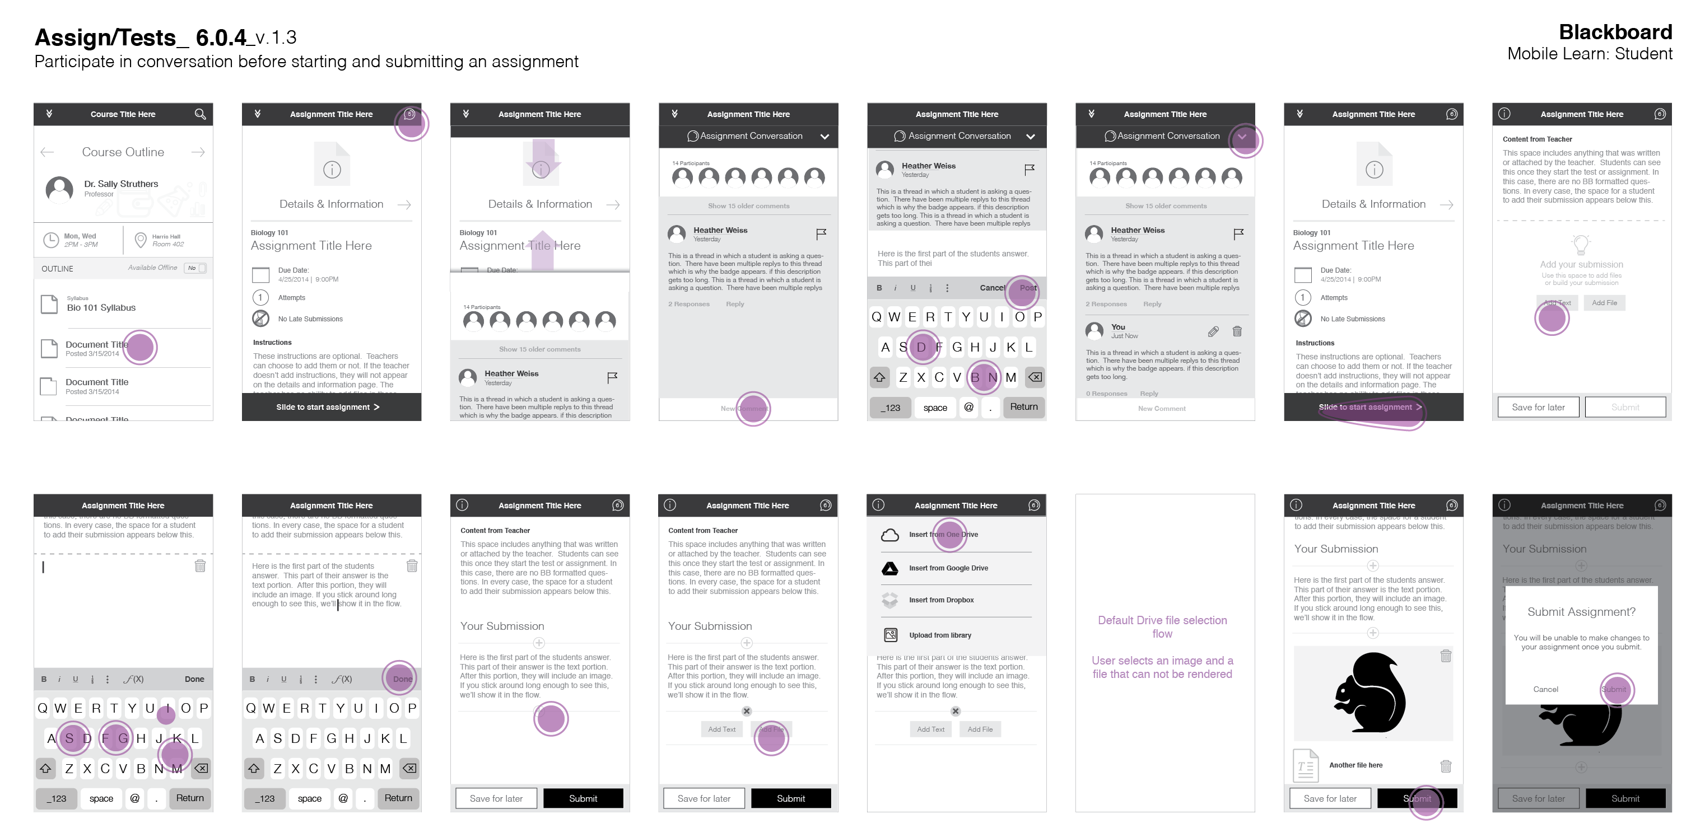

Slide 33
Creating Wireframes
Start with your scenarios and storyboards.
Using the storyboards as a starting point, sketch a loose wireframe for each screen the user will encounter. Acknowledge that this is a scrap copy and will be thrown away.
Consider elements that show up on every page (navigation, framing devices) as anchors for understanding, and make sure that the user can understand where they are, where they’ve been, and where they’re going.

Slide 34
Creating Wireframes
Sketch the story again.
Redraw the entire flow, increasing your attention to detail. Make your lines crisper and stronger, and make sure things line up clearly.
As you redraw the flow, begin to notice paths that haven’t been clearly defined – buttons, links, or controls that “lead nowhere”. Make a list of these dead ends.

Slide 35
Creating Wireframes
Sketch the dead ends.
Draw the screens that don’t exist. This will force you to extend your scenario; at this point, you no longer need to conform to the story, as you are completing the designed system.

Slide 36
Creating Wireframes
Refactor and revise the flow.
Look at the entire set of wireframes, arranged on the wall in front of you.
Are there elements that you didn’t account for on some screens, that became important on other screens?
Is the navigation consistent?
Will someone know what to do on each screen?
Can someone find their way back?
Redraw the entire set of wireframes, again.

Slide 37
Always show a flow.

Slide 38
Details matter, no matter what fidelity you are sketching at.

Slide 39
Always indicate interaction points.

Slide 40
No fake text!

Slide 41
Level of effort & fidelity
Key pages, functions, and states
Few or no annotations
Simple wires, few details
All pages, including edge-cases and errors
Full annotations (“detailed specification”)
Complicated wires: all content, all features, all details, etc.
Early stages of design
Simple product or service
Small quantity of stakeholders
Control over implementation
Final stages of design
Complex (“large”) product or service
Large quantity of stakeholders
Limited or no control over implementation
Fast and Cheap
Lack of planning can be detrimental later
Slow, tedious, and expensive
Forces thought for every design detail

Slide 42
Wireframes – Recap
Creating a visual representation of a user-interface, abstracted to show behavior and controls instead of color or emotion.
A GOOD SET OF WIREFRAMES/
Advances the fidelity of an idea
Stands on its own, without explanation
Describes every control
Uses actual content, not “filler” or “placeholder” content
Uses space in a realistic manner
CREATING WIREFRAMES/
Start with your scenarios and storyboards.
Sketch the story again.
Sketch the dead ends.
Refactor and revise the flow.
Notes:
42

Slide 43
Critique
A special, structured format for identifying problems and proposing solutions.
Notes:
43

Slide 44
Critique
A special, structured format for identifying problems and proposing solutions.
A GOOD CRITIQUE/
Advances the fidelity of an idea
Is extraordinarily detailed
Is focused and time-controlled
Focuses on execution rather than intention
This is not a standard presentation – different rules apply.
Notes:
44

Slide 45
If you are giving a critique…
Think before you speak.
First, consider the piece of the design you are responding to. Zoom in, and make sure you are thinking as detailed as possible.
Next, think about why you feel that piece is not successful.
Then, think about how you can make your criticism actionable: if you were to receive this criticism, would you know what steps to take to fix it?
Finally, think about your delivery style.

Slide 46
If you are giving a critique…
Be succinct and very, very detailed.
A rambling critique is not about the design – it’s about you. Describe your criticism in as concise a manner as possible.
Be as specific as you can about the piece of the product you are responding to.
Be as specific as you can about what’s wrong with it.
Be as specific as you can about how you might fix it.

Slide 47
If you are giving a critique…
Do not point out something good (unless it’s relevant to make your point clearer) – no “shit sandwich” .
A critique is not intended to highlight the parts of a design that are successful – it’s intended to point out the parts that are not successful.
It may be useful to compare something that is working to something that is not working; this is a good use of positive criticism.

Slide 48
If you are giving a critique…
Critique the design, never the person.
Direct your comments exclusively to the work. “You didn’t…” is directed at a person. “The design doesn’t…” is directed at the work.

Slide 49
If you are being critiqued…
Offer a succinct walkthrough of your design.
Present the work at a meta level, so we know what we are responding to.
Direct the criticism. What do you want feedback on? What do you not want feedback on?
Do not self-deprecate. Your work is what it is; do not say things like:
“I just didn’t have enough time…”
“I know this isn’t great, but…”
“I know what I need to change on these already…”

Slide 50
If you are being critiqued…
Do not defend or explain your work.
Contain all of your comments to clarifications, and only clarify the design (if someone asks), not the intent.
Never defend a design decision in a critique; remember that not all presentations are critiques, and it’s completely appropriate to defend your design in other contexts.

Slide 51
If you are being critiqued…
Make sure you understand the comments.
Critique comes quickly, and there are often a lot of voices contributing to the discussion. Make sure you understand the comments.
If you are unsure, repeat the point of criticism back to the person who asked it, and have them validate that you heard it correctly.
If the comment is not actionable, turn the comment around: ask the person “What would you do in this case?”

Slide 52
If you are being critiqued…
Write it all down, and suspend judgement until later.
Write down every single piece of feedback. Write directly on the work artifacts that are printed out.
Suspend judgment on the feedback until later; try not to decide which suggestions are good and bad during the critique. Instead, just try to understand them and capture them.
You don’t have to do any of the things you hear in critique. These are opinions and outside perspectives; they should be useful, but often they are not.

Slide 53
Critique
A special, structured format for identifying problems and proposing solutions.
A GOOD CRITIQUE/
Advances the fidelity of an idea
Is extraordinarily detailed
Is focused and time-controlled
Focuses on execution rather than intention
This is not a standard presentation – different rules apply.
Notes:
53

