Slide 1
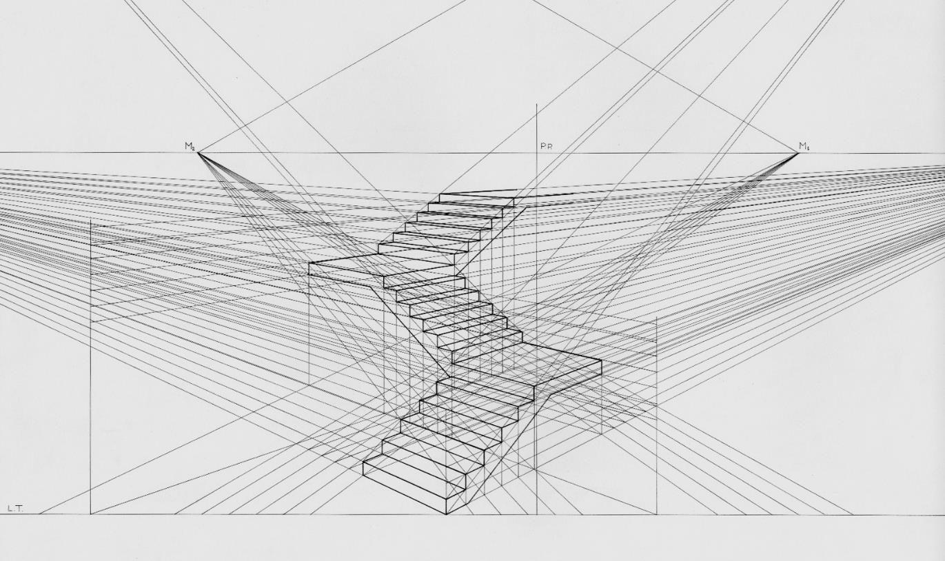
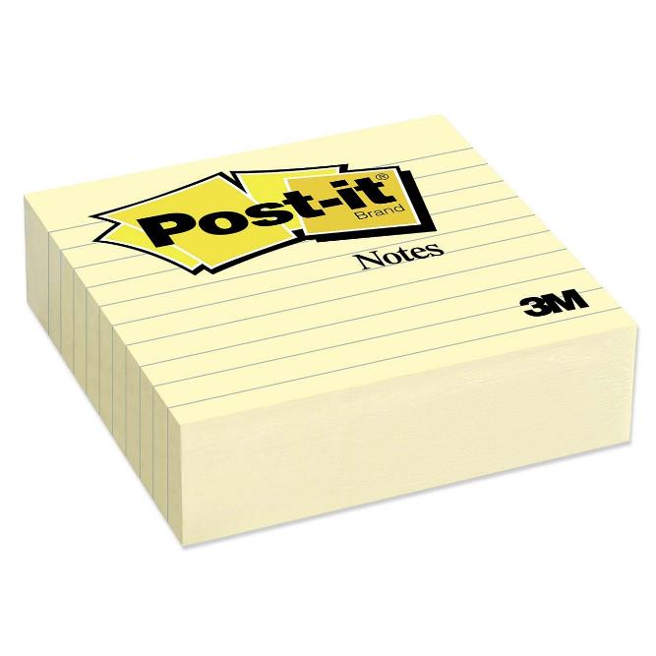
Introduction to Design Strategy
Professor Jon Kolko

Slide 2
Design is in the middle of an enormous professional shift.

Slide 3
For years, design was about form giving, aesthetics, and styling.

Slide 4
Notes:
A historical perspective on design describes that designers are rarely “in the right place”.
We built lots of things that were square, because we could.

Slide 5
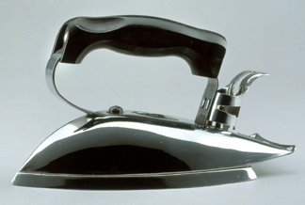
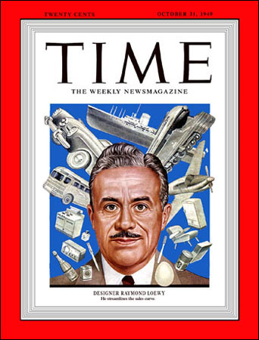
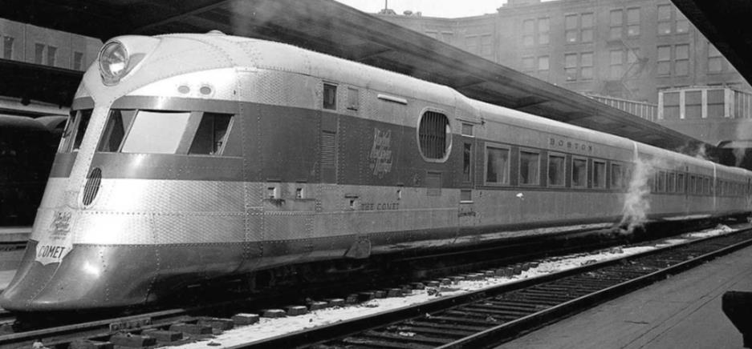
Notes:
We focused on streamlining and styling, instead of doing something of substance with the post-war [pre cold war] financial success; we invented consumerism

Slide 6
During this period, design was a big deal – to designers.

Slide 7
As technology got cheaper, our world got more complicated. Designers made things easier to use.

Slide 8
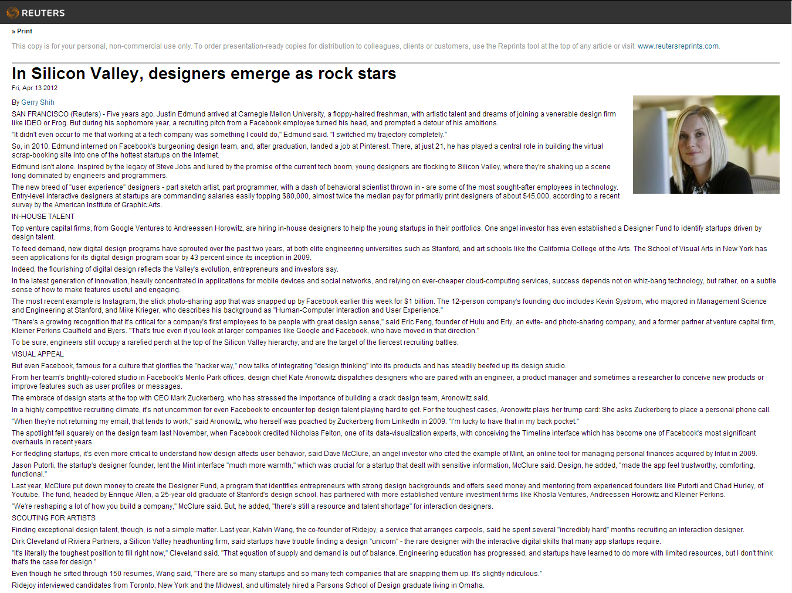

Slide 9
“The new breed of ‘user experience’ designers – part sketch artist, part programmer, with a dash of behavioral scientist thrown in – are some of the most sought-after employees in technology.”

Slide 10
Design was also at the heart of the “innovation” conversation.

Slide 11
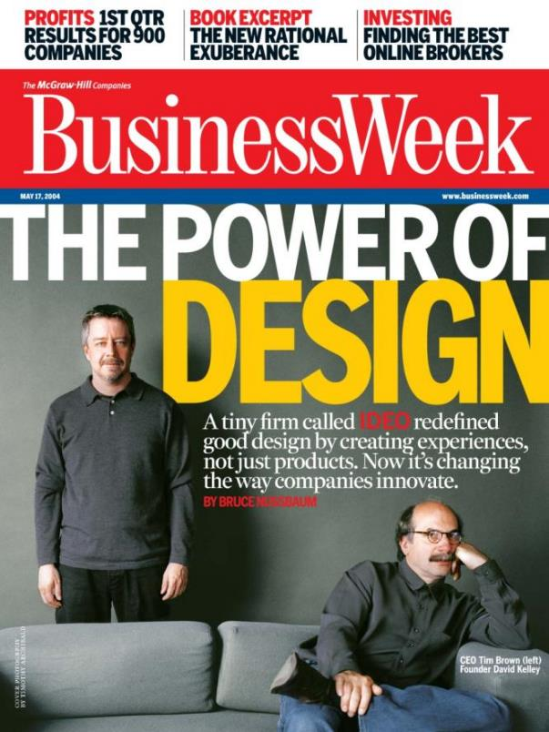

Slide 12
Innovation gave us a seat at the big-kids table.

Slide 13
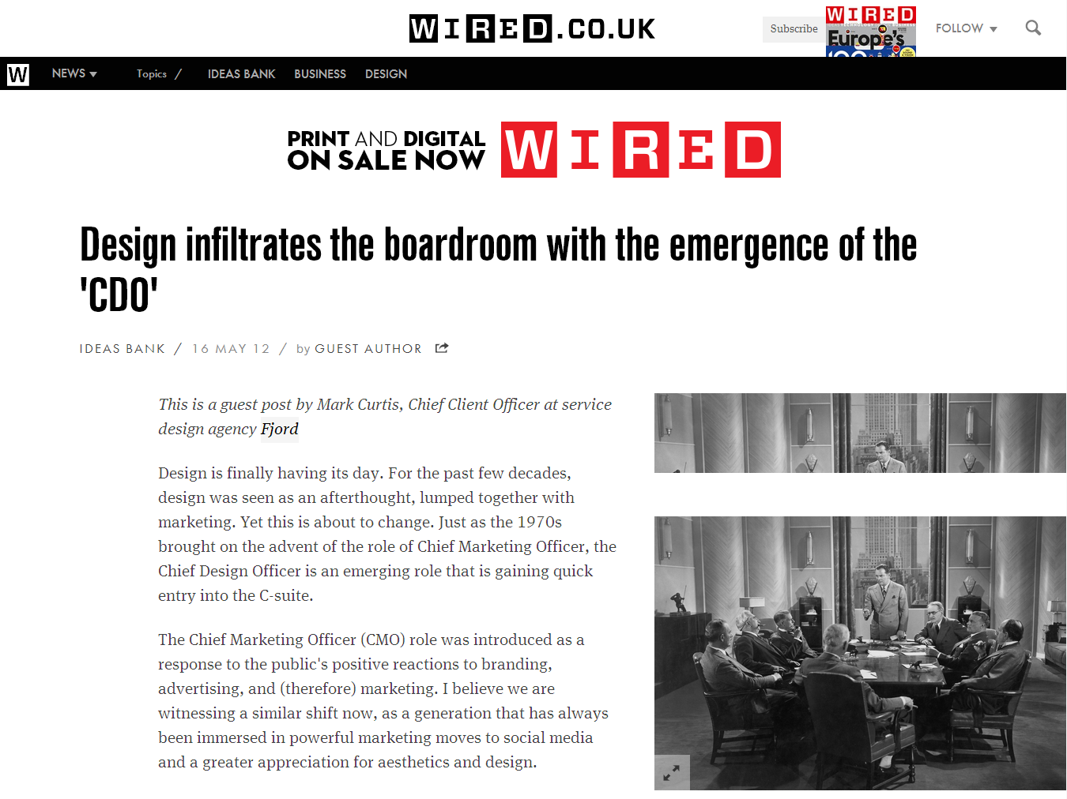

Slide 14
“The CDO is vital in helping companies take the lead to understand customers, define products and services, and to help build marketing and innovation into services…”

Slide 15
Now, design-as-innovation is recognized as a driver of economic growth and policy success.

Slide 17
“To win the future, we must out-innovate,
out-educate, and out-build the rest of the world.”

Slide 19
“The MOEA will devote its efforts to the promotion of a technology and innovation driven industrial development policy…”

Slide 20
But…

Slide 23
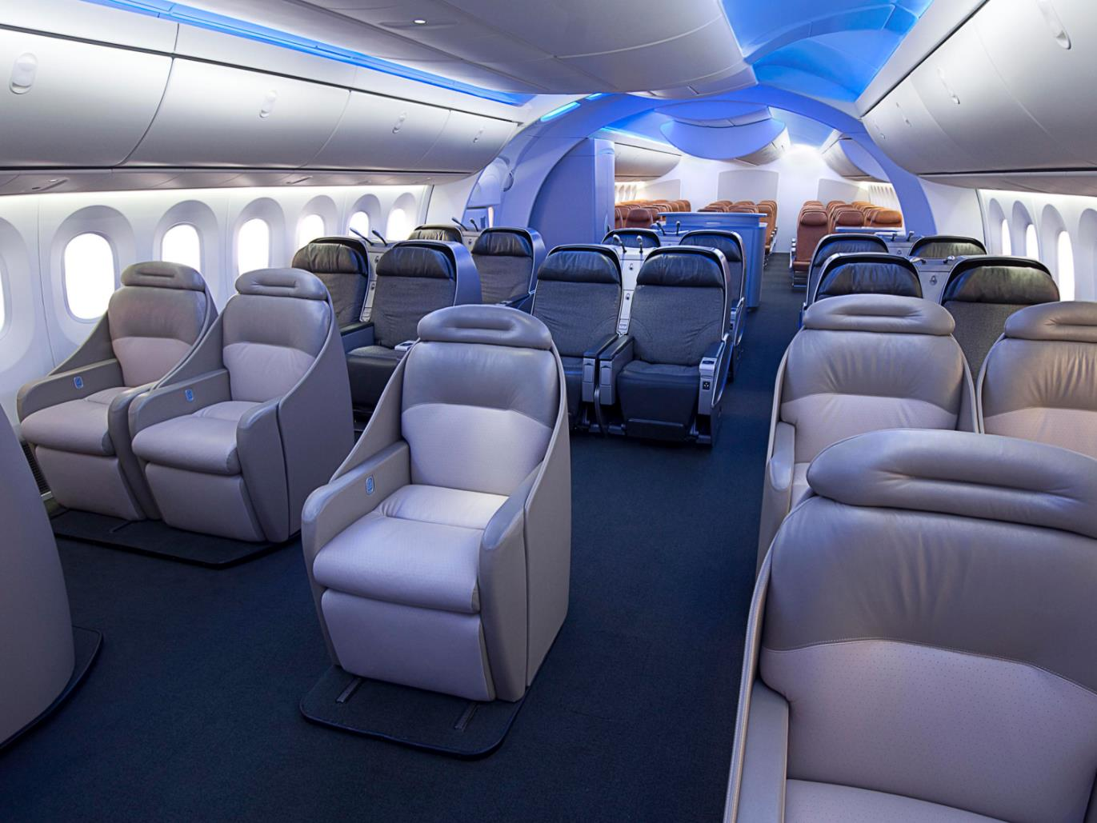
IDSA2011 Best In Show!
Notes:
IDSA2011 Best In Show: 787 Dreamliner

Slide 24
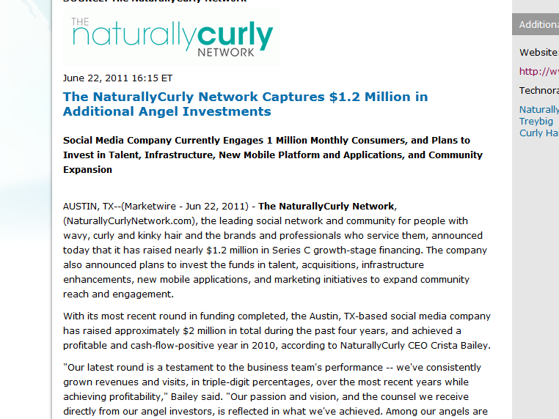
“The leading social network for people with wavy, curly, and kinky hair…”

Slide 25
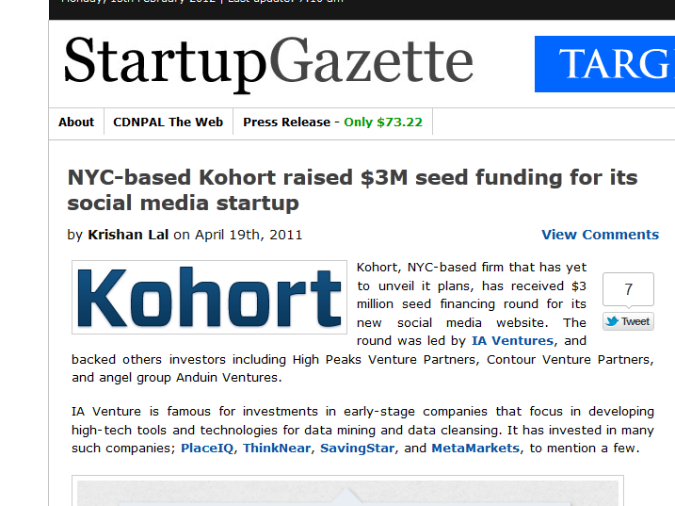
“Kohort allows for hierarchical groups, so groups can have as many subgroups as a user would like."

Slide 26
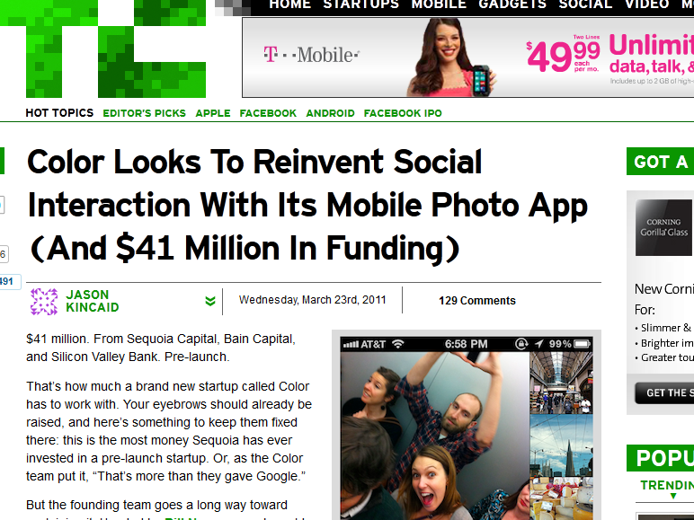
“Broadcast live from your phone to Facebook.”

Slide 27
We’re really good at designing products. We’re really bad at picking what to design.

Slide 28
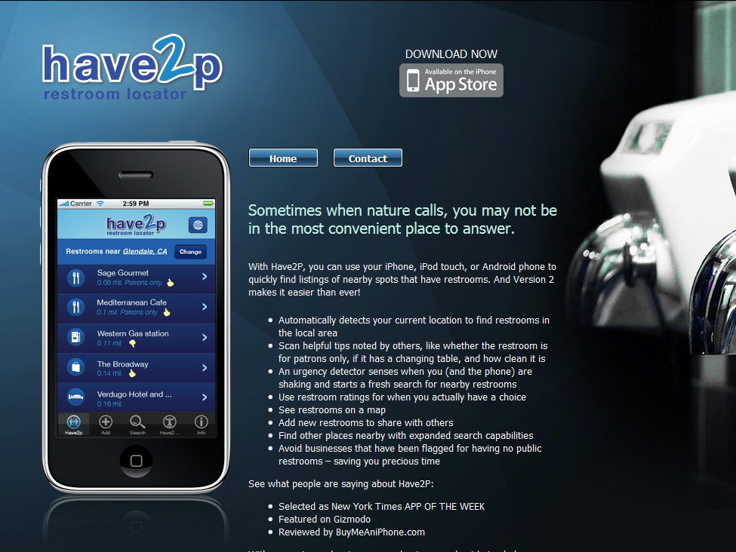

Slide 29
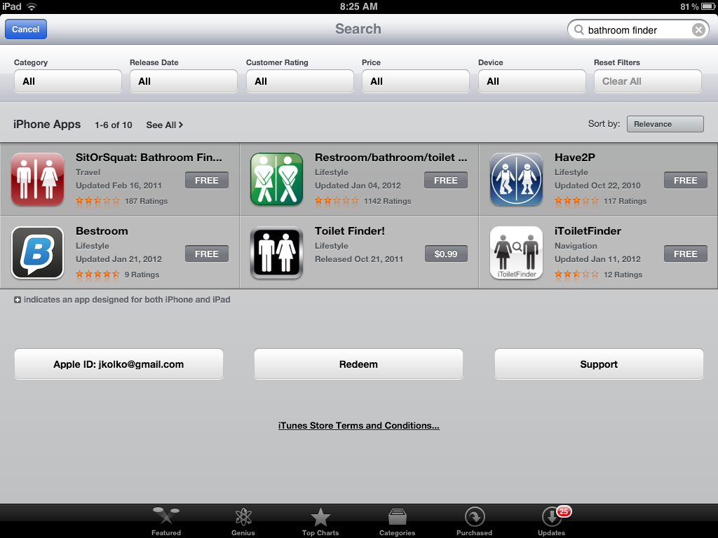

Slide 30
We work on some really stupid stuff.

Slide 31
Design lives in a context of traditional, outdated business ideas: market-driven vision

Slide 32
Design lives in a context of traditional, outdated business ideas: responsive “competitive” roadmaps

Slide 33
Design lives in a context of traditional, outdated business ideas: requirements

Slide 34
We need a new way to think about designing products.

Slide 35
1

Slide 37
debt

Slide 39
“Even in school I never took a class on how to balance a checkbook. They never taught us any of that. Because learning the history of the Alamo was more important for the 8 billionth time… A real adult knows how to handle your money, knows how to be on your own, and be responsible for your money and how to budget things... which I know nothing.”
Paige

Slide 40
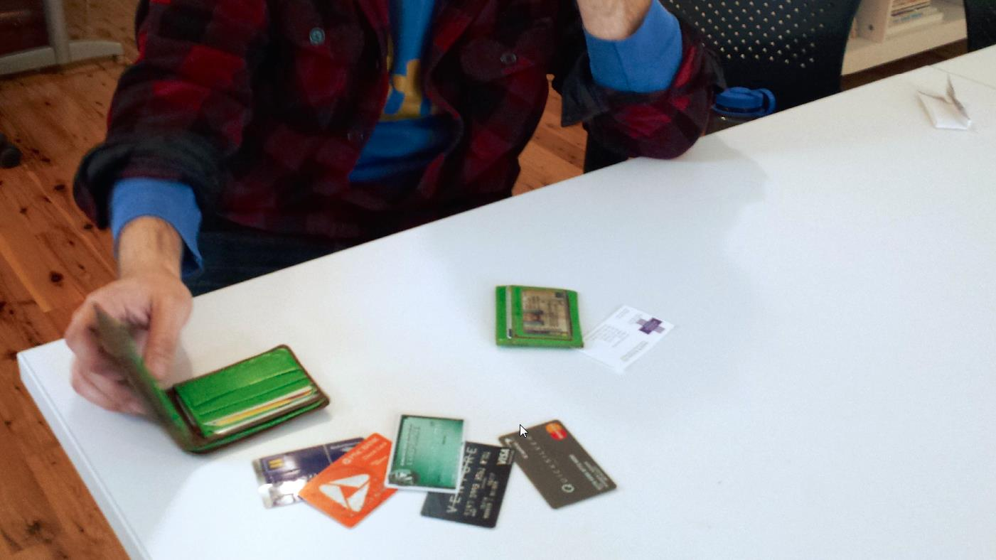

Slide 41
“I hate budgeting, it’s really hard reigning myself in and keeping myself on some sort of track… I’d like to pay off my credit cards as soon as possible because it is a cloud, it is something hanging over my head... [But] in the moment of choosing to buy something or not, it’s really easy to make that decision–yeah fuck it, I don’t care–I want this now…”
Carl

Slide 42
Observation
Immediate gratification, delayed anxiety.

Slide 43
Insight
There is no satisfaction in future benefits. We need to feel immediate value to be satisfied.

Slide 44
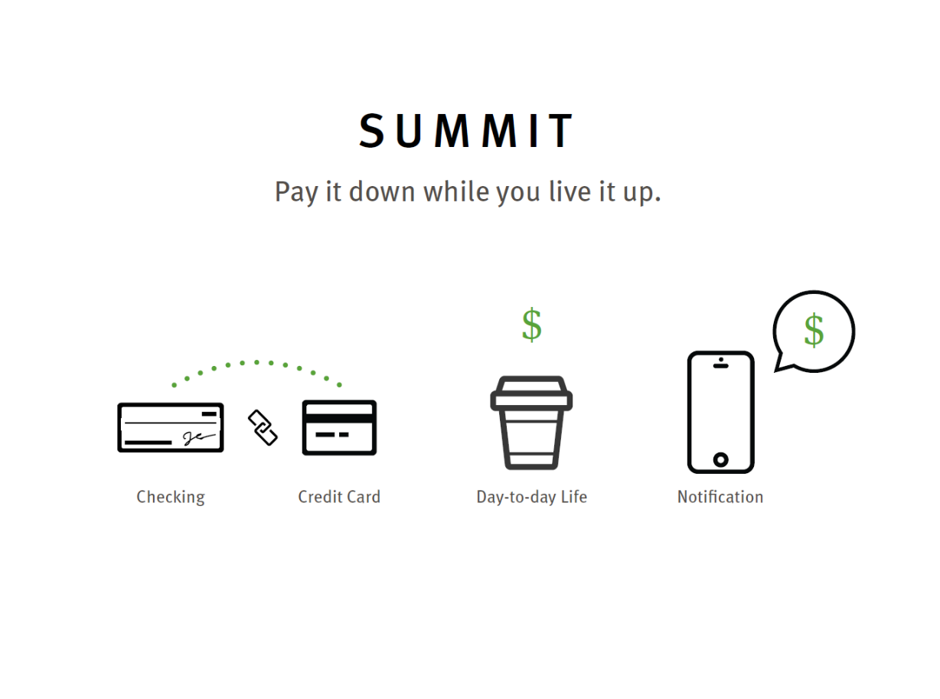

Slide 47
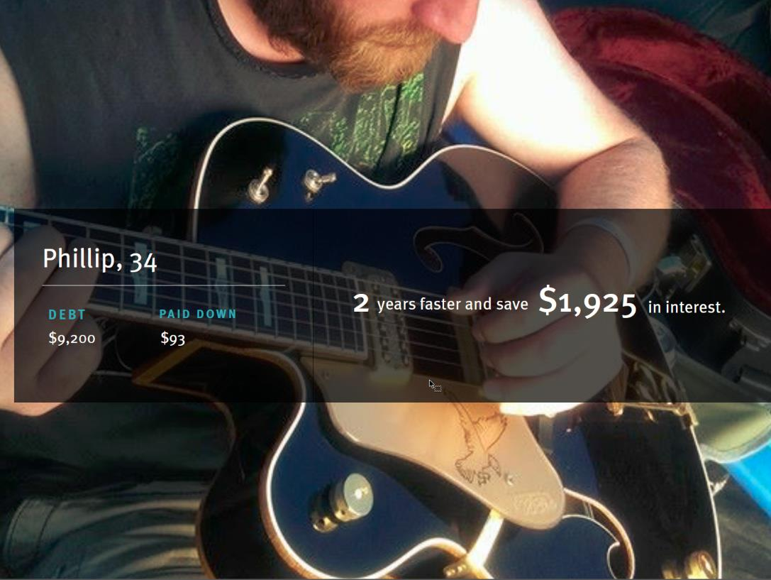

Slide 48
Value
We will reduce the anxiety
caused by debt in the lives of young adults,
and empower them to change their behavior
and achieve a better financial future.

Slide 49
2

Slide 51
aging

Slide 53
I'm kind of secretive. I have gone to the hospital and I don’t tell my sons because I want to take care of myself. Why should I worry them?
Annette

Slide 55
She’s going to look at me like I’m insane; “What do you mean I can’t drive that car?’ Um, I think as long as she can talk she thinks she can drive.”
Martha

Slide 56
Observation
A conflict of interests over aging.

Slide 57
Insight
Elderly individuals fear asking for help because
taking others’ time and resources will result in
being robbed of their own independence.

Slide 60
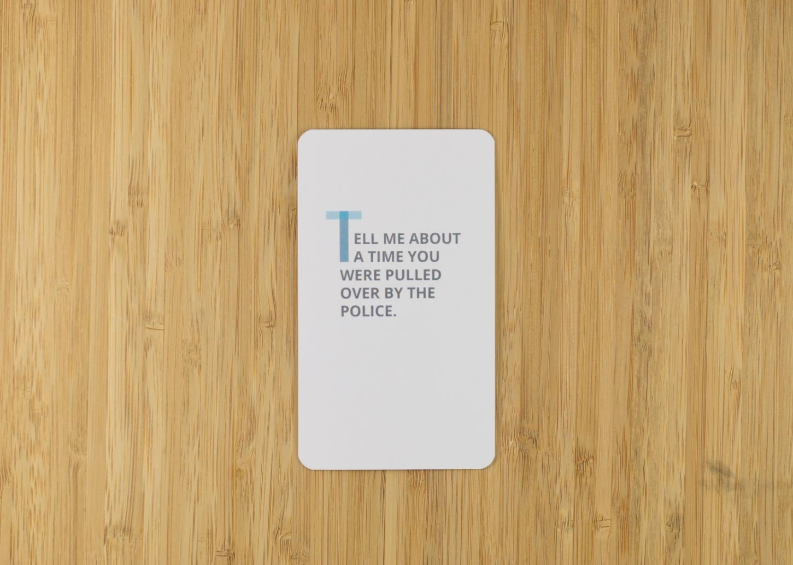

Slide 61
Value
We will create a safe space for open discussion of
aging-related topics.

Slide 62
3

Slide 64
decision making

Slide 66
I used to be a psych major, they have one of the best psych programs. But I wasn’t liking it that much. I switched majors my junior year, you have to have a major that makes money, so I knew I wasn’t a business person, and I wanted to be a therapist, because girls like to talk about their problems, and I thought I would be a good therapist, and then I get into college and was like this isn’t what I signed up for…
Shanae

Slide 68
I started off in engineering, but it was too difficult, I kind of searched around sophomore year for another major and took a class in economics and I liked it, so I switched. So I'll graduate, and hopefully find a job and then probably keep that job for like 2 or 3 years. I've got a friend of my mom who has been mentoring me. He's like an entrepreneurial dude–he helps me figure out how to go about doing stuff, in like searching for a job.
Jacob

Slide 70
After graduation, I’ll get a job or get into graduate school. If I want to stick with psychology, I'll get a masters degree in it so I can become a certified psychologist, or I might stick to the original plan and go to law school. After I make the decision, pretty much the rest of life happens after that. You know, be a lawyer, finish school and make sure you make enough money to support yourself and do fun things. And then you just get old.
Desiree

Slide 71
Observation
Students don’t know.

Slide 72
Insight
Students feel that college determines the “rest of your life,”
and describe pressure and an urgency to constantly push forward.

Slide 73
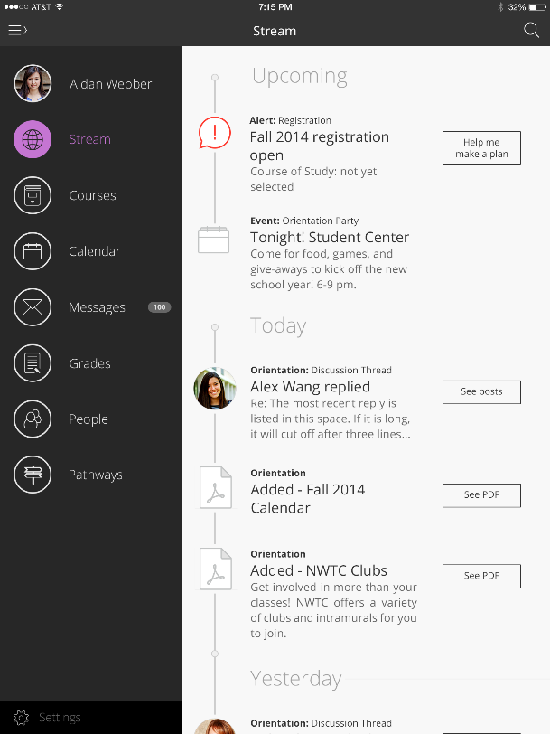

Slide 75
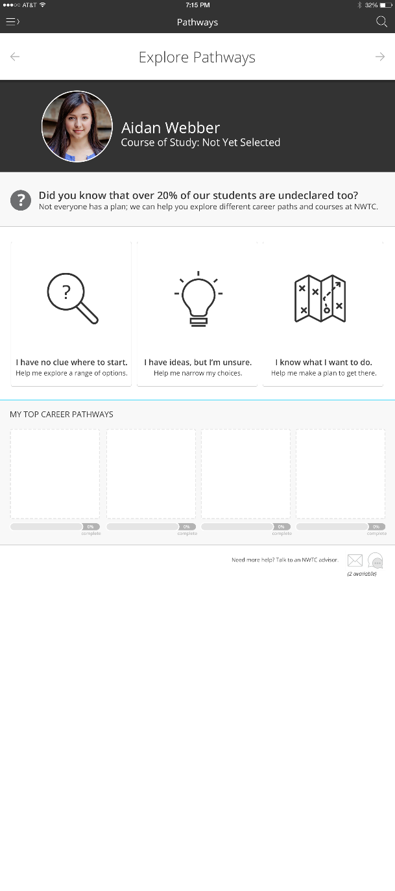

Slide 79
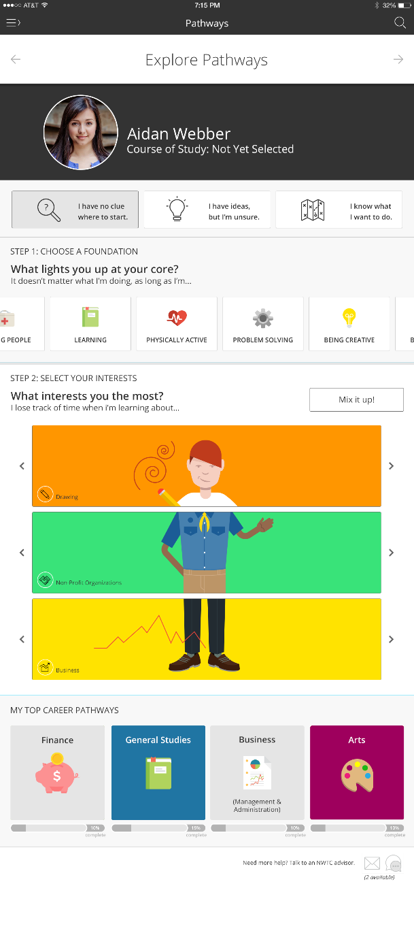

Slide 82
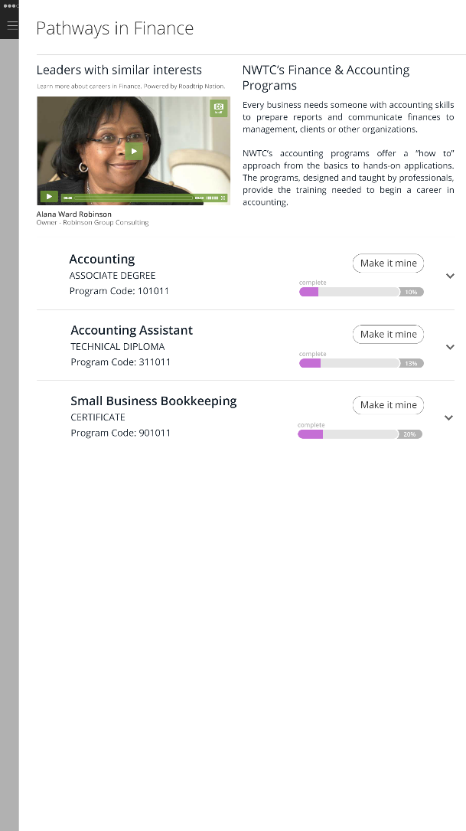

Slide 83
Value
We minimize anxiety around the academic experience,
and help students identify their hidden passions and interests.

Slide 84
1 2 3

Slide 85
We need a new way to think about designing products.

Slide 86
What is Design Thinking & Design Strategy?
Ethnography
Synthesis
Prototyping

Slide 87
Non-Linear
Ethnography
Synthesis
Prototyping
Immersion in the cultural and human context of a problem
Making meaning through inference and reframing
Hypothesis validation through generative, form-giving activities

Slide 88
The Output: Design Strategy
Ethnography
Synthesis
Prototyping
Design strategy

