Slide 1
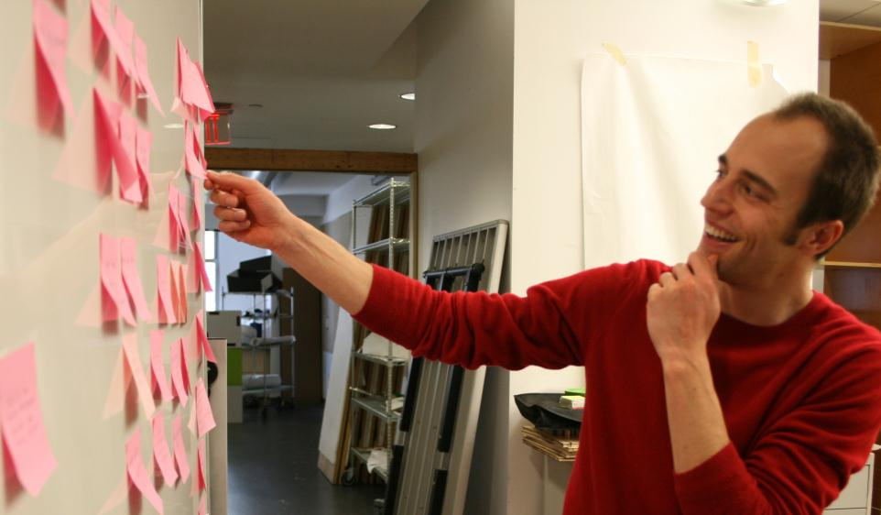
Insight Combination
Jon Kolko Professor, Austin Center for Design

Slide 2
Ethnography
Synthesis
Prototyping
Making meaning through abductive sensemaking and reframing
Combining data in new ways
Identifying patterns and anomalies
Judging, and learning

Slide 3
Insights
An insight is a clear, deep, meaningful perception into human behavior in a particular design context.
It’s a provocative statement of truth.
* And it may be wrong.
Notes:
3

Slide 4
Insights
An insight is a clear, deep, meaningful perception into human behavior in a particular design context.
It’s a provocative statement of truth.
* And it may be wrong.
Notes:
4

Slide 5
Insights
An insight is a clear, deep, meaningful perception into human behavior in a particular design context.
It’s a provocative statement of truth.
* And it may be wrong.
Notes:
5

Slide 6
Insights
An insight is a clear, deep, meaningful perception into human behavior in a particular design context.
It’s a provocative statement of truth.
* And it may be wrong.
Notes:
6

Slide 7
Design Patterns
A design pattern describes a possible solution to a problem, based on problem / solution sets in other contexts.
Notes:
7

Slide 8
Design Patterns
A design pattern describes a possible solution to a problem, based on problem / solution sets in other contexts.
Notes:
8

Slide 9
Design Patterns
A design pattern describes a possible solution to a problem, based on problem / solution sets in other contexts.
Notes:
9

Slide 10
Notes:
10

Slide 11
Notes:
11

Slide 12
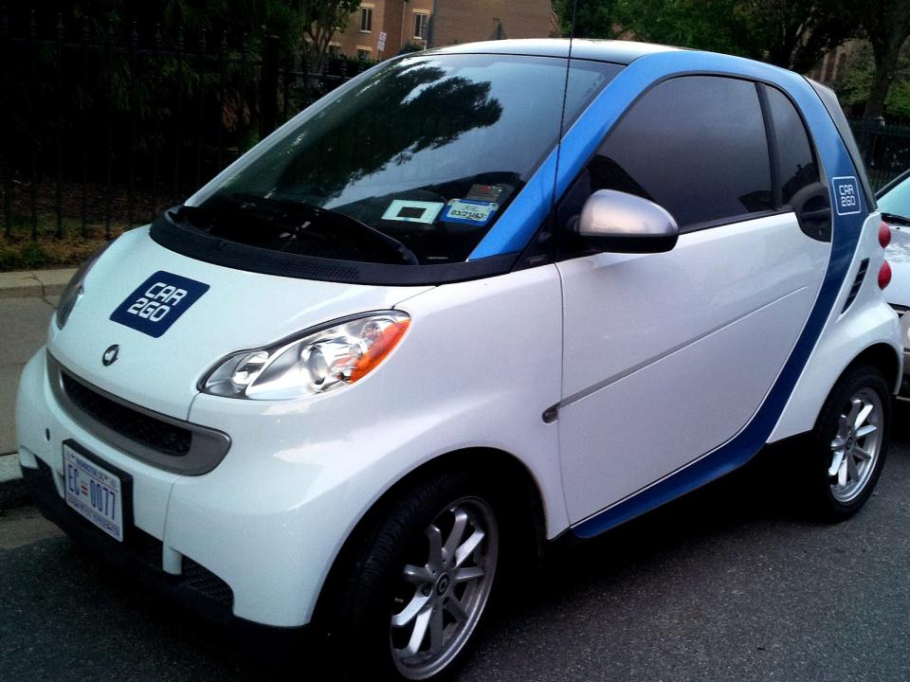
Notes:
12

Slide 13
Insight Combination
A method of building on insights and established design patterns in order to create initial design ideas.
Notes:
13

Slide 14
Insight Combination
A method of building on insights and established design patterns in order to create initial design ideas.
Notes:
14

Slide 15
Insight Combination
A method of building on insights and established design patterns in order to create initial design ideas.
Notes:
15

Slide 16
Insight Combination
A method of building on insights and established design patterns in order to create initial design ideas.
Notes:
16

Slide 17
Insight Combination
A method of building on insights and established design patterns in order to create initial design ideas.
INSIGHT COMBINATION/
Is detailed
Is divergent
In nonlinear
Is generative
Is biased
Notes:
17

Slide 18
I saw this
+
I know this
Insight
=

Slide 19
I saw this
+
I know this
Insight
=
Data gathered through ethnography, contextual inquiry, questionnaires, and interviews

Slide 20
I saw this
+
I know this
Insight
=
Data gathered through ethnography, contextual inquiry, questionnaires, and interviews
Guided by ethics & morals, intellectual prowess, and the accumulation of world view and breadth of experience

Slide 21
I saw this
+
I know this
Insight
=
Data gathered through ethnography, contextual inquiry, questionnaires, and interviews
Guided by ethics & morals, intellectual prowess, and the accumulation of world view and breadth of experience
Clear, deep, meaningful perception into human behavior in a particular design context

Slide 22
I saw this
+
I know this
Insight
Design Pattern
=
Design Idea
=
+
Data gathered through ethnography, contextual inquiry, questionnaires, and interviews
Guided by ethics & morals, intellectual prowess, and the accumulation of world view and breadth of experience
Clear, deep, meaningful perception into human behavior in a particular design context

Slide 23
I saw this
+
I know this
Insight
Design Pattern
=
Design Idea
=
+
Data gathered through ethnography, contextual inquiry, questionnaires, and interviews
Guided by ethics & morals, intellectual prowess, and the accumulation of world view and breadth of experience
Clear, deep, meaningful perception into human behavior in a particular design context
A trending paradigm that describes invariant qualities, referencing history and similar solutions

Slide 24
I saw this
+
I know this
Insight
Design Pattern
=
Design Idea
=
+
Data gathered through ethnography, contextual inquiry, questionnaires, and interviews
Guided by ethics & morals, intellectual prowess, and the accumulation of world view and breadth of experience
Clear, deep, meaningful perception into human behavior in a particular design context
A trending paradigm that describes invariant qualities, referencing history and similar solutions
A new, creative concept, somewhat facilitated by existing design paradigms

Slide 25
Insights go on yellow cards.
People are expanding their understanding of “appropriate” human to human interactions, as they search for meaning in the minutia of their daily lives. (#14, 15)
22
Provocative statement of truth
Evidence from a transcript (citation)
Unique insight number

Slide 26
Patterns go on blue cards.
Reality TV has moved from realistic, to surreal, to “car-crash-in-slow-motion”.
G
Pattern, or trending piece of culture and society
Unique pattern letter

Slide 27
Design ideas go on green cards.
A dating site that puts people into finite situations of absurdity, which is live-streamed to the internet and open to online commentary. 22-G
Design idea, built on the combination of an insight and a pattern
Unique insight and pattern identifier

Slide 28
Insight Combination…
… with boring old enterprise configuration software …
Notes:
28

Slide 29
Support the increasingly detailed nature of a configuration.
As a configuration moves through the sales cycle, it will become increasingly detailed and complicated. The tool should afford all levels of detail in the configuration process. (#14, 15)
22
Introduce pricing only when necessary.
Many sales people avoided talking about pricing until it was absolutely necessary; the tool should allow for and produce materials where pricing can be added or removed easily. (#33, 78, 199)
55
Provide both offline and online access.
Salespeople work in disconnected environments – like airplanes – and the tool should work in those environments too. (#98, 99)
87
Allow for an iterative configuration process.
Even a simple configuration will exist in multiple states throughout the configuration process, and the user will try several variations before identifying an ideal and final solution. The configuration tool should support this. (#44, 123)
17
Allow for a visual configuration.
Salespeople frequently sketch out a configuration on a whiteboard or a piece of paper during the sales cycle; allow the tool to help them work in a visual manner.
(#123-144)
Allow users to create multiple “what if” scenarios.
Salespeople frequently work through multiple configurations in parallel, in an attempt to understand all of the possible solutions to their problems.
(#123-144)
Allow the creation of an “invalid” configuration.
Some of the advanced engineers will try to create configurations they know are not valid, with a work-around in mind. Support this.
(#123-144)

Slide 30
Direct manipulation, drag and drop tools on the web are increasingly prevalent.
R
More and more portable devices allow file management and employ some sort of data-synching.
G
Support the increasingly detailed nature of a configuration.
As a configuration moves through the sales cycle, it will become increasingly detailed and complicated. The tool should afford all levels of detail in the configuration process. (#14, 15)
22
Introduce pricing only when necessary.
Many sales people avoided talking about pricing until it was absolutely necessary; the tool should allow for and produce materials where pricing can be added or removed easily. (#33, 78, 199)
55
Progressive disclosure with AJAX is an effective way to provide increasingly more granular levels of detail.
A
Provide both offline and online access.
Salespeople work in disconnected environments – like airplanes – and the tool should work in those environments too. (#98, 99)
87
There seems to be a push towards online backup and recovery tools for large datasets.
D
Allow for an iterative configuration process.
Even a simple configuration will exist in multiple states throughout the configuration process, and the user will try several variations before identifying an ideal and final solution. The configuration tool should support this. (#44, 123)
17
Allow for a visual configuration.
Salespeople frequently sketch out a configuration on a whiteboard or a piece of paper during the sales cycle; allow the tool to help them work in a visual manner.
(#123-144)
Small screens are commonly used in tandem with larger, more broad operational canvases.
P
People are increasingly familiar with visual and playful configuration tools that allow for side by side comparison of similar items.
F
Allow users to create multiple “what if” scenarios.
Salespeople frequently work through multiple configurations in parallel, in an attempt to understand all of the possible solutions to their problems.
(#123-144)
Allow the creation of an “invalid” configuration.
Some of the advanced engineers will try to create configurations they know are not valid, with a work-around in mind. Support this.
(#123-144)

Slide 31
Provide both offline and online access.
Salespeople work in disconnected environments – like airplanes – and the tool should work in those environments too. (#98, 99)
87
Direct manipulation, drag and drop tools on the web are increasingly prevalent.
R
More and more portable devices allow file management and employ some sort of data-synching.
G
Provide an HTML drag and drop tool that looks like an application.
Allow it to run when disconnected from the server, and provide a clear and cohesive mechanism for synching (and for displaying when things are out of synch).
87-R-G-1
I saw this
+
I know this
Insight
Design Pattern
=
Design Idea
=
+
Data gathered through ethnography, contextual inquiry, questionnaires, and interviews
Guided by ethics & morals, intellectual prowess, and the accumulation of world view and breadth of experience
Clear, deep, meaningful perception into human behavior in a particular design context
A trending paradigm that describes invariant qualities, referencing history and similar solutions
A new, creative concept, somewhat facilitated by existing design paradigms

Slide 32
Performing Insight Combination
Begin to identify insights
Examine the data you’ve gathered, and constantly ask the question “why” (and try to answer it). This is an interpretative activity: you are assigning meaning to data. Tell a credible story, but realize you may be wrong.
Write the insights on yellow post-it notes.
Reference the line numbers from any applicable transcripts, and give each yellow post-it note a unique numeric ID.

Slide 33
Performing Insight Combination
Identify design patterns
You can use patterns that are “appropriate” to your context, in order to provoke “safe” ideas. You can use patterns that are extremely disassociated from your context, in order to provoke “wild” ideas.
Ideally, you begin to keep a design pattern library.
Write the patterns on blue post-it notes.
Give each blue post-it note a unique letter ID.

Slide 34
Performing Insight Combination
Combine insights and patterns.
Mingle the blue and yellow post-its, moving them around physically, and actively reflecting on potential combinations.
Force each combination into a new design idea. Write the idea on a green post-it note.
Give each green post-it note a unique design idea ID (referencing both the yellow and blue notes above).
Limit yourself to 1 minute per idea; use a timer.

Slide 35
Insight Combination
A method of building on insights and established design patterns in order to create initial design ideas.
INSIGHT COMBINATION/
Is detailed
Is divergent
In nonlinear
Is generative
Is biased
HOW TO DO INSIGHT COMBINATION/
Begin to identify insights
Identify design patterns
Combine insights and patterns, to provoke new ideas
Notes:
35

