Slide 1
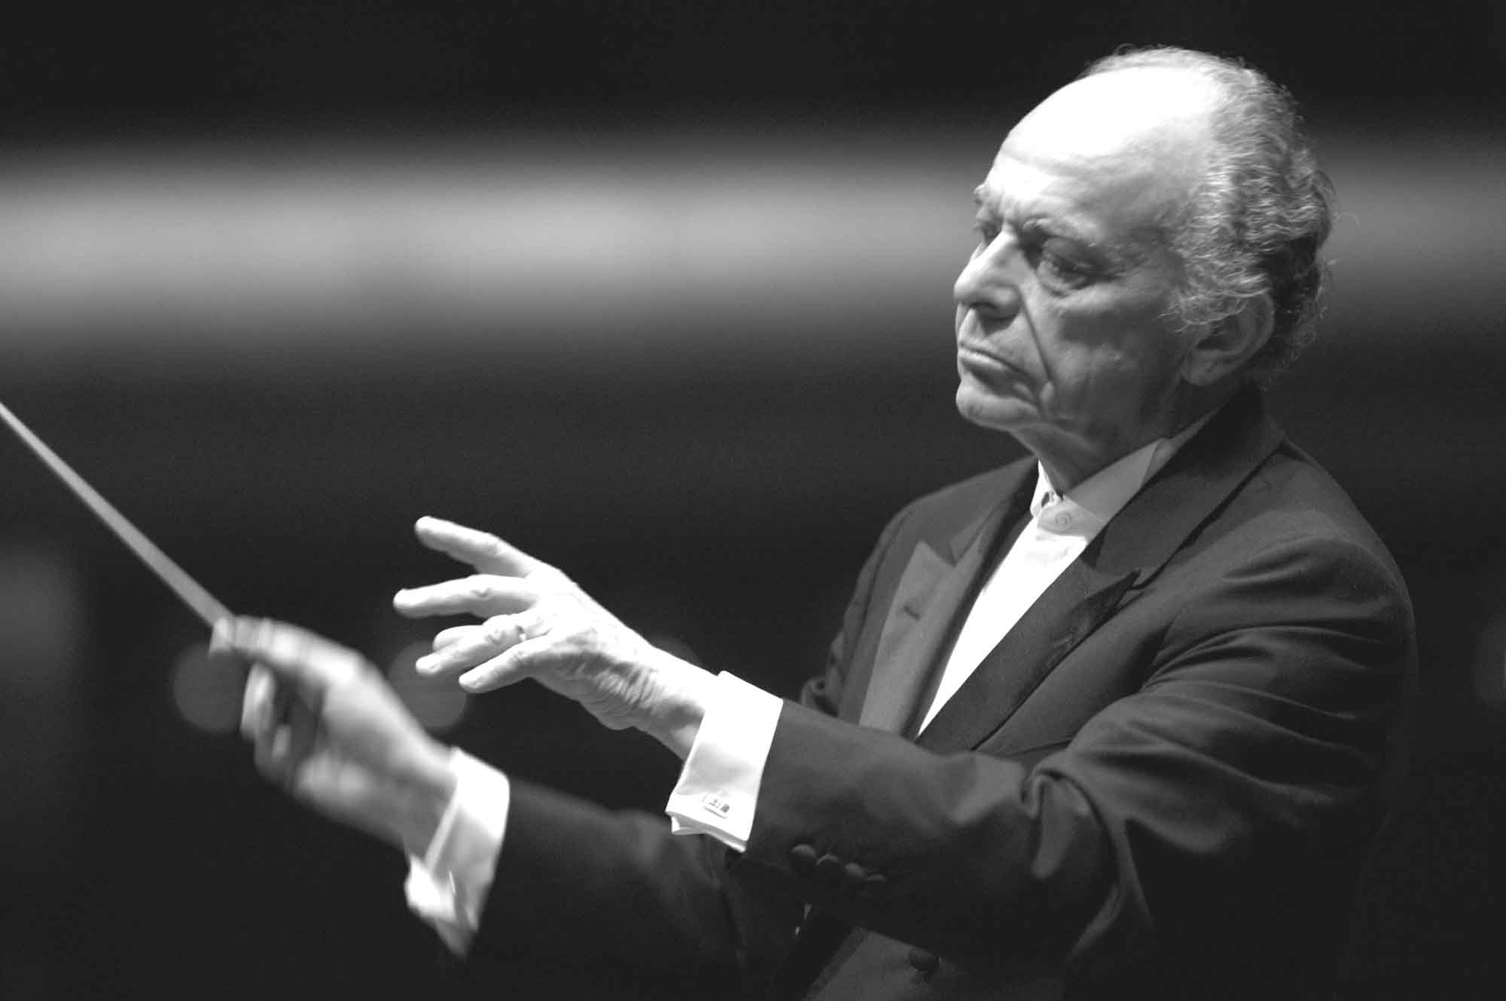
Introduction to Creative Facilitation
Matt Franks
Professor, Austin Center for Design

Slide 2
Creative Facilitation
Considering the stakeholder as part of the creative process, provide them tools to descriptively discuss their experiences and solutions.
Notes:
2

Slide 3
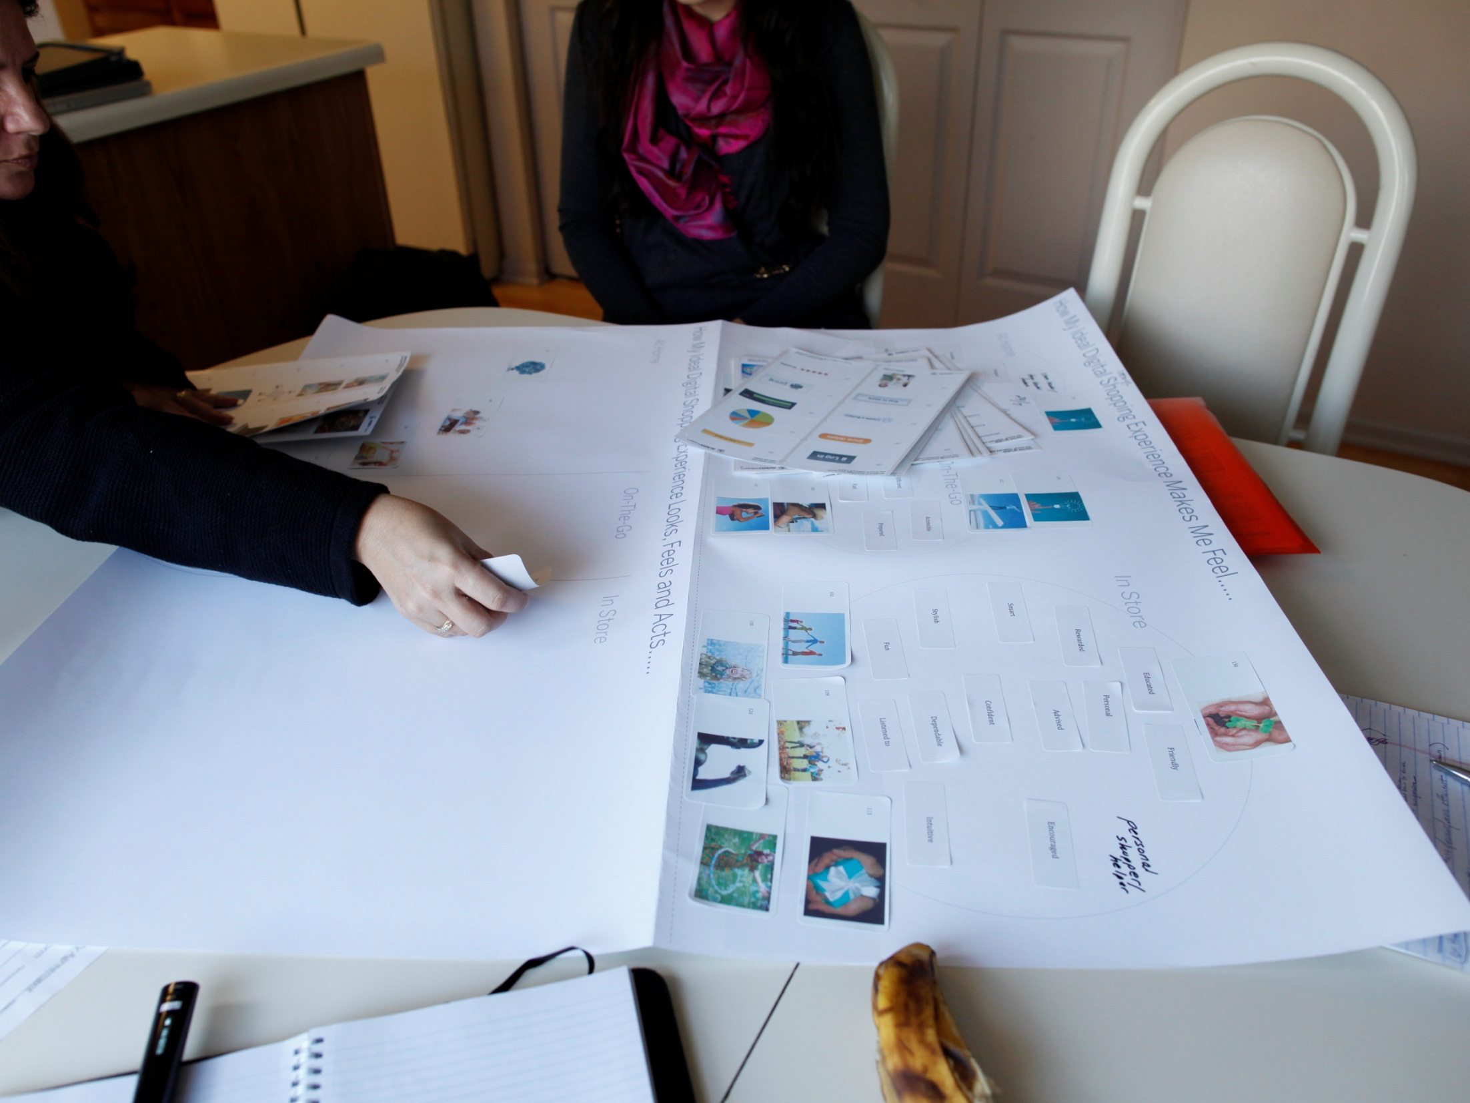
Like participatory design, creative facilitation includes a series of structured activities where users externalize ideas and reflect upon them.
Notes:
3

Slide 4
Ultimately, the artifact is not as important as the conversation it generated.
Notes:
4

Slide 5
Creative Facilitation
Brings stakeholders together in a collaborative environment, where they use designed tools to visualize their goals, express solutions and create alignment.
Notes:
5

Slide 6
Creative Facilitation
Brings stakeholders together in a collaborative environment, where they use designed tools to visualize their goals, express solutions and create alignment.
Notes:
6

Slide 7
Creative Facilitation
Brings stakeholders together in a collaborative environment, where they use designed tools to visualize their goals, express solutions and create alignment.
Notes:
7

Slide 8
Creative Facilitation
Brings stakeholders together in a collaborative environment, where they use designed tools to visualize their goals, express solutions and create alignment.
Notes:
8

Slide 9
Creative Facilitation
Brings stakeholders together in a collaborative environment, where they use designed tools to visualize their goals, express solutions and create alignment.
Notes:
9

Slide 10
The Challenge of Alignment:
It’s compelling for consultants to create a working relationship of “us” and “them” – while an ideal relationship will have a single team, working together to achieve a common goal.
Clients often view problems in linear ways – while the design process frequently embraces a non-linear, and therefore, unfamiliar, process.
Design deliverables can seem mysterious. Teams often forget to set expectations about what artifacts will be created and delivered.
Unless explicit success criteria are established, it’s difficult to judge if a subjective design has been successful in achieving business goals and driving user value.
Notes:
10

Slide 11
Creative Facilitation
Is grounded in the stance of design:
A headspace that allows all team members to temporarily forget business, market, and technological constraints – and to focus on the right thing to do for the users of the product, system, or service.
Empathetic
Iterative
Optimistic
Notes:
11

Slide 12
Creative Facilitation
Is grounded in the stance of design:
An externalization of ideas – even in rough form – through visualization techniques like sketching, diagramming, and model making.
Tangible things can be refined, debated, and explored; by giving an idea form, the idea gains identity, depth, and resonance.
Because the idea is “real”, it can be reflected upon and evaluated by a group of people with a common perspective.
Empathetic
Iterative
Optimistic
Notes:
12

Slide 13
Creative Facilitation
Is grounded in the stance of design:
The ability to consider how things could be, irrespective of tradition, trends, seniority, or even practical constraints.
Being optimistic is to dream – to temporarily ignore realities and constraints, in order to think of alternate possibilities.
Often embodied as “Yes, and…” instead of “Yes, but…”
Empathetic
Iterative
Optimistic
Notes:
13

Slide 14
Kickoff
The beginning of a program is the optimal time to establish a creative relationship with the client, frame the business challenge with “fresh eyes,” set the rhythm for a different style of working, and establish the success criteria for the project.

Slide 15
Insight Readout
This is a facilitated review of the discovery and synthesis process to create stakeholder buy in. It is an opportunity for stakeholders who were not part of the research and synthesis process to gain empathy with the users, review the process, and redefine expectations and success criteria from an informed perspective.

Slide 16
During Ideation
Good ideas often come from subject matter experts dispersed throughout the organization. Diverse teams can bring new ideas to life through joint ideation activities, and capture & disseminate new ideas in actionable formats. This establishes ownership through an inclusive process.

Slide 17
Driving Solutions
Innovative products and services require coordination and cooperation from various parts of a client’s organization. By capturing requirements and defining priority, a team can collaboratively sculpt a roadmap for success.

Slide 18
Creative Facilitation is about dialogue.
Unlike a presentation, where content is delivered through a lecture or discussion, Creative Facilitation is dynamic and expressive. Facilitators and participants are continuously engaged in an exchange of perceptions, ideas and emotions.
Notes:
18

